Slide 1
Loan Classification and Provisioning
Md. Shahidur Rahman
Deputy General Manager
Establishment and Welfare Division
Rupali Bank limited.

Slide 2
Loan Classification and Provisioning
History of Loan classification
In order to strengthen credit discipline and improve the recovery position of loans and advance given by the banks a system has been introduced by Bangladesh bank in 1989 covering loan classification, the suspension of interest due and the making of provisions against potential loan
BCD Circular No: 34/1989
Master Circular: BRPD : 14 Dated 23/09/2012

Slide 3
Loan Classification and Provisioning
What is Loan Classification ?
The management of the institutions as well as their supervising authority i. e the Central Bank (Bangladesh Bank) evaluates the assets of the institution keeping in view the aforesaid aspect. This evaluation at stipulated intervals is called “Classification of Loans and Advances”.

Slide 4
Loan Classification and Provisioning
Purpose of Loan Classification
Objective and Qualitative Judgment
Required Provision
Strengthen Credit Discipline
Bring classification and provisioning regulation in line with international standard.
To improve the recovery position of loans & advances.

Slide 5
Loan Classification and Provisioning
Categories of loans and Advances
All loans and advances will be grouped into 4 (four) categories for the purpose of classification.
1. Continuous Loan
2. Demand Loan
3. Fixed Term Loan
4. Short Term Agricultural & Micro Credit

Slide 6
Loan Classification and Provisioning
Continuous Loan:
Loans which are continuing having no definite repayment schedule but with a limit and expiry date are called Continuous Loan. Examples are:- Cash Credit, Over Draft etc.

Slide 7
Loan Classification and Provisioning
Demand Loan
The loans that become repayable on demand by the bank will be treated as Demand Loan. If any contingent or any other liabilities are turned to forced loan (i.e without any prior approval as regular loan) those too will be treated us Demand Loan. Such as forced Loan against Imported Merchandise (LIM), Payment against Documents (PAD), Foreign Bill Purchased (FBP), Inland Bill Purchased (IBP) etc.

Slide 8
Loan Classification and Provisioning
Fixed Term Loan
The loans which are payable within a specific time period under a specific repayment schedule will be treated as fixed term loan. Such as SME, Personal Loan, etc.

Slide 9
Loan Classification and Provisioning
Short-term Agriculture and Micro Credit
1. Short-term agricultural credit will include the short term credits as Listed under the Annual Credit Program issued by the Agricultural Credit and Financial Inclusion Department (ACFID) of Bangladesh Bank.
2. Credits in the agricultural sector repayable within 12 (twelve) months will also be included herein.
3. Short term microcredit will include any micro-credits not exceeding an amount determine by the ACFID of Bangladesh Bank from time to time and repayable within 12 (twelve) months also be included herein.

Slide 10
Loan Classification and provisioning
Loan Status
Unclassified
∗ Standard
∗ Special Mention Account (SMA)

Slide 11
Loan Classification and provisioning
Loan Status
Classified
∗ Sub-Standard – SS
∗ Doubtful - DF
∗ Bad/ Loss – BL

Slide 12
Loan Classification and provisioning
Basis for loan classification:
a) Objective Criteria.
b) Qualitative Judgment Criteria

Slide 13
Past Due/ Over Due
1. Any Continuous Loan if not repaid/ renewed within the fixed expiry date for repayment or after the demand by the bank will be treated as past due / overdue from the following day of the expiry date.
2. Any Demand Loan if not repaid within the fixed expiry date for repayment or
after the demand by the bank will be treated as past due/overdue from the following day of the expiry date.
Whereas
3. In case of any installment(s) or part of installment(s) of a Fixed Term Loan is not repaid within the fixed expiry date, the amount of unpaid installment(s) will be treated as past due/overdue after six months of the expiry date.

Slide 14
classification in Objective criteria
Catagories of laon | SMA | SS | DF | B/L | Remarks
Continuous Loan | 2< and<3 | 3<and<9 | 9<and<12 | 12< | Month
Demand Loan | 2< and<3 | 3<and<9 | 9<and<12 | 12< | Month
Fixed Term Loan | 2<and<3 | 3<and<9 | 9<and<12 | 12< | Month
Short Term Agri. & Rural Credit | NA | 12<and<36 | 36<and<60 | 60< | Month
Cottage, Micro and Small Credit under CMSME | NA | 6< and<18 | 18< and<30 | 30< | Month

Slide 15
Loan classification & Provisioning
Standard loan
. All unclassified other than Special Mention Account (SMA) will be treated as Standard Loan.

Slide 16
Loan classification & Provisioning
Special Mention Account
. A Continuous Loan, Demand Loan or a Fixed Term Loan which will remain overdue for a period of 02 (Two) month but less than 03 (Three) month will put in to “Special Mention Account” (SMA).

Slide 17
Special Mention Account (SMA)
Features of SMA
To early warning Signal of weakness
To Report to Credit Information Bureau (CIB)
To help banks to look at accounts will potential problems in a focus manner.
Moreover all restructured loans according to BRPD Circular No. 04 Date: 29.01.2015 shall be treated as Special Mention Account.

Slide 18
Default Loan
Loans have to be treated as defaulted loan as per section 5 (GaGa) of the Banking Companies Act 1991 and to be reported accordingly as per formats given in BRPD Circular No. 08 dated August 02 2015. In this regard, a portion of the “Sub-standard (SS)” loans will be reported as defaulted loan.

Slide 19
Classification in qualitative Judgment Criteria (QJ)
If the situation changed on which credit has been sanctioned.
If the capital of the borrower destroyed due to unfavorable situation.
If the value of the collateral decreases.
If the recovery of the loan become uncertain due to other adverse situation.

Slide 20
Accounting of Interest of Classified Loan:
1. If any loan is classified as Sub-standard and Doubtful interest accrued such loan will be credited to Interest Suspense Account, instead of crediting the same to Income Account.
2. In case of reschedule loans the unrealized interest, if any, will be credited to Interest Suspense Account instead of crediting the same to Income Account.
3. As soon as any loan or advance is classified as Bad/Loss charge of interest in same account will cease.

Slide 21
Maintenance of Provision:
Particulars |  | Short Team Agri. & Micro Credit | Cottage, Micro and Small Credit under CMSME | Consumer Financing |  |  | SMEF | Loans to BHs, MBs, SDs | All other loan
 |  |  |  | Other than HF, LP | HF | LP
UC | Standard | 1% | 0.25% | 5% | 1% | 2% | 0.25% | 2% | 1%
 | SMA | NA | 0.25% | 5% | 1% | 2% | .25% | 2% | 1%
Classified | SS | 5% | 5% | 20% | 20% | 20% | 20% | 20% | 20%
 | DF | 5% | 20% | 50% | 50% | 50% | 50% | 50% | 50%
 | BL | 100% | 100% | 100% | 100% | 100% | 100% | 100% | 100%
Figure-1

Slide 22
Maintenance of Provision:
∗ Besides, banks are required to maintain General Provision against off balance sheet exposures @ 1% and.
∗ Provision of all Restructured loans shall be calculated at existing applicable rate of SMA with additional 1% (BRPD Circular No. 04 Date: 29.01.2015).

Slide 23
. Base for Provision
For the following types of eligible collateral security as.
a) Deposit with the same bank under lien against the loan.
b) Government bond/savings certificate under lien.
c) Guarantee given by the Government Or Bangladesh Bank.
Then provision will be maintained at the above rate on the outstanding balance of the classified loans less the amount of Interest suspense and the value of eligible collateral.
Base for Provision
= Outstanding- (Value of eligible Collateral+ Interest Suspense )

Slide 24
Base for Provision
For All Other eligible collaterals, the provision will be maintained at the stated rates in (Figure-1) on the balance calculate as the greater of the following two amounts
1. Base for Provision= Outstanding- (Value of eligible Collateral+ Interest Suspense )
2. 15% of outstanding Balance
Which is Greater

Slide 25
Base for Provision
Outstanding | Value of eligible Collateral | Interest Suspense A/C | Base for Provision | Remark
100 | --70 | --20 | =10
But Base for Provision will be
100 | --65 | --20 | =15

Slide 26
Eligible Securities :
1. 100% of the deposit under lien against the loan.
2. 100% of the value of Government bond/ Savings certificate under lien.
3. 100% of the value of Guarantee given by Government Or Bangladesh Bank.
4. 100% of the market value of Gold or Gold ornaments pledged with the bank.
5. 50% of the Market value of easily marketable commodities kept under control of bank.
6. Maximum 50% of the market value of land and building mortgaged with the bank.
7. 50% of the average market value for last 06 (Six) months or 50% of the face value, whichever is less of the share traded in Stock Exchange.

Slide 27
Purpose of loan provisioning :
Protection of the depositors’ money.
Protection of Banks Capital.
Setting aside fund from profit against possible loss.

Slide 28
CL- Form
CL-1 Compilation/Summary.
CL-2 Continuous loan.
CL-3 Demand loan.
CL-4 Term loan and Reschedule loan.
CL-5 Short term Agriculture and Micro credit.

Slide 29
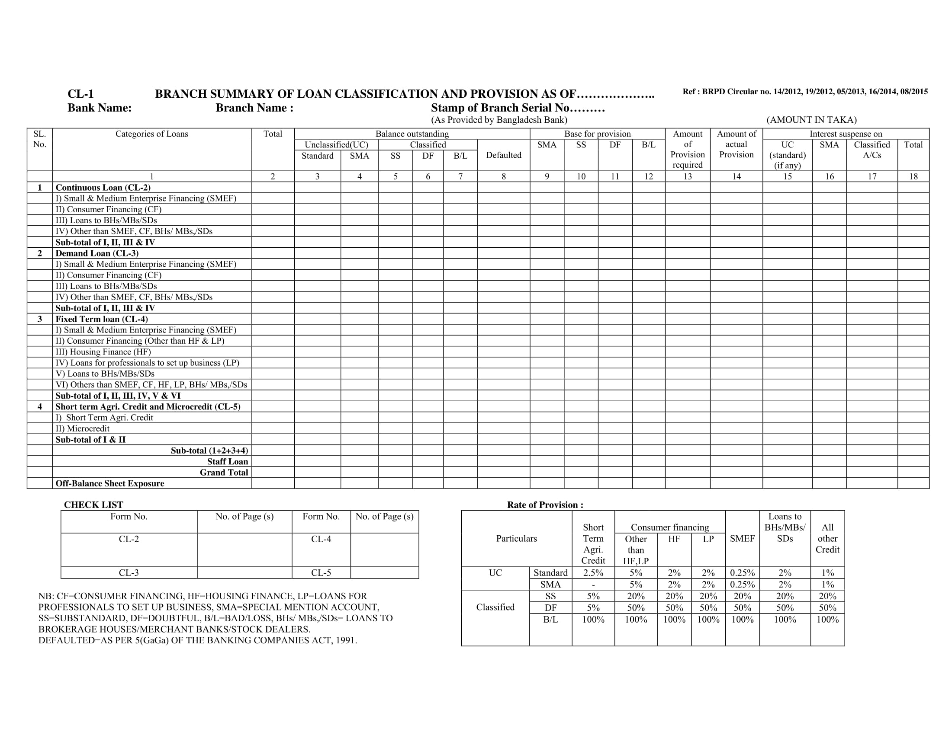

Slide 30
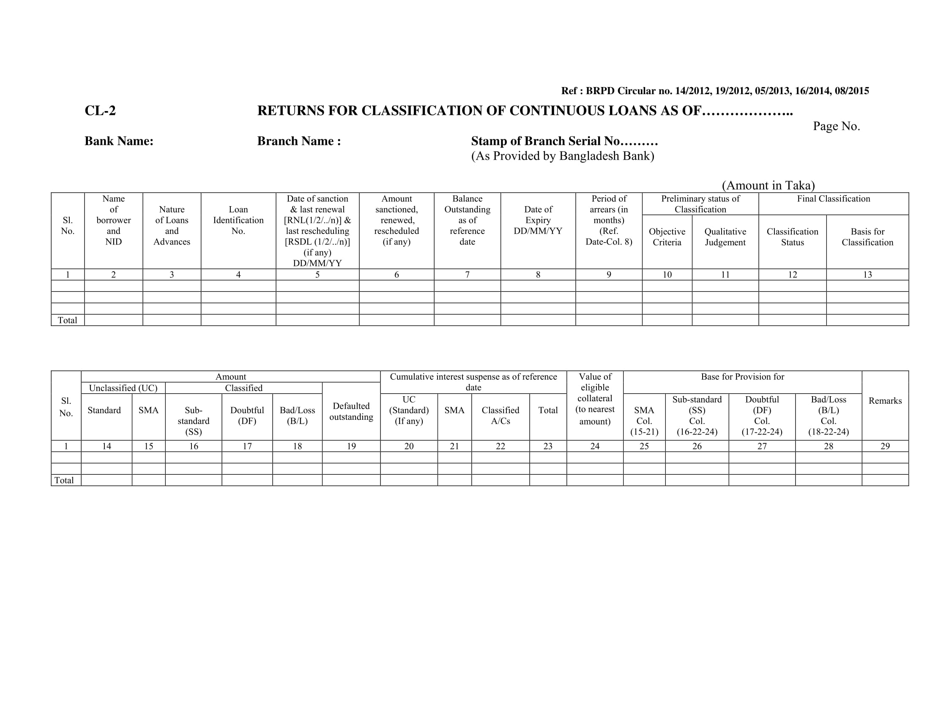

Slide 31
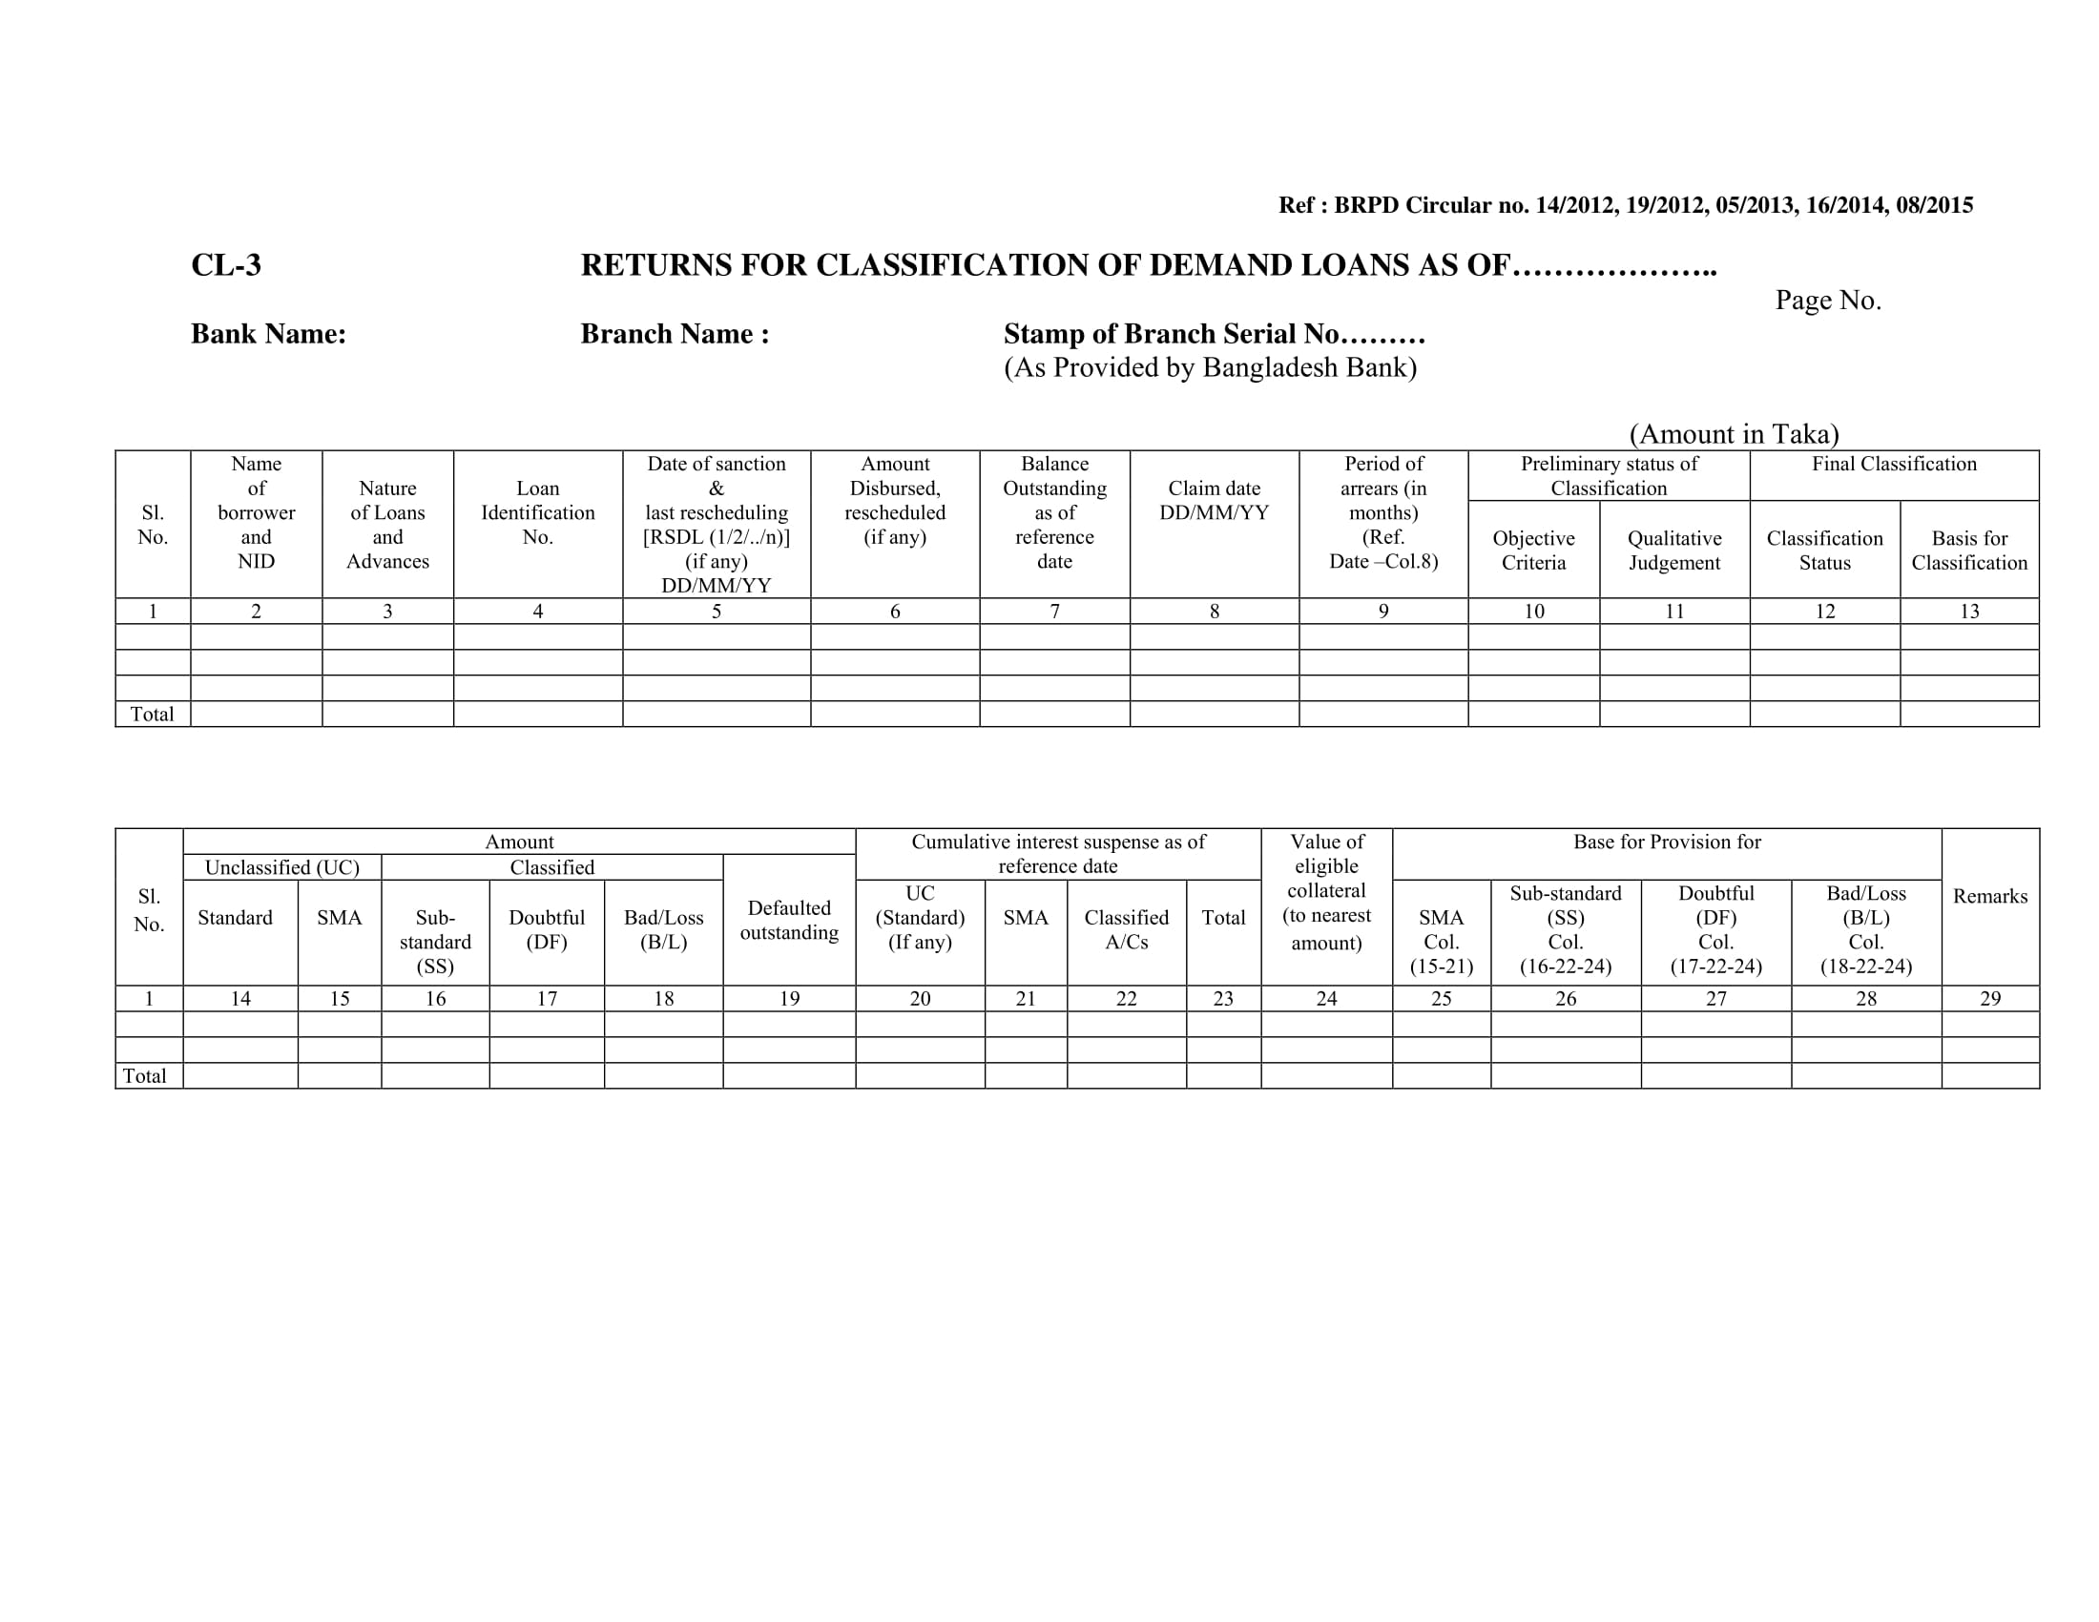

Slide 32
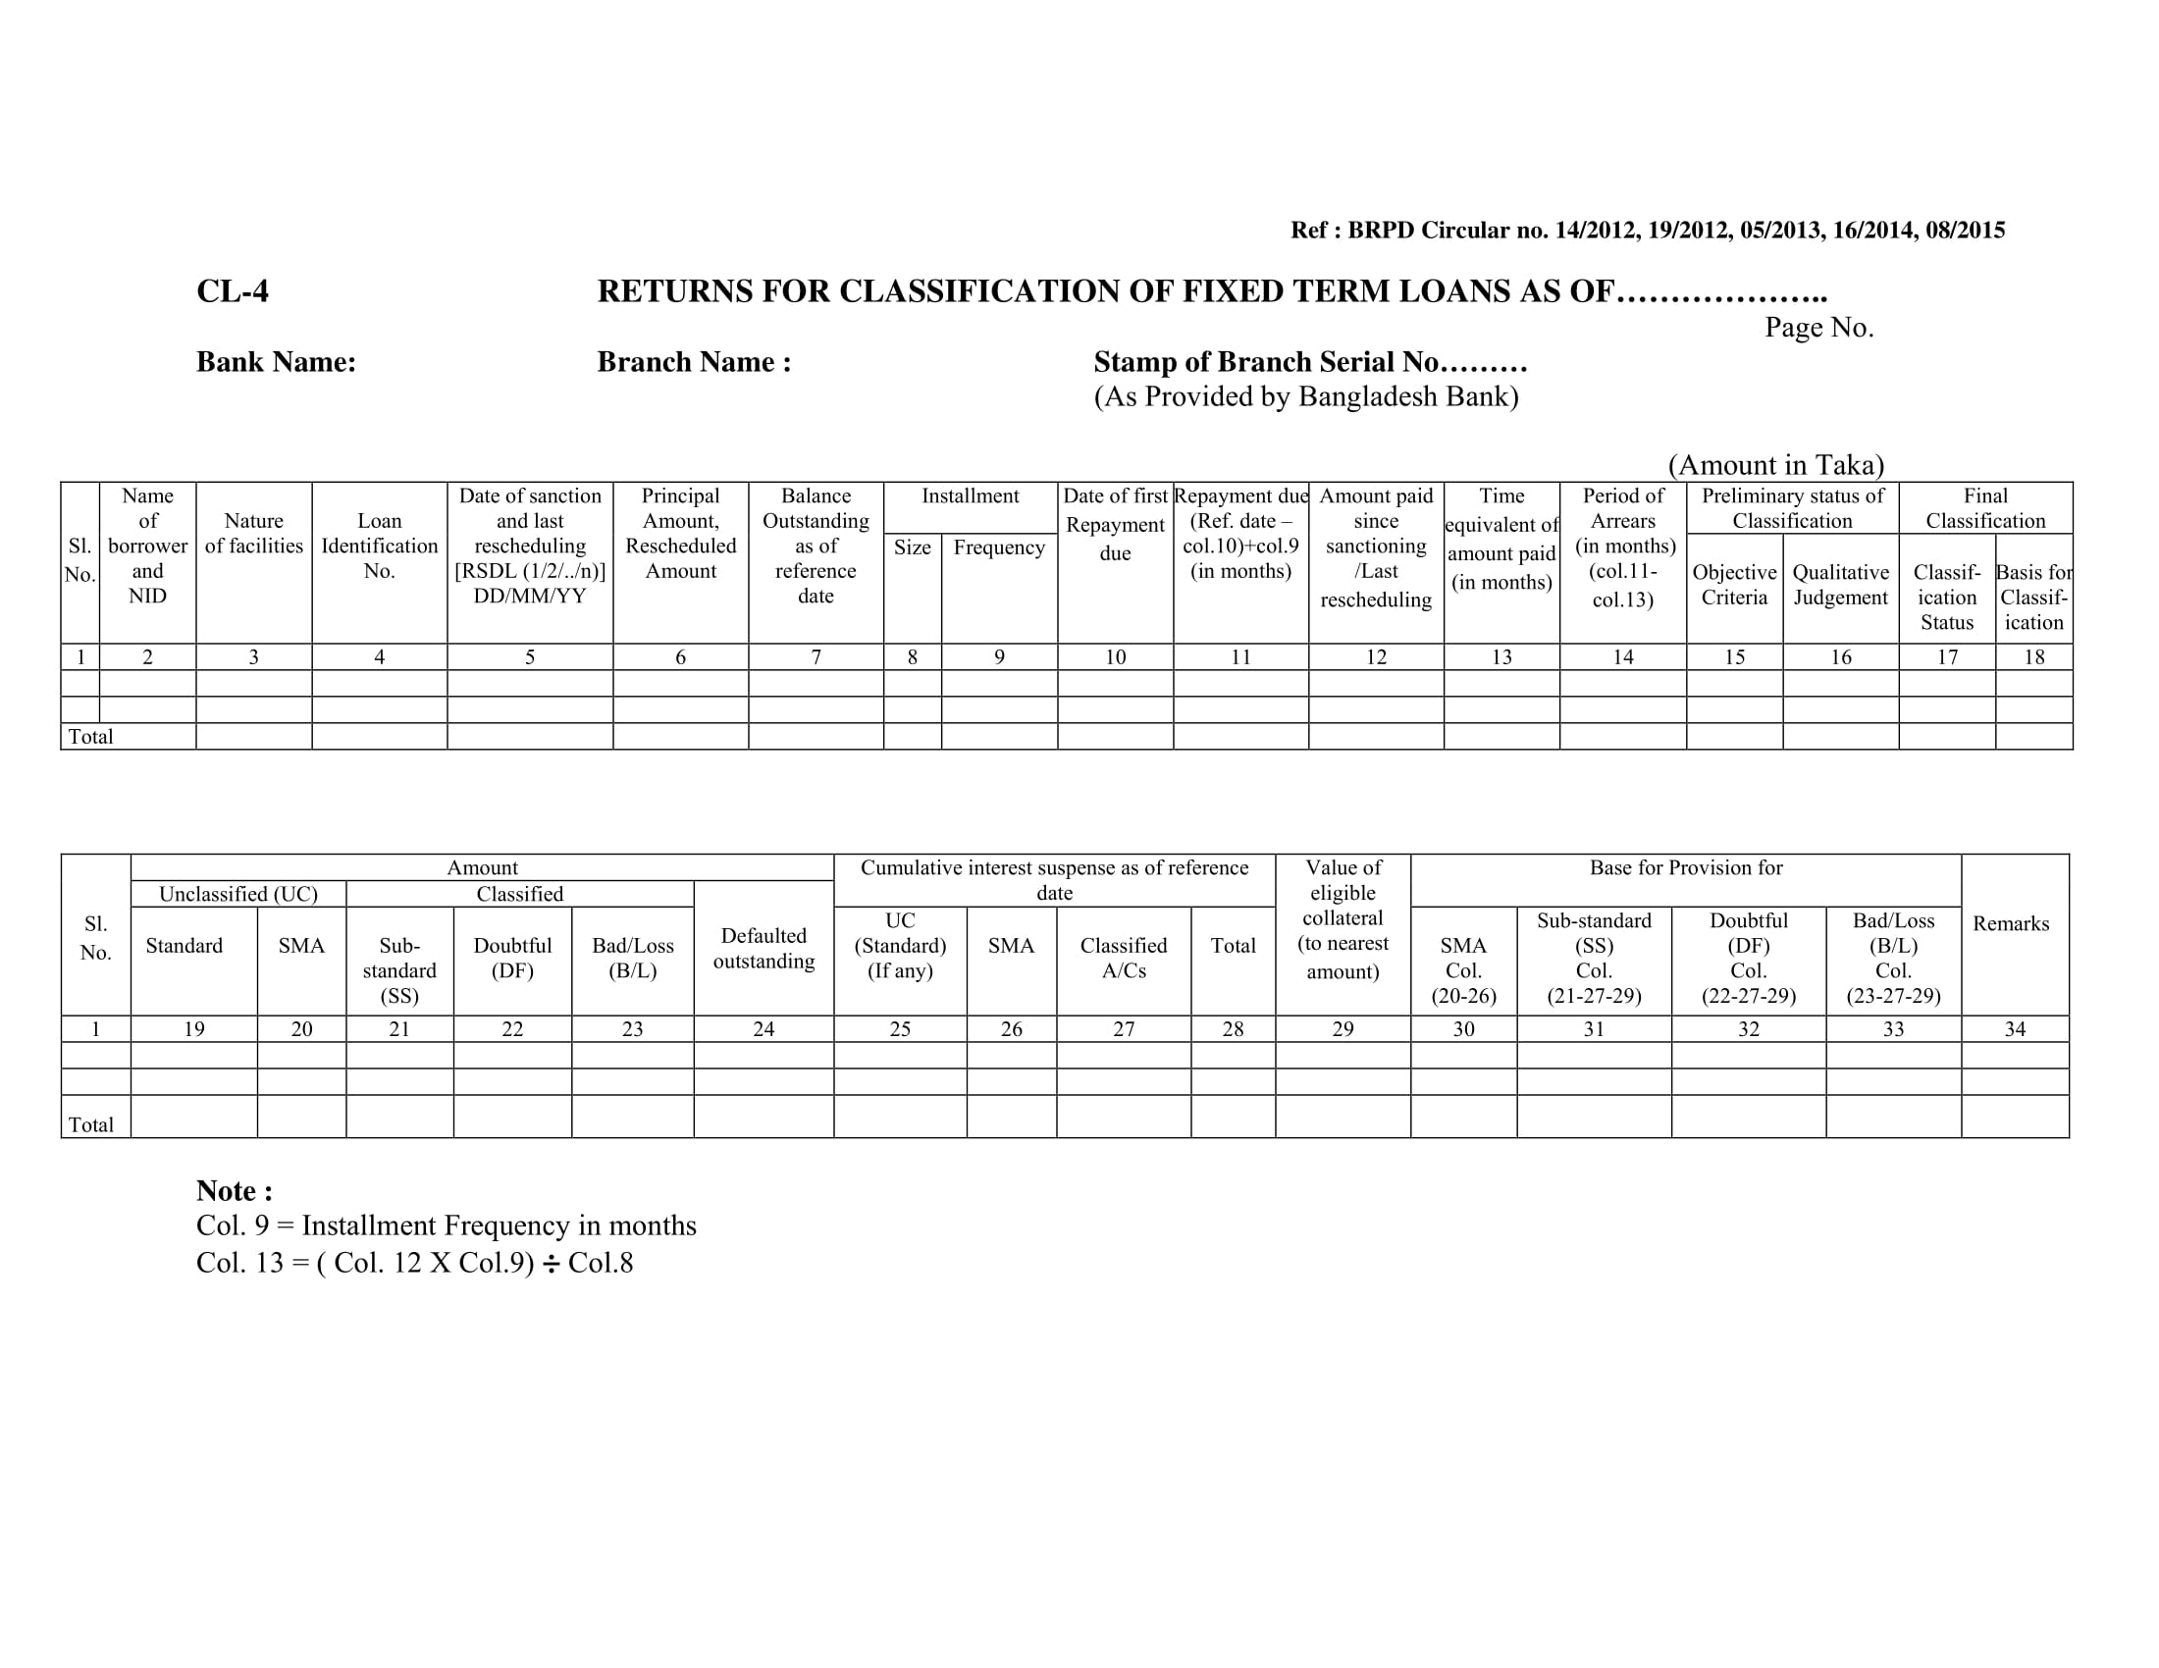

Slide 33
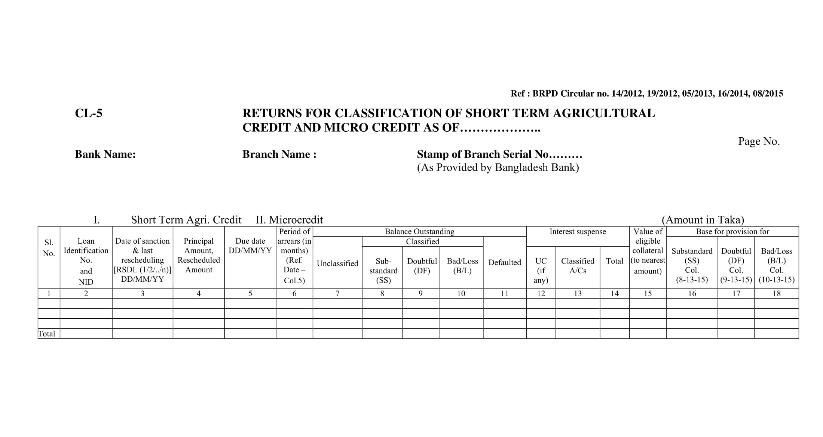

Slide 34
Reporting Defaulted Loan
i) Continuous Loan : Defaulted Loan = DF+BL
ii) Demand Loan : Defaulted Loan = DF+BL
iii) Fixed Term Loan : Defaulted Loan = SS+DF+BL
(Up to 10.00 Lac)
iv) Fixed Term Loan : Defaulted Loan = DF+BL
(Above 10.00 Lac)
v) Short-Term Agri. and
Micro Credit : Defaulted Loan = SS+DF+BL

Slide 35
Procedure of Declassification
1. Consideration :-
The business is running
Capital Requirement
Management Capability
Acceptability of the security
Financial Ability/ Viability

Slide 36
Procedure of Declassification
Procedure :-
Cash Recovery.
Renewal of Loans
Enhancement
Rescheduling
Block/ Segregate Loan etc.
BMRE
Interest remission

Slide 37
Classification Time
31 March
30 June
30 September
31 December

Slide 38
. Impact of classified loan
Bank confronted with the question of survivability.
Huge Provisional shortfall
Capital Shortfall
Less Income
Reduce Loan able fund
Image Crisis
Increase cost of fund
Reverse effect on balance sheet
Liquidity Crisis
Titled as Problem Bank
Depositor’s money not protected.

