Slide 1
FinTech Opportunities & Challenges
Dr. Md. Majharul Haque
PhD in Artificial Intelligence (AI) from the University of Dhaka
Systems Analyst (Joint Director), Bangladesh Bank
Consultant (Specialist), EDGE Project (Funded by World Bank), ICT Division

Slide 2
FinTech
Introduction
A Brief History of Money
Challenges & Opportunities of FinTech
Adoption and Integration
Regtech & Suptech
Future Outlook
Conclusion
Notes:
This presentation will explore the opportunities and challenges including the adaptation of FinTech

Slide 3
Introduction
FinTech refers to the integration of technology into financial services to explore the unexplored.
The FinTech industry has seen tremendous growth in recent years and is expected to continue to grow in the future.

Slide 4
Some Necessary Terms
Money: Medium of Exchange in intangible form, can’t be touch or smell
Currency: Promissory note or coin in Tangible form
Plastic Money: It just a Credit or Debit Cards
Electronic Money: A digital store of a medium of exchange for payment with or without bank accounts. Must have a regulatory body.
Digital Money: Any Electronic form of Cash/value which may not have any regulatory body.
Cryptocurrency: It is Digital Money, always exists in BlockChain

Slide 5
History of Money

Slide 6
Lets Connect FinTech with Money Circulation

Slide 7
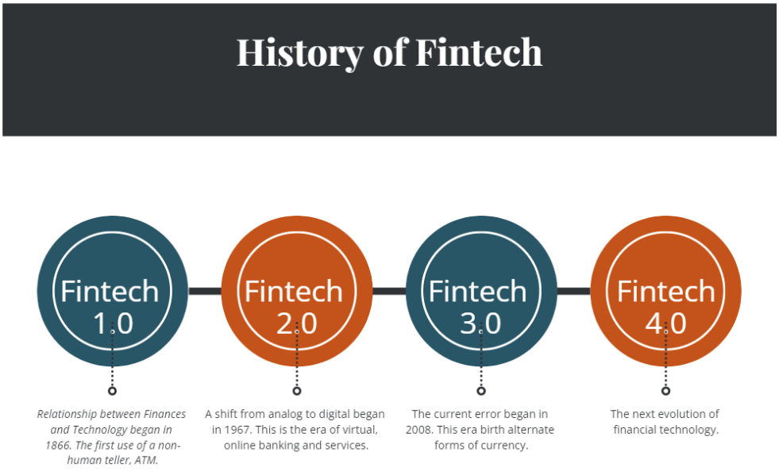
History of FinTech

Slide 8
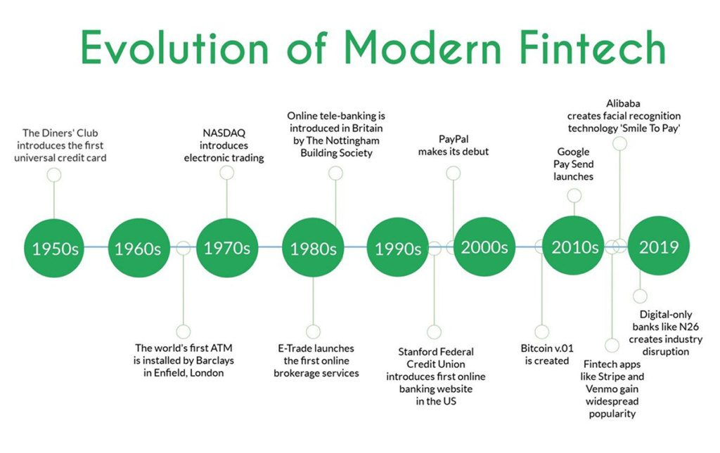
Evolution of FinTech

Slide 9
Opportunities of FinTech
Improve services and reach new customers
Increase accessibility
Anywhere at any time, enabling people to manage their finances more conveniently
Greater efficiency through automation

Slide 10
Opportunities
Allowing for the development of new products and services that better meet the needs of consumers
More personalized financial services
Tailoring products to individual needs and preferences.

Slide 11
Challenges
Comply with a range of regulations and standards
Cyber Security risks
Lack of Tech Experts in related fields
User Retention and User Experience
BlockChain, BigData, AI Integration
Personalized services
Integration of legacy systems with latest technologies

Slide 12
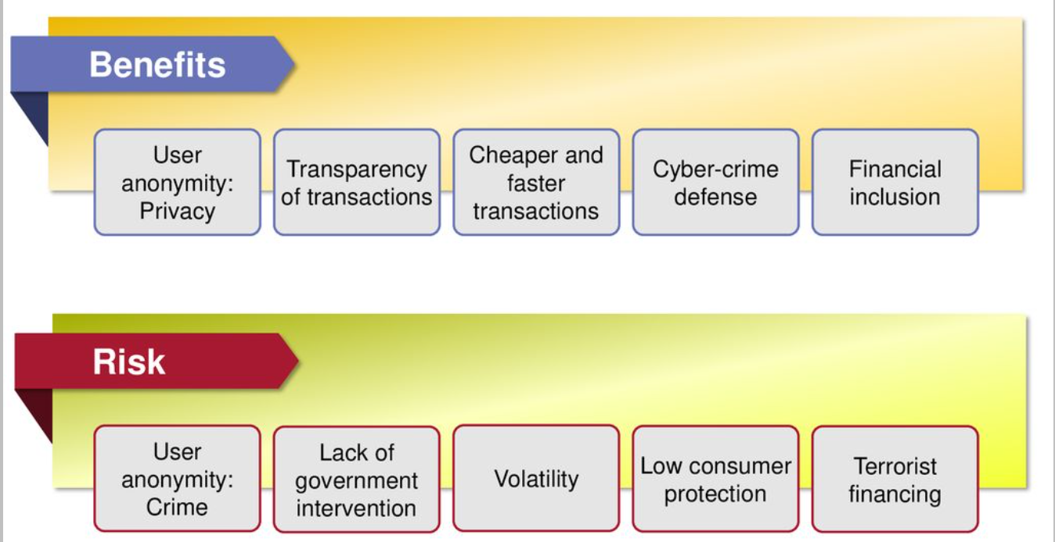
Benefits & Risks

Slide 13
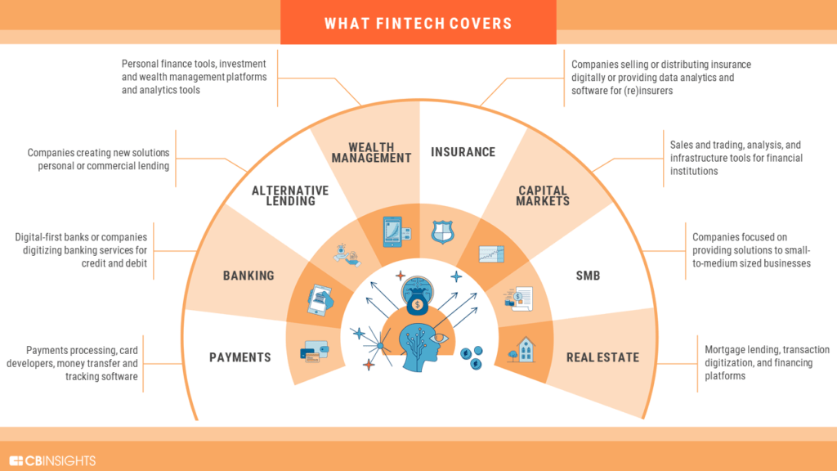
Adoption & Integration

Slide 14
Adoption & Integration
It is essential to adopt and integrate Fintech solutions to stay competitive otherwise loss of Market Share.
Fintech solutions can also improve efficiency, reducing costs and allowing institutions to offer more competitive products and services.

Slide 15
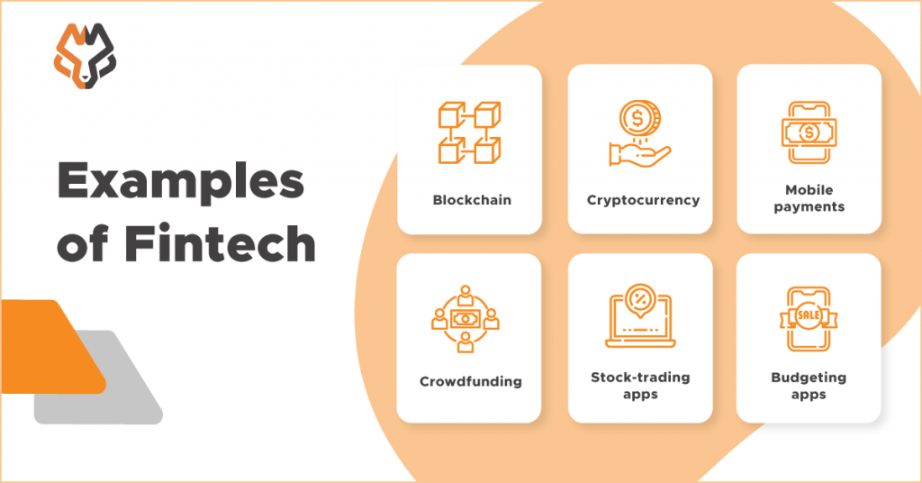
Adoption & Integration

Slide 16
Lets Come to Regulatory Compliance…
RegTech & SupTech

Slide 17
Regtech & Suptech
Regtech: Short for “regulatory technology,” it refers to technology used to regulate compliance operations at a company. Used in their own processes.
Suptech: Short for “supervisory technology,” it refers to technology used to supervise compliance operations at companies. Supervisors monitor whether companies are properly following regulations.

Slide 18
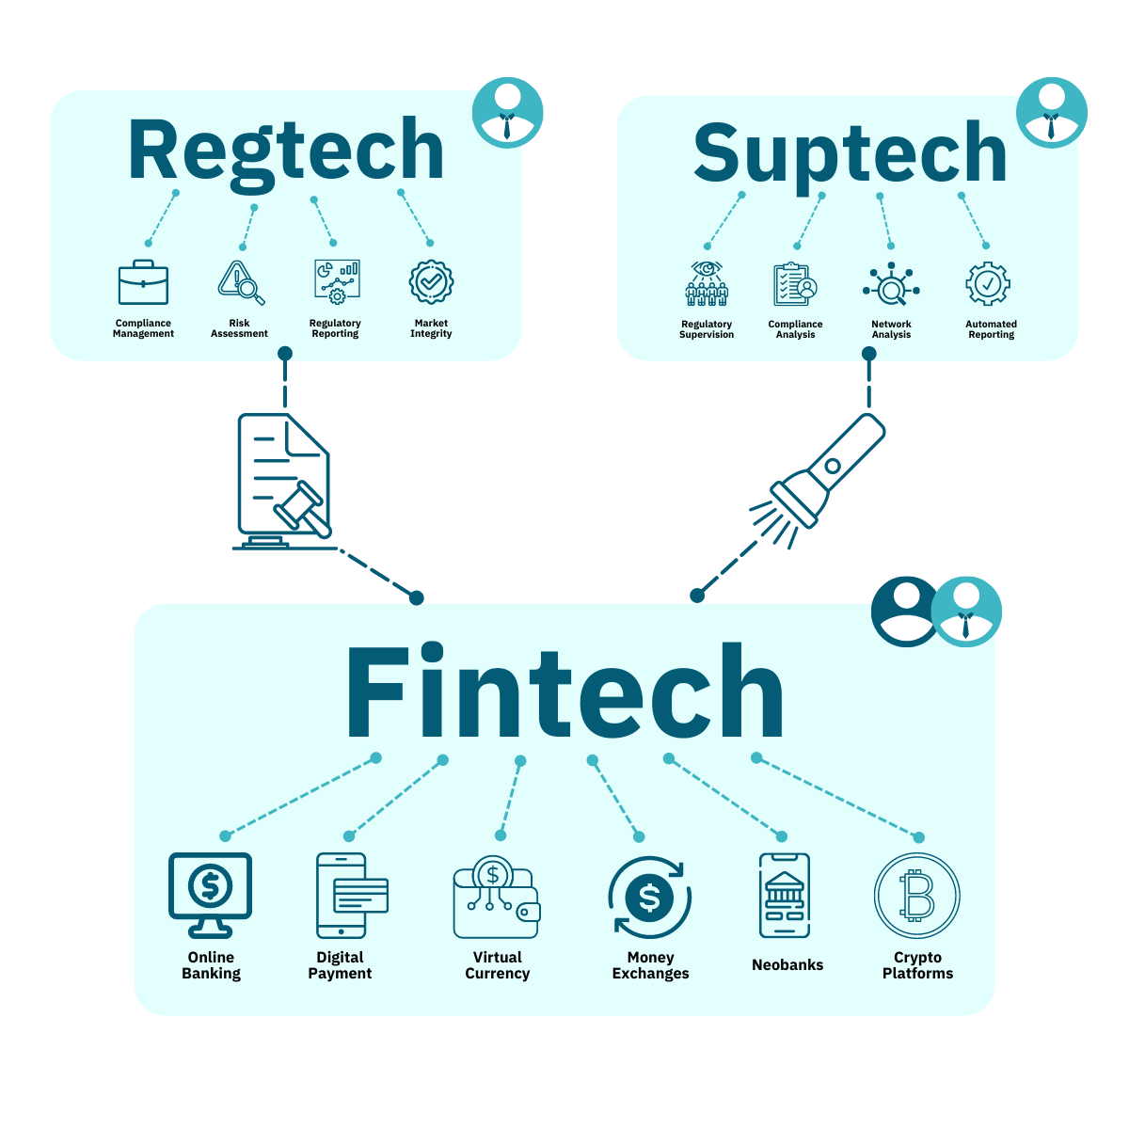
Regtech & Suptech

Slide 19
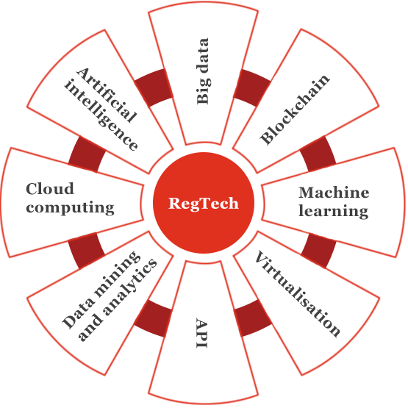
Technologies for Regtech

Slide 20
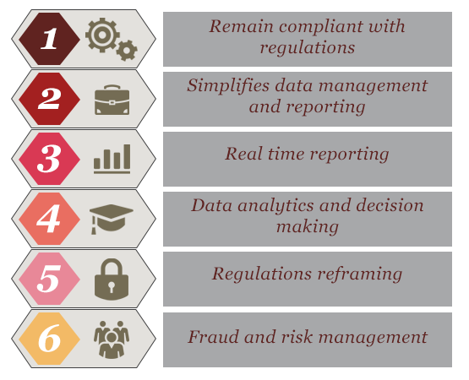
Regtech Enable us to…

Slide 21
Future Outlook
The Fintech industry is expected to continue to grow in the future.
Expected to include digital currencies, mobile payments, and open banking.
There will be new opportunities and challenges.

Slide 22
Conclusion
Fintech presents many opportunities for financial institutions. However, it also comes with challenges, including regulatory compliance, cyber security risks, and the need for skilled professionals.
Traditional financial institutions must adopt and integrate Fintech solutions to stay competitive in the rapidly evolving industry.

Slide 23
References
[1] https://www.wallstreetmojo.com/money-vs-currency/
[2]https://tipalti.com/electronic-money-emoney- explained/#:~:text=Debit%20cards%2C%20prepaid%20cards%2C%20and,make%20these% 20electronic%20transactions%20safer.
[3] https://www.youtube.com/watch?v=xBLVPuNstC0
[4]https://dnh.com.my/the-rise-of-digital-payments-digital-currency-vs-electronic-money-and-their-regulation/#:~:text=This%20type%20of%20digital%20currency,issued%20by%20a%20sovereign%20body).
[5] https://anywhere.epam.com/business/challenges-in-the-fintech-industry
[6] https://www.pwc.in/industries/financial-services/fintech/fintech-insights/regtech-a-new-disruption-in-the-financial-services-space.html
[7] https://www.topcoder.com/thrive/articles/fintech-digitizing-of-the-financial-industry

Slide 24
Thank You for Your Attention.
Dr. Md. Majharul Haque
PhD in Artificial Intelligence (AI) from the University of Dhaka
Systems Analyst (Joint Director), Bangladesh Bank
Consultant (Specialist), EDGE Project (Funded by World Bank), ICT Division

