Slide 1
Discussion on
Guidelines on foreign exchange transactions(Vol. 1 & 2) and
Foreign exchange regulation Act
Pradip Paul CDCS, CSDG,CERM
Additional Director, Bangladesh Bank

Slide 2
Local Regulators of International Trade
Name of Regulator | Name of Regulations | Area of Regulation | Implementing Agency
National Parliament | FERA, BCA, Export and Import Control Act, BID Act, etc. | Different laws | MoF, MoC, NRB, BB, BIDA etc.
Ministry of Commerce | Import Policy, Export Policy, Gold Policy etc. | Types, volume, specification of Good/Service eligible of export/import, Licensing of Exporter and Importer etc. | CCI&E, DEDO, Registrar of Joint Stock Companies and Firms etc.
National Board of Revenue | Bond Rules, Baggage Rules, Tax, VAT, AIT etc | Different taxes | Bangladesh Customs, Bond Commissionerate, DEDO etc.
Bangladesh Bank | GEFT, circular/circular letter, etc. | Foreign/Local Payment and Finance | AD Banks

Slide 3
GFET Vol. 1(20 chapters, no hard copy of reporting to BB)
GFET Vol. 2 (Reporting format to BB)

Slide 4
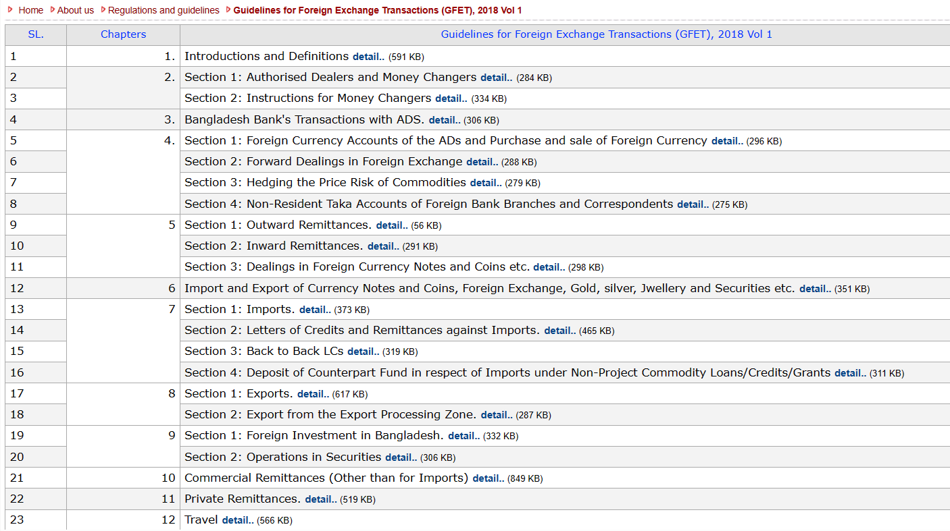

Slide 5
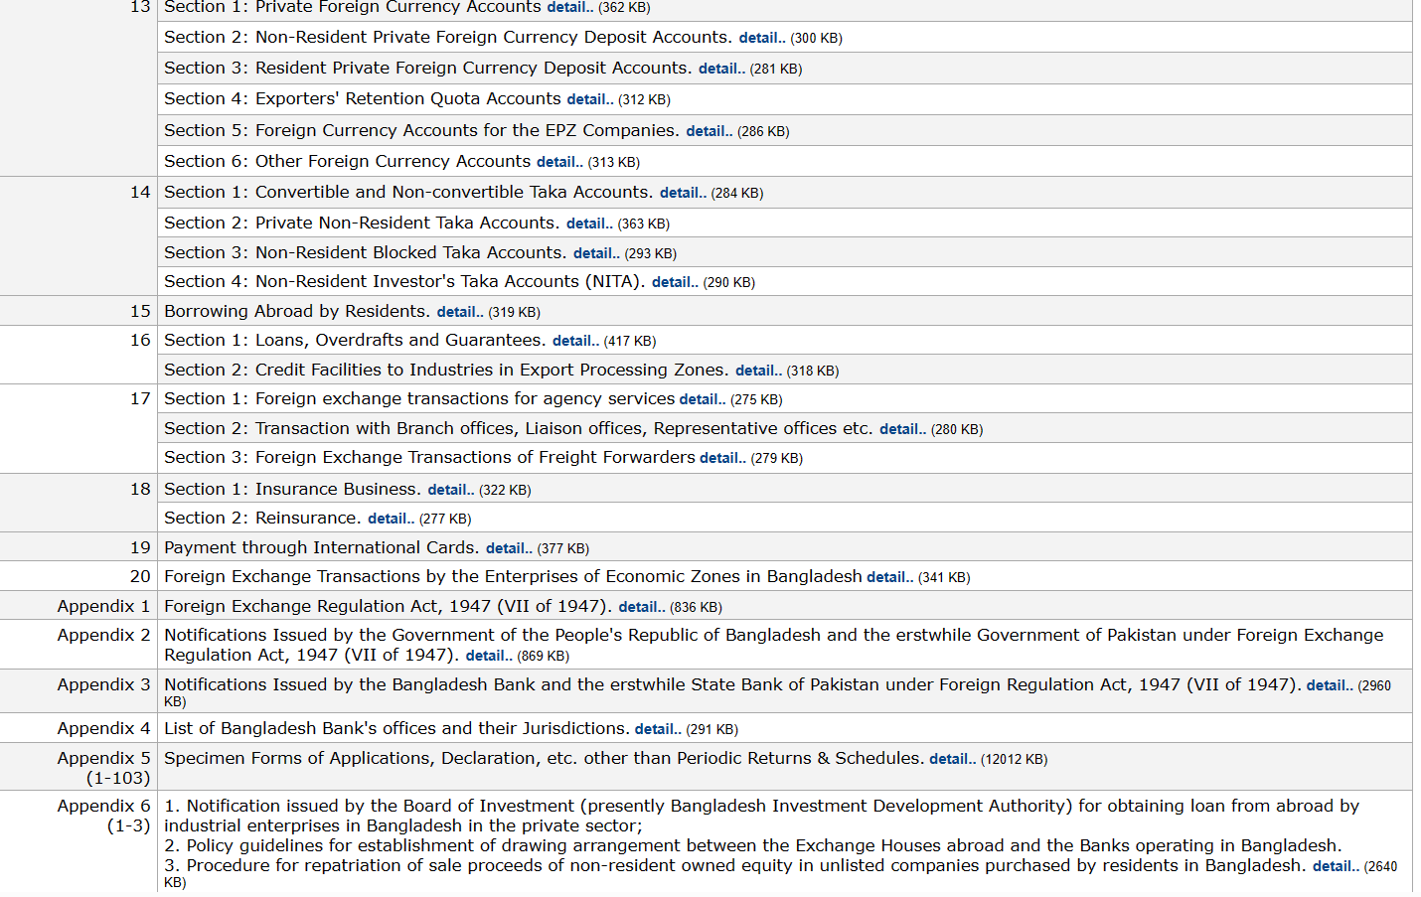

Slide 6
Law related to Payment and Finance in Foreign Currency: FERA
  Under the terms of Section 7(a) of the Bangladesh Bank Order 1972, Bangladesh Bank is responsible for managing transactions with the external sector i.e. foreign exchange transactions in Bangladesh.
  Foreign exchange transactions of the country are guided by Foreign Exchange Regulation Act, 1947. Bangladesh Bank has been bestowed with the authority to exercise the act.

Slide 7
Resident Vs Non-Resident : as per FERA
“person resident in Bangladesh” means-
(i) an individual residing in Bangladesh for six months or more in the last twelve months;
(ii) an individual temporarily residing in Bangladesh holding a residential or working visa valid for not less than six months;
(iii) a person whose place of business is in Bangladesh; or
(iv) a person whose principal place of business may be located outside Bangladesh but branch or liaison office or representative office of such business is in Bangladesh;
(v) diplomatic, consular and other representative offices of the Government of the People’s Republic of Bangladesh abroad as well as Bangladeshi citizens employed at these offices;

Slide 8
Resident: As per FERA
(vi) persons holdings any office in service of the People’s Republic of Bangladesh wherver they may be for the time being either on duty or on leave:
provided that “person resident in Bangladesh” shall not include foreign diplomatic representations or accredited officials of such representations located within Bangladesh and offices of organizations established by international treaty located within Bangladesh;]

Slide 9
Imports
Imports may be done normally against Letter of Credit.
Is import possible without LC?
In all cases of Import ( with or without LC) declaration on IMP must be made.

Slide 10
Import Without LC
The following items may be imported without opening of LC:
easily perishable items/food items as specified in the Import Policy Order in force
capital machinery and industrial raw materials without any value limit.
Other items as specified in Import Policy Order

Slide 11
Import Policy Order 2021-24
Unless otherwise directed import shall be effected only through opening irrevocable LC :
Provided that each consignment of quickly perishable food goods worth US dollar 50,000 (Fifty Thousand) via Teknaf Customs Station, essential food goods and raw materials used in industry worth US Dollar 10,000 (Ten Thousand) and capital machinery irrespective of price limit via other custom land stations can be imported against contract without LC

Slide 12
Transactional procedures for import trade on phase-out of LCAF (FE Circular No. 29 Date: October 20, 2022)
ADs shall observe the following procedures for relevant import transactions:
(a) Before establishment of LCs or initiation of imports, ADs shall obtain underlying indents, proforma invoices, purchase or sales contracts from relevant importers.
(b) For imports on FOB or similar other terms, ADs shall obtain applicable transport charges against the shipments to facilitate issuance of certificate.
(c) ADs shall provide primary import information based on (a) above to online import monitoring system of Bangladesh Bank.
(d) In case of permissible imports without LCs by industrial imports, and commercial imports within authorized limits, ADs shall report to Bangladesh Bank as per (c) above with indication of imports without LCs.
e) Payments for relative imports shall not exceed the amount of LCs or other underlying arrangements, as the case may be.

Slide 13
Credit Report of the Exporter
Import against proforma invoices issued direct by foreign suppliers- if import value exceeds USD 10,000.
Import against indents issued local agent by foreign suppliers- if import value exceeds USD 20,000.
Credit report provided by the importer will not be accepted by the Bank.
Central database for credit report
Validity of Credit Report- One Year

Slide 14
Validity of Shipment
For Shipment (as per IPO 2021-24) |  | For Remittance (not in action)
Capital Machinery | 24 months from the issuance of contract | Capital Machinery | 30 months subsequent to the month of issuance
Other | 09 months from the issuance of contract | Other | One year subsequent to the month of issuance
14

Slide 15
Import: Payment and Finance (Taka and Foreign Currency)
1. Payment (Made by importer) | 2. Finance(Made by financier)
 | 2 a) Foreign Source (FC) | 2 b) Local Source (FC)
1. a) Sight Payment | 2a (i) Supplier’s Credit (Exporter) | 2b (i) AD (Non funded)
1 b) Deferred/ Acceptance Payment | 2a (ii) Buyer’s Credit (FFI) | 2b (ii) Buyer’s Credit (OBU)
1c) Advance Payment |  | 2b(iii) Import of raw material by sight payment EDF (First by AD and then refinance by BB) including B and C type of EPZ.
Import Finance (made by local financier) in local currency: LIM/MIM/LTR, term loan.

Slide 16
Advance Remittance-General
Advance remittance for permissible imports is permissible against repayment guarantee. Without Guarantee, Advance payment for import (except from the balance from ERQ: USD 25000) is permissible upto USD 10,000.
Advance payment up to USD 500,000.00 or equivalent for import of COVID related life-saving drugs, medical kits/equipment and other essential medical items as per FE Circular No. 15 of March 23, 2020

Slide 17
Items to be imported under deferred LC( Supp. & Buyer’s Credit)
Items | Deferred Period ( Max)
Capital Machinery, empty LPG cylinder, ……………and 4 raw materials of Steel Industries | 360 days
Industrial raw materials imports for own use of industrial importers ( including Back to back imports) | 180 days (360 days for COVID up Dec 22)
Import of coastal vessels including oil tankers and oceangoing vessels including those procured for scrapping | 360 days
Import of agricultural implements and chemical fertilizers and Empty Cylinder (by industrial units for their own use -180days) | 180 days(360 days for COVID up Dec 22)
Import of life saving drugs /Ophthalmologic Instruments | 90 days

Slide 18
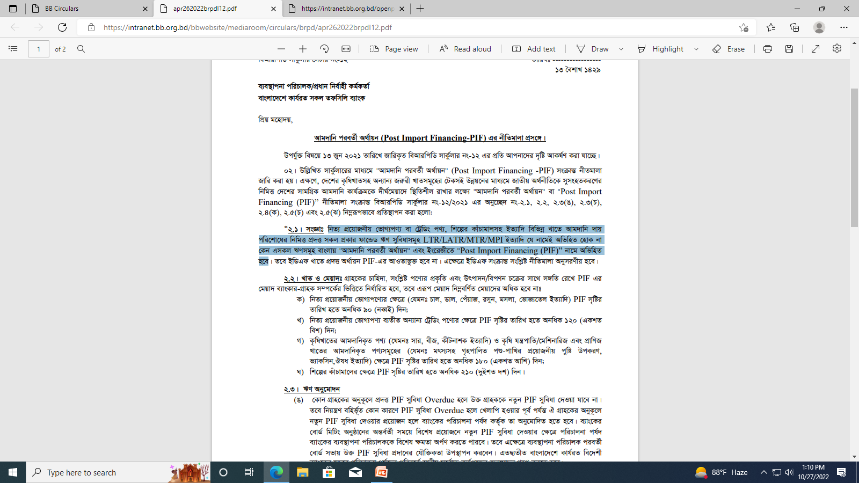
Post Import Finance in Taka

Slide 19
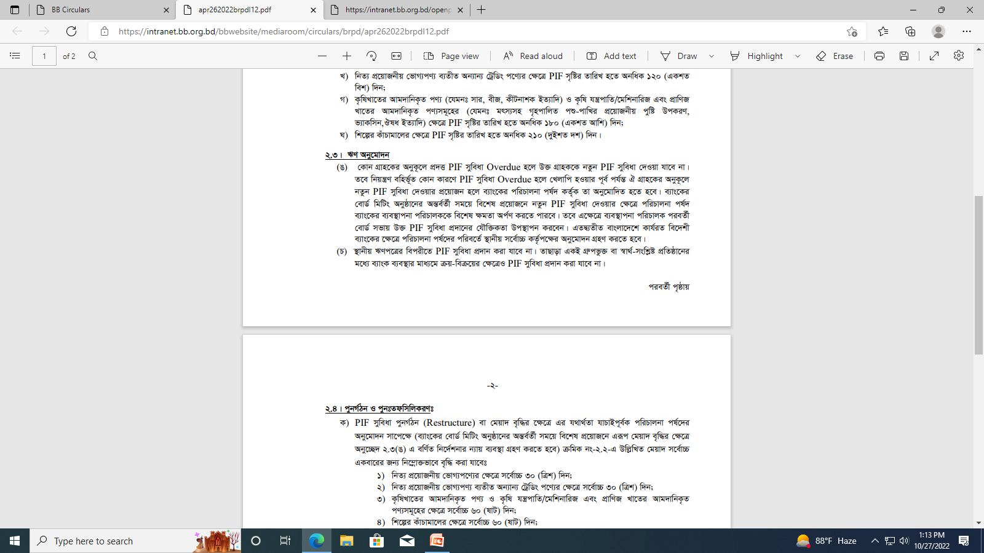
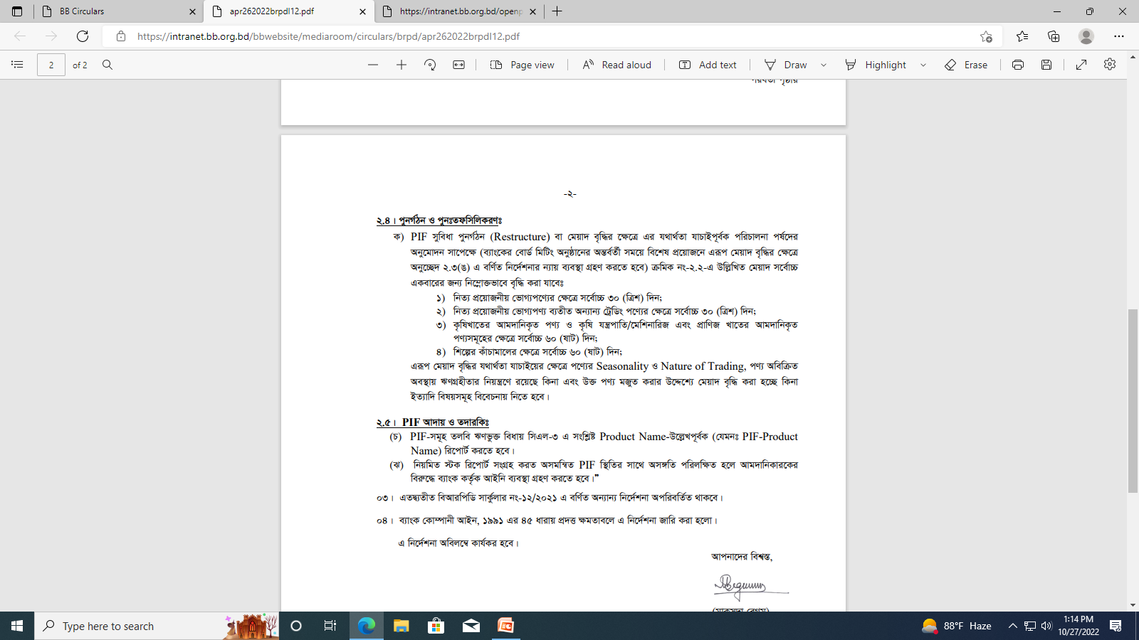
Post Import Finance in Taka

Slide 20
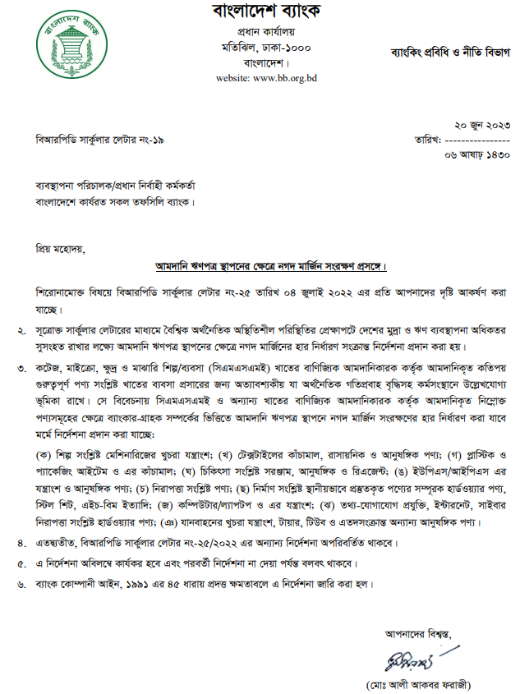
Cash LC Margin

Slide 21
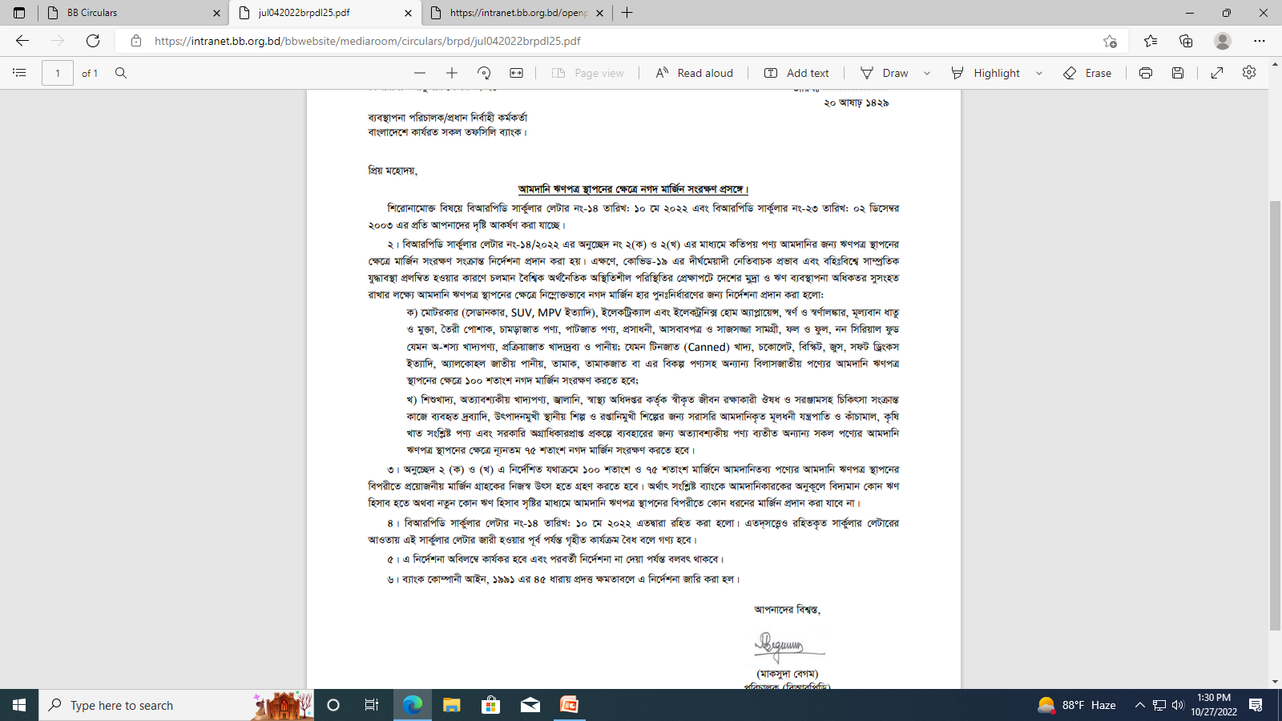

Cash LC Margin

Slide 22
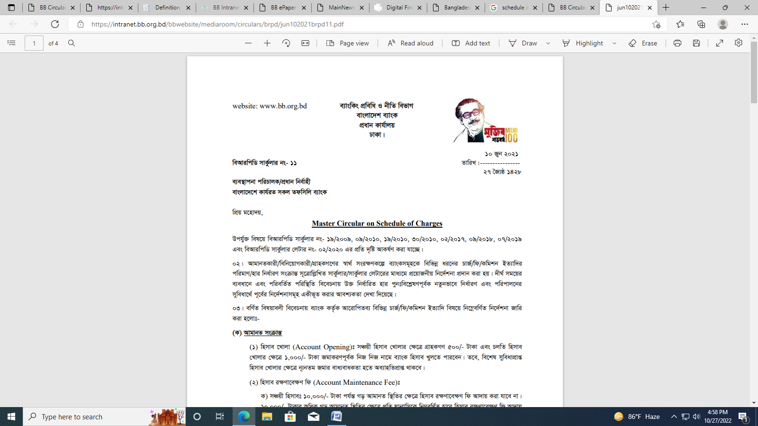
Allowable Bank Charges

Slide 23
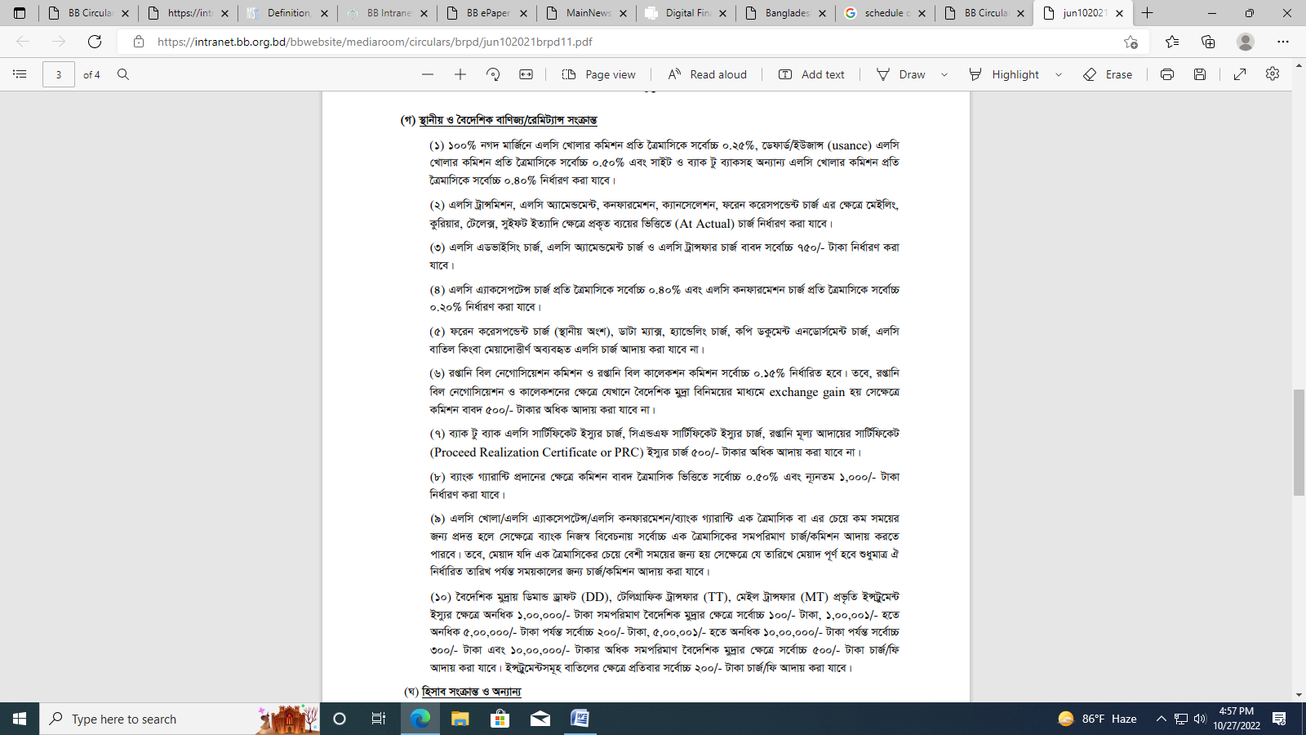

Slide 24
Short Term Foreign Currency Loan for Import
Supplier’s and Buyer’s Credit
Suppliers’ credit and Buyers’ credits from foreign banks and financial institutions arranged through designated ADs of the importers in Bangladesh may be obtained subject to overall interest cost not exceeding SOFR + 3.5% per annum.
NB: The long term (more than 1 year) import finance from foreign source in foreign currency is subject to approval of Bangladesh Investment Development Authority (BIDA).

Slide 25
Risk Management- Import
Dealing with known customers only- ADs must ensure that they deal only with known customers having a place of business in Bangladesh and can be traced easily.
ADs should establish LCs against specific authorization only on behalf of their own customers who maintain accounts with them and known to be participating in the trade
Registration of customer-IRC, -No person is entitled to import unless that is registered with the CCI&E or exempted from the provision.

Slide 26
Risk Management- Import
LC to be opened against Firm Contract Only
Terms on which LCs may be opened
All LCs and similar undertakings covering import into Bangladesh must be documentary LCs and should provide for payment to be made against full set of onboard (shipped) bill of lading, air way bill, etc. showing despatch of goods covered by the credit to a destination in Bangladesh.
Special Instructions for import through land port
(Para 21, Chapter 7)

Slide 27
Risk Management- Import
Remittance against discrepant documents or documents received directly from the suppliers- Payment to be made by ADs after the goods have been cleared from the customs, on the basis of the relative LCAF, the authenticated copy of the customs bill of entry for consumption or customs certified invoice in the case of import by post/courier and the relative invoices.

Slide 28
Submission of Bill of Entry (BOE)-
Submission of Bill of Entry (BOE)- In all cases of remittances for import into Bangladesh, the importer must submit within 4 months from the dates of remittances the relevant authenticated copy of the customs bill of entry.
BB is prepared to consider applications for extension of the time limit beyond 4 months in case of genuine difficulties such as delay in arrival of the ship or difficulties in clearing the goods already landed at port in Bangladesh, etc.
Banks will not open any LC (except USD 200 up to 31 Oct,2017) of any importer who has failed to submit BOE within the stipulated by without prior Bangladesh Bank permission.

Slide 29
Back to back (BTB) import LCs
The ADs may open back to back (BTB) import LCs against export LCs received by export oriented industrial units operating under the bonded warehouse system, subject to observance of domestic value addition requirement (stated in terms of permissible limit of value of imported inputs as percentage of FOB export value of output) prescribed by the Ministry of Commerce from time to time.
Time: 180 days

Slide 30
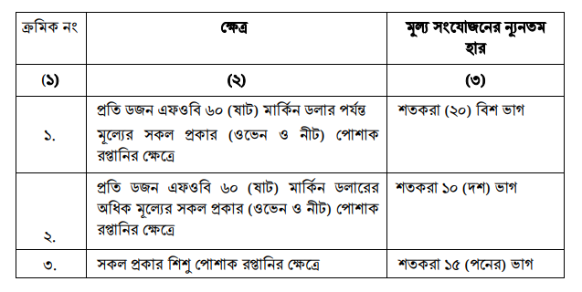
Minimum Value Addition on RMG Sector

Slide 31
Inland back to back LCs
Inland back to back LCs denominated in foreign exchange may be opened in favor of local manufacturer-cum- suppliers of inputs, against master export LCs received by export oriented manufacturing units operating under the bonded warehouse system, upto value limits applicable as per prescribed value addition requirement/utilisation permit.
BTB import LC against inland BTB LC : Back to back LC may in turn be opened for import of necessary inputs, against inland back to back LC in favor of a local manufacturer-cum-supplier operating under the bonded warehouse system.

Slide 32
Opening of LC in FC by exporters operating without bond licence and LC in local currency
As per decision of the National Board of Revenue, a manufacturer-cum-exporter operating without bonded warehouse licence, may open usance LC and sight LC (against advance receipts of export proceeds) denominated in foreign exchange favouring packaging industries, manufacturers of hanger and plastic goods operating under bonded warehouse licence against all types of export contracts (sales contract, purchase order, proforma invoice, etc.) received from abroad.
Hundred percent export oriented industries/direct exporters shall open and settle inland LC in foreign currency favouring manufacurer-cum-suppliers in the above cases only. For procuring inputs from local traders/suppliers, LC shall be opened in local currency only.

Slide 33
Payment settlement against BTB LCs
Payment shall be made at maturity, out of proceeds of the relative export repatriated in foreign exchange; the required foreign exchange will be set aside, out of the export proceeds, in a separate foreign currency account in the subsidiary ledger of the AD.
Usance bills against back to back import LCs should be settled at maturity even where for some reason export has not taken place, or where the export proceeds have not been realised or where the realised export proceeds net of value addition requirement is not adequate to cover the back to back import payment. In such cases post facto approval of Bangladesh Bank (FEOD, Head office or other offices of Bangladesh Bank) will have to be sought for within fifteen days of the following month of effecting the payment, explaining fully the circumstances of export failure or non-realisation/ short realisation of export proceeds, with relevant supporting documents. Cases of failure of export against the relative master LCs should also be reported to the NBR.

Slide 34
Retention of foreign currency in single pool for back to back import payments under bonded warehouse system
On encashment of export proceeds equivalent to the portion of value addition, residual portion of export proceeds against different export bills of the same export unit operating under bonded warehouse system may be maintained in foreign currency in a single pool by the ADs.
Funds from this pool may be used for different back to back import payments of the same exporting unit on maturity basis to keep minimum involvement of AD's own fund under the exchange position as well as to keep exporter free from debt burden.
The retention facility of the value added portion for 30 days is applicable, vide FE Circular Letter No. 32 of September 06, 2022, for exporters producing outputs against procurement of input contents under BBLCs as stipulated in paragraph 42(i), chapter 7 of GFET.

Slide 35
Payment of import bills (other than back to back) from direct and deemed export earnings
If import bills (other than back to back LC) fall due for payment within 30 (thirty) days from the date of receipt of export proceeds by the exporters/deemed exporters, the ADs may, on application by the manufacturers-cum-exporters retain such proceeds in foreign exchange for a maximum period of 30(thirty) days for making such import payments even it exceeds the allowable retention quota limit.
However, export proceeds so retained (in excess of the usual retention quota entitlement) shall be encashed compulsorily in Taka if the same is not utilised for such import payment within 30(thirty) days from the date of receipt. To identify such transactions distinctly, ADs are required to maintain appropriate register and other necessary records. Furthermore, Head Office/Principal Office shall gather information of retention and utilisation of foreign currency as per Appendix 5/26 for each AD branch separately, shall prepare a consolidated statement as per Appendix-5/27 and submit the same to FEOD, Bangladesh Bank, Head Office on monthly basis.

Slide 36
Paragraph 42(ii) and its subsequent circulars are applicable for exporters and eligible local suppliers producing outputs against (i) bulk imports, and/or (ii) local contents. This paragraph is also applicable for eligible local suppliers producing intermediate goods by import of input contents under BBLC opened against delivery orders received in the form of inland BBLCs. The unencumbered balance so retained is useable for specified purposes through other ADs in terms of FE Circular No. 10, dated April 15, 2018 and its subsequent amendments, if any.

Slide 37
Methods of Export
Exports may be done through:
Letter of Credit
Contract (DA/DP) without opening of LC
Payment Term ( Sight/Advance/Usance)
Usually against sight payment basis;
Can be done DA/DP basis;
Can be done against advance receipt
Deferred receipt basis only for jute and jute goods

Slide 38
AD must issue EXP Form as per Sec 12 of FERA
Before issuing EXP AD shall check bonafides of the buyers/consignees abroad and their credentials through correspondents abroad. Greater care should be taken particularly in case of shipments on CAD/DA basis.
Where ADs doubt the bonafides and standing of the buyers abroad or owing to common interest or otherwise they suspect collusion with the intent of delaying or avoiding repatriation

Slide 39
Before issuing EXP, AD needs to be ensured of
of export proceeds, ADs should report such cases promptly to BB. ADs should report to BB cases where it comes to their knowledge that the exporters are directly or indirectly connected with or have any financial or other interest in the buyer/consignee abroad. Where felt necessary, discreet enquiry about the bonafides and credentials of the Charter Party should also be made in case the shipment is to against a charter part BL so as to avoid loss of cargo/foreign exchange.

Slide 40
Title of the Shipping Documents- AD
Export (excepting export from Type A industrial units located in the EPZs/EZs) by land route or by sea/air, the Railway Receipts, Bills of Lading and any other documents of title to cargo should be drawn only to the order of an AD designated for this purpose by the respective exporters and delivered to the authorized representatives of the ADs concerned and to none else.
Cont’d

Slide 41
Exceptions about Title of Goods
In the following cases, transport and other documents may be endorsed by the AD in favor of foreign importers and the same may be sent directly to the importers abroad by the AD. :
Where full value of export has been received in advance;
Type A units of EPZs/EZs
Export of fresh fish, vegetables, fruits, poultry and other perishable items.

Slide 42
Direct and Deemed Export : Receipt and Finance (Taka and Foreign Currency)
Export Proceed Receipt | Pre shipment Finance |  | Post shipment Finance
Advance Payment Documentary Collection (DA/DP) Open Account Documentary Credit | Taka | Foreign Currency | 2 a) Foreign Source (FC) | 2 b) Local Source (FC)
Bi | 1. a) Packing Credit/Working Capital (Funded) | EDF | 2a (i) OBU’s bill purchase/discount | BBLC (Non funded) FDBP/LDBP OD
 | 1 b) Term Loan |  | 2a (ii) Foreign FI’s purchase/discount

Slide 43
Export under open account credit terms against payment undertaking/payment risk coverage
ADs may allow exporters to ship goods on sales contracts under open account credit terms within the statutory period against payment undertaking/payment risk coverage for settlement of export bills/receivables by international factoring companies/ foreign banks/foreign financial institutions/trade financiers/insurance entities.

Slide 44
EXPORTERSRETENTION QUOTA ACCOUNT ERQ
Category | % of FOB value
Merchandise Export | 60
RMG, POL products | 15
Computer software/data processing service | 70
Service Sector | 60
Type-A of EPZ/EZ Cos | 100
Type- B and Type-C of EPZ Enterprises | 80
Type- B and Type-C of EPZ Enterprises | 75

Slide 45
Time Limit for Repatriation of Export Proceeds
The period prescribed by Bangladesh Bank within which full (95%) foreign exchange proceeds of export must be received by exporters is four months.
If the receipt of the full proceeds of any shipment is delayed beyond this period without special or general authorization of BB, the exporter as well as the AD and its officials certifying the EXP render themselves liable to punish under FER Act, 1947.

Slide 46
Endorsement of shipping Documents by the ADs
The ADs to whose order the transport documents are drawn shall endorse the same to the order of their foreign correspondents but in no case they shall make any blank endorsement or endorse it to the order of their consignee unless they have obtained specific or general approval of the BB thereof.
However, in the case of export from Type A units of EPZs/EZs , such documents may be blank endorsed or endorsed in favour of the consignees as per terms of the LC.

Slide 47
Credit Report of Buyer
Bonafides of the buyers/consignees abroad and their credentials should be enquired through correspondents abroad.
Greater care should be taken particularly in case of shipments on CAD/DA basis.

Slide 48
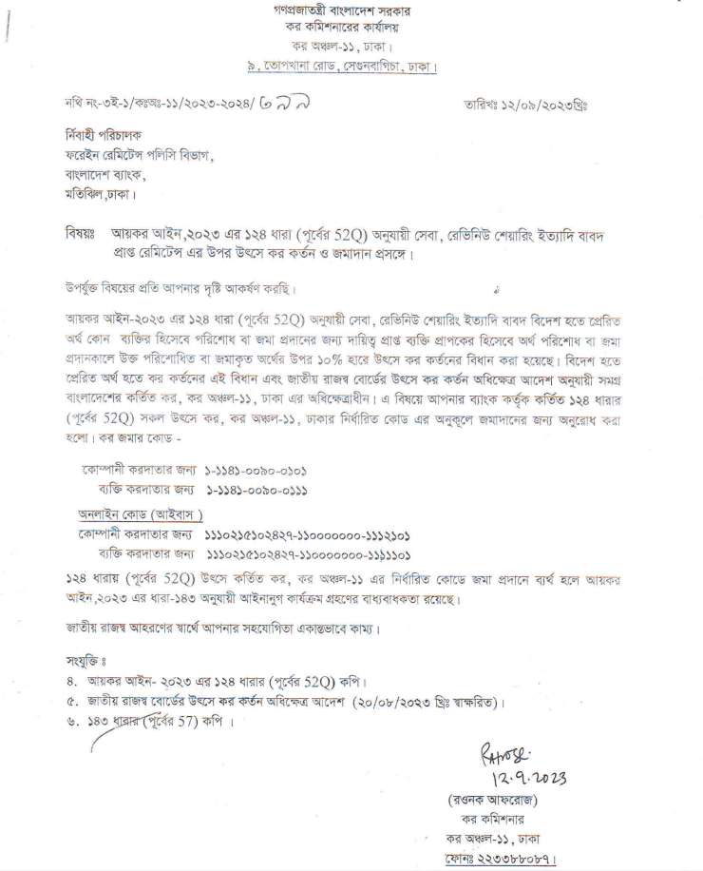
Tax deducted at Source on service earning (As per Sec. 124 of Income Tax Act, 2023)

Slide 49
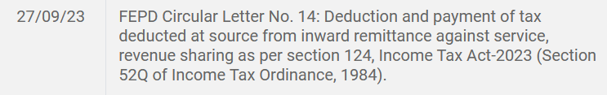

Slide 50
AD and OBU: Same or Different
ADs
(FERA, GFET, FE Circulars/Circular letter etc.)
OBUs
(BCA, BRPD Circulars etc.)
FE Circulars/Circular
letter etc

Slide 51
Clients of ADs and OBUs
ADs
Resident Entities
Type B of EPZ/EZ/PEPZ
Type C of EPZ/EZ/PEPZ
Type A of EPZ/EZ
Non resident
OBUs

Slide 52
With fully foreign-owned enterprises (BRPD Circular 2, Date 25 Feb, 2019)
Offshore banking operation/transactions with fully foreign-owned enterprises in EPZs, PEPZs, EZs and Hi-tech Parks shall include nothing other than accepting deposits, making short term loans/advances and investments, discounting bills, negotiating bills, issuing letter of credit and guarantee. However, prior permission from the Foreign Exchange Investment Department of Bangladesh Bank is required in accordance with the instructions/circulars issued from time to time before making any medium and long term financing facility to the said enterprises.

Slide 53
With enterprises other than fully foreign-owned
With prior permission from the Foreign Exchange Investment Department of Bangladesh Bank, banks, as part of their offshore banking, may make loans/advances to the enterprises other than fully foreign-owned in EPZs, PEPZs, EZs and Hi-tech Parks

Slide 54
With natural persons not resident in Bangladesh
Offshore banking transactions with the natural persons not resident in Bangladesh including Bangladeshi nationals working abroad (NRBs) shall include nothing other than accepting deposits.

Slide 55
With persons residents in Bangladesh
A bank, in its offshore banking operation, may discount bills accepted by ADs in Bangladesh against import L/Cs opened on deferred/usance basis applying due diligence and arrange payment to overseas suppliers.

Slide 56
Remittances against export claims
The ADs may remit export claims not exceeding 10(ten) percent of the repatriated export proceeds as mentioned in right column:
(a) Short weight claim;
(b) Quality claim;
(c) Part shipment.

Slide 57
Opening and operations of NIT Account through online by NRBs (FEID Circular Letter No.05 Date: 10 August, 2023)
To promote further foreign investment in Bangladesh, ADs are advised to develop online interactive web platform for enabling NRBs to open NITAs in Bangladesh
ADs may accept deposits through International Cards of NRB. In this regard, ADs are required to make necessary arrangement in their website for acquiring the fund from card issuing authorities, with deposits through normal banking channel.
On receipt of remittances, ADs will place the fund to the respective NRBs’ accounts. ADs will have to provide PIN codes to the accountholders to operate their accounts through online interactive web platform.

Slide 58
Maintenance of foreign currency (FC) accounts for foreign investment (FE Circular No. 10 Date: June 21, 2023)
Authorized Dealers (ADs) may retain foreign currency sent by foreign investors to invest in Bangladesh. In this context, ADs may open FC accounts in the names of local companies which will issue shares in compliance with regulatory instructions
ADs may henceforth open temporary FC accounts in the names of the proposed companies/enterprises of foreign investors to park fund remitted from abroad on account of equity. On completion of the registration/commencement of the business, new FC accounts in the names of the companies may be opened by transferring the fund held in temporary FC accounts

Slide 59
Interest rate on borrowing from Export Development Fund (EDF)
In case of extension of tenure beyond 180 days, the interest rate prevailing at the time of such extension will be applicable for the extended period.
It has been decided to reset the ceiling to USD 10.00 million from USD 15.00 million for input procurements under back to back LCs (BBLCs) against relevant export orders. The limit for imports under BBLCs by individual member mill of BGMEA and BKMEA is set at USD 20.00 million and USD 15.00 million respectively, including USD 15.00 million for individual exporter of leather goods and footwear sectors.

Slide 60
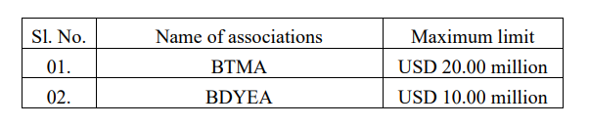
EDF(Cont.)
In addition, the maximum eligible limit for bulk imports as under:
Whereas EDF loans are not being realized within given period, it has been decided that penal interest (compensation in case of Shariah based Islamic Banking) will be charged by Bangladesh Bank to ADs at 4.00% pa above the prevailing interest rate on overdue amount of EDF loans for the delayed period.
Interest rate on EDF loans to ADs will be charged by Bangladesh Bank at 3.00% pa, while ADs will charge interest to manufacturer-exporters at 4.50% pa; for disbursements until further instructions.. (Ref: FE Circular No. 02 Date: February 01, 2023)

Slide 61
Partial repayment of loans against EDF:
Repayment against EDF loans can be made partially for maximum two times and the remainder, if any, needs to be settled at one-go within the remaining admissible tenure. (Ref: FE Circular Letter No. 33 Date: September 15, 2022)

Slide 62
Settlement of loans against EDF
In some situation, EDF loans are settled, without repayment out of realized value in foreign currency, by extending funded facilities. It does not ensure export of goods for which EDF loans have been used. In view of the situation, you are advised to comply with the instructions in settlement of EDF loans and refrain from forwarding applications of EDF loans, irrespective of nature of imports, for customers whose liabilities have been settled through funded facilities in the immediate past 180 days. (Ref: FE Circular Letter No. 21 Date: June 29, 2022)

Slide 63
Eligibility of EDF
Disbursement of EDF loans is required to be settled out of export proceeds/foreign currency funds held in respective pools in terms of paragraph 3 of FE Circular No. 45, dated December 31, 2017.
It has been decided that those customers whose EDF liabilities have to be settled through funded facilities against disbursement from the date of this circular letter will not be accessible for further EDF loan. (Ref: FE Circular Letter No. 27 Date: July 19, 2022)

Slide 64
Interest charges for interim period under EDF
ADs may charge additional interest to borrowers not exceeding 1.0 percent per annum for the period between ‘import payments from sources of ADs’ and ‘receipts of refinancing from EDF’.

Slide 65
Realization of export proceeds
To bring discipline in realization of export proceeds, it has been decided to initiate appropriate measures in cases where export proceeds are not realized within prescribed period. In cases of delayed realization, ADs shall apply prevailing exchange rate for encashment into Taka but shall make payments to exporters applying the rate on the date at which the export proceeds should have been realized as per above regulatory instructions.
(Ref: FE Circular No. 04 Date: March 06, 2023)

Slide 67
Enhancement of limit for declaration on Form-C against inward remittances
FE Circular No. 03 Date: February 22, 2023.
To facilitate inward remittances, it has been decided that declaration on Form-C shall not be required for inward remittances up to 20,000 US dollar or its equivalent.
However, no declaration is required for inward remittances sent by Bangladeshi nationals working abroad.

Slide 68
Retention quota accounts for export of software, ICT and other services
ADs are advised to provide ERQ account services to service exporters so as to enable them to carry out remittance transactions from these accounts.
ADs are also advised to issue international credit/debit/prepaid cards for nominated officials of companies, and freelancers against the balances held in their ERQ accounts for online payments abroad against bonafide requirements.
Non-ADs providing banking services to freelancers shall make arrangements with nearby ADs/CTPCs/head offices/principal offices for

Slide 69
opening ERQ accounts and issuing international cards.
ADs providing settlement account services to MFSPs shall arrange to open ERQ accounts and to issue international cards to freelancers in accordance with FE Circular No. 06/2021. (Ref: FE Circular Letter No. 02 Date: February 05, 2023)

Slide 70
Inward Remittance-Declaration on Form-C
ADs may receive Form-C through electronic means. In this context, ADs shall have secured electronic communication channels, preferably designated ‘app’ for Form-C under internet banking network, with customers. ADs shall execute transactions after being satisfied with the electronic information received through authenticated channels regarding Form-C. Afterwards, ADs shall take a print out of Form-C and get it signed by beneficiaries within 30 days for preservation.

Slide 71
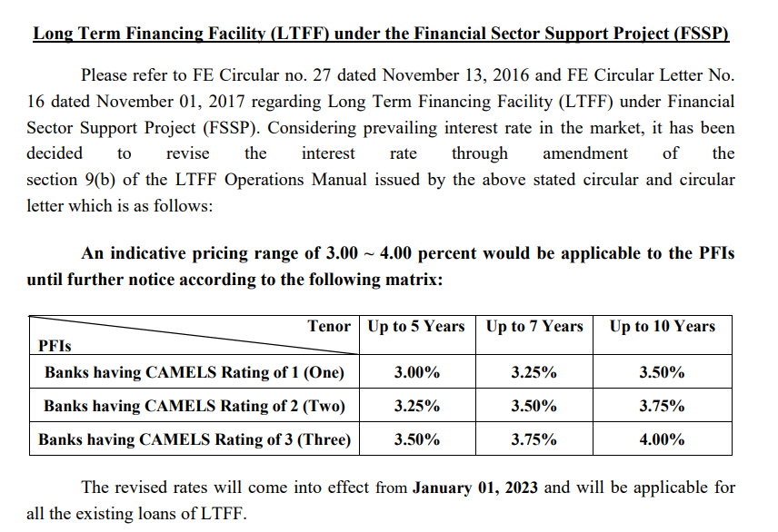
Variable Interest Rate based on CAMELS

Slide 72
Open Position Limit of Banks
The ‘Open Position Limit’ of AD banks approved by Bangladesh Bank on 14 July, 2022 shall remain the same until further instructions.

Slide 73
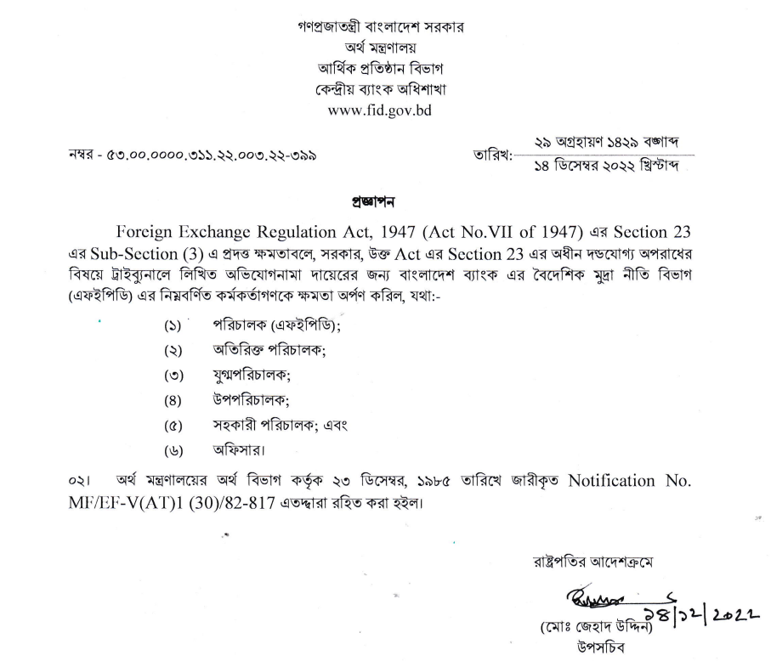
Power delegation to Bangladesh Bank under Section 23 of Sub-section (3) of Foreign Exchange Regulation Act, 1947 (Act No. VII of 1947)

Slide 74
Discount claims against export trade
(FEPD Circular No. 37 , 15/12/22)
In accordance with the decision of the Government, Discount Committee will consider applications for discount claims against exports of leather goods, besides RMG.
ADs may submit applications for discount claims against such exports to Discount Committee through FEPD at Bangladesh Bank, head office in compliance with usual formalities and procedures.
In view of the decision, Leathergoods and Footwear Manufacturers and Exporters Association of Bangladesh (LFMEAB) will be co-opted as member of the committee.

Slide 75
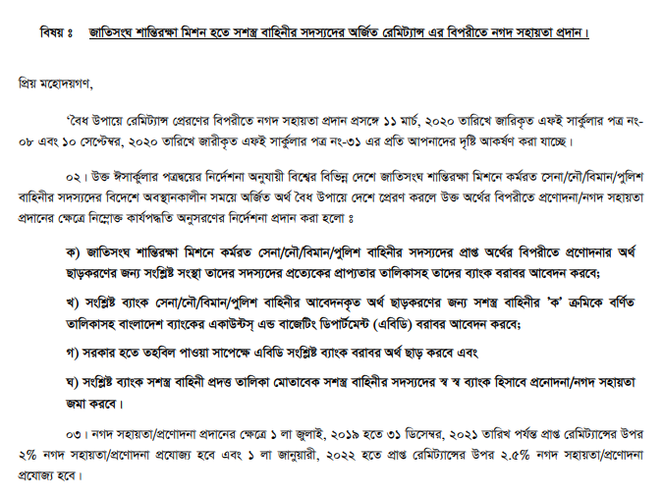
04/12/22 | FEPD Circular Letter No. 45:

Slide 76
Inward wage remittances by MFSPs
29/11/22 | FEPD Circular No. 34
licensed MFSPs will be allowed to repatriate wage earners’ remittance in association with internationally recognized online payment gateway service providers (OPGSPs)/banks/digital wallets/card schemes and/or aggregators abroad (hereinafter referred to as approved/licensed foreign payment service providers, foreign PSPs). In this context, MFSPs shall have standing arrangements with foreign PSPs to receive foreign currency in their account and equivalent Taka value will be credited to the wage earners’ MFS accounts. Subsequently foreign PSPs shall provide credit to the designated AD’s nostro account. After receiving amount in Taka, wage earners’ can use the MFS account from abroad to do all transactions in Taka.
A wage earners’ can open MFS account in Taka through proper e-KYC along with validated proof of departure from Bangladesh (arrival or departure date stamped page of the passport). On return to Bangladesh, such account can be converted to local MFS account. This account may be converted again to wage earners’ MFS account with the proof of departure. It is important that wage earners MFS account can only be credited against foreign currency.

Slide 77
MFSP
ADs are advised to provide settlement account services to MFSPs. Operational procedures in this regard are as follows:
ADs shall transfer the fund, on receipt in their nostro accounts, to settlement accounts in equivalent Taka of MFSPs.
As an alternative to (a) above, ADs may maintain accounts in the name of foreign PSPs at their desire in foreign currency/Taka as per paragraph 1(i), chapter 13 and paragraph 8(b), chapter 14 of the Guidelines for Foreign Exchange Transactions-2018, Vol-1 to facilitate the said transfer by debit the accounts.

Slide 78
Working capital loans to industrial enterprises operating in Domestic Processing Areas(DPAs) of EZs
Type A and Type B industrial enterprises of EZs operating for marketing their products for domestic market only, having no sources of income in foreign currency, are allowed to access to working capital loans in Taka from domestic banking system in terms of paragraph 4(B), chapter 16 of GFET, subject to observance of all applicable credit norms and prudential parameters.
(Ref: FE Circular No. 33 Date: November 28, 2022)

Slide 79
Encashment certificate against inward remittances on account of Information Technology Enabled Services (ITES) exports
ADs maintaining settlement accounts may issue encashment certificates in support of remittances on request from MFSPs electronically. In this case, the request needs to be supported by auto generated information – beneficiary’s name, wallet account number, amount in Taka, date of credit - from remittance service provider abroad. Based on their own screening parameters regarding the information, designated ADs shall generate electronic encashment certificate (as per enclosure A) with QR code accessible to beneficiaries through MFSPs. The above mentioned certificate is intended to be used for Income Tax purpose only.
FE Circular No. 31 Date: November 16, 2022

Slide 80
Stock of cash currency and foreign currency account maintained by Money Changers.
10/11/22 | FEPD Circular Letter No. 42
“The initial stock of foreign currency notes and coins shall be built up by the Money Changers as prescribed at para 5 of this Section. The maximum stock of cash foreign currency must not exceed USD 25,000 (Twenty five thousand) or equivalent at the close of each business day. Cash foreign currency beyond this limit shall either be encashed with any AD or deposited to the foreign currency account maintained with the designated AD of the concerned Money Changer. Cash foreign currency can be withdrawn from this FC account. The balance of that account must not exceed USD 50,000 (Fifty thousand) or equivalent at any point of time. Moreover, the maximum stock of Bangladeshi taka must not exceed BDT 50,00,000 (Fifty lac) at any point of time. Bangladeshi taka beyond this limit shall be deposited to money changers’ current deposit account.”

Slide 81
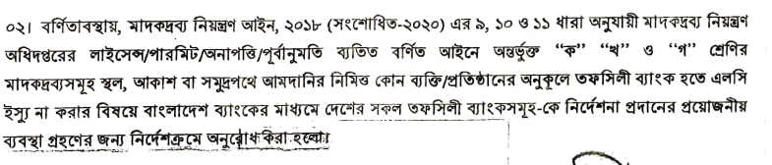
FEPD Circular Letter No. 37 Date: 12/10/22
Prohibition of issuance of LCs for import of narcotics without license/permit/NOC/prior permission from Department of Narcotics Control.

Slide 82
FEPD Circular Letter No. 36: Date: 10/10/22 Price verification of import transactions
Authorized Dealers (ADs) are, before initiating import transactions, required to verify prices of relative goods in terms of prevailing price in the international markets on the date of contracts and/or similar imports in contemporary period.
Given the prevailing global commodity market trends, ADs are advised to adhere to regulatory parameters for verification of import prices and price competitiveness. As usual, ADs shall comply with extended due diligence in import transactions and relevant regulations without limiting to provisions of Import Policy Order in force, credit reports of suppliers, KYC and AML/CFT standards, and so on.

Slide 83
All-in-cost ceiling for short term permissible trade finance in foreign exchange
FE Circular No. 27 Date: September 28, 2022
It has been decided to set all-in-cost ceiling per annum at SOFR + 3.50 percent for short term trade finance in foreign exchange.

Slide 84
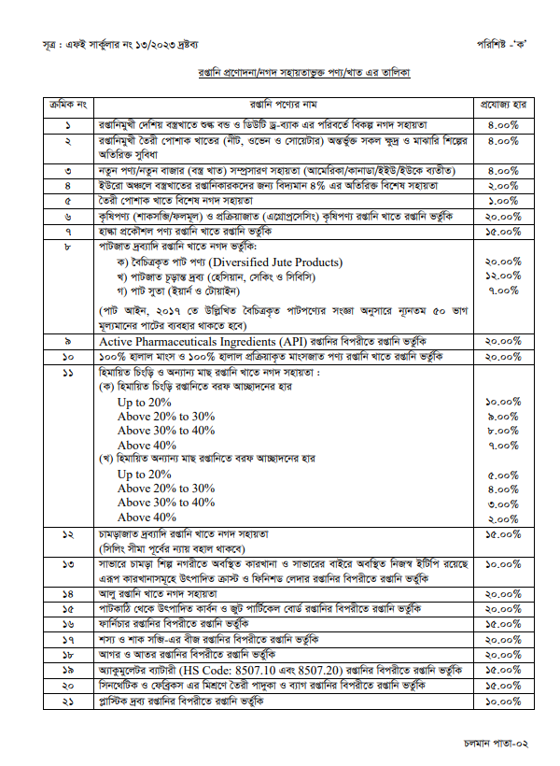
Cash Incentive FY 2023-24

Slide 85
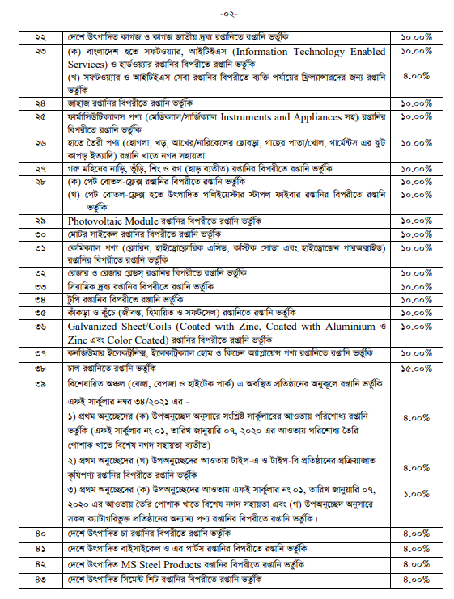

Slide 86
FE Circular No. 24 Date: September 15, 2022
Virtual currencies [subset of virtual assets] are neither approved foreign exchange/currency nor approved form of transactions/investments in accordance with section- 2(aa) and 2(bb) of the FER Act, 1947. Virtual currencies or virtual assets have no financial claim embedded and neither issued by any sovereign nor guaranteed by any jurisdiction. Thus, their value is highly volatile and associated with high financial risks
Virtual assets do not include digital representations of fiat currencies, securities and other financial assets, recognized by Bangladesh Bank.

Slide 87
Foreign exchange transactions for merchanting trade (FE circular 22/2022)
To facilitate transactional services by ADs to their merchanting traders customers, it has been decided to formulate a set of operational guidelines as outlined below:
(a) Regulatory instructions applicable to exports (except EXP Form) and imports (except IMP Form) shall be complied with for export-leg and import-leg respectively, with reporting routine on Form C (at export-leg) and Form TM (at import-leg). Requirement of EXP Form and IMP Form respectively for export and import of goods will not be applicable
b) ADs shall satisfy themselves with the bonafides of the transactions, including adherence to KYC and AML/CFT guidelines while handling such transactions. The counterparties to merchanting trades shall be from FATF compliant countries.
(c) The entire merchanting trade is to be routed through the same AD. The designated AD shall verify the documents and satisfy themselves about the genuineness of the trade. The designated AD should, if necessary, make online verification of transport documents (in case of goods) through acceptable tracking system.

Slide 88
(d) In case of the receipt of transferable Letters of Credit (LCs) to execute merchanting trade, the same may be transferred favoring suppliers of relevant countries in terms of relevant provisions of UCP in force for procurement of goods/services to be sold to respective customers of third countries. The payment for the procurement will be settled in observance of the procedure laid down in UCP.
(e) In case fresh LCs from Bangladesh to suppliers abroad for import-leg are issued, import payments need to be settled out of receipts from export-leg. Import settlement, however, may be arranged by traders before receipts of payments from export-leg under short term buyers' credit from external sources. Traders can assign the receivables from export-leg for the credits. ADs shall not issue any forms of payment undertaking/commitments/acceptance for the credits.

Slide 89
(f) Receipts from export-leg, on encashment of mark-up including deposit to retention quota accounts at traders’ option, shall be retained in margin accounts maintained in foreign exchange till the settlement of payments under import-leg including charges. Discounted proceeds, if any realized before maturity, can also be retained in the said margin accounts.
Agency commission is allowed from the receipts of export-leg retained in margin accounts provided that the payment does not result the transactions ending in shortfall of settlement of payments to suppliers abroad. The agency commission is subject to deduction and payment of applicable taxes.

Slide 90
ADs shall satisfy themselves to the effect that payments for import-leg are to be met out of receipts from export-leg other than buyers’ credit as per 2(e) above. ADs shall, in no way, execute payments from their own sources. The difference between inward receipts and outward payments including relevant all charges shall be reasonably satisfactory for meeting local expenses and profits. ADs shall comply with regulations regarding deductions of applicable taxes for the transactions.
Merchanting traders will be entitled to have retention quota facility on realized proceeds, net of outward remittances, in accordance with rate applicable for service exports as per paragraph 27(d), chapter 13 of GFET and its subsequent circulars.
Reporting for merchanting trade transactions to Bangladesh Bank shall be done on gross basis with purpose as “merchanting services” at both legs.

Slide 91
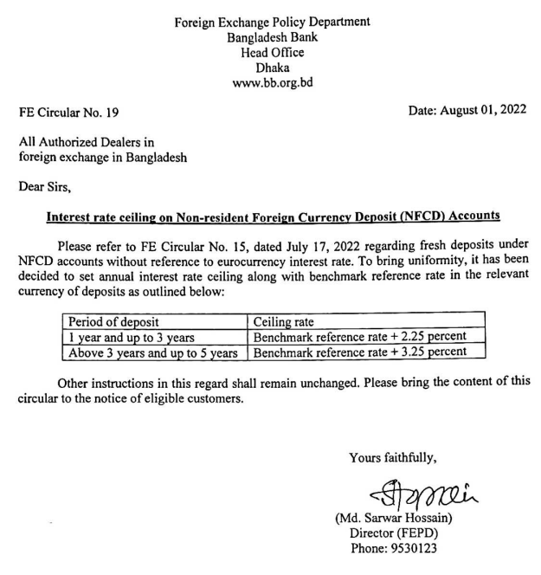
Interest Rate in NFCD Accounts

Slide 92
Online reporting of import information to Bangladesh Bank web portal
FE Circular Letter No. 29 Date: July 28, 2022
Circular Letter No. 24 of July 14, 2022 mentions regarding submission of information on import amounting to USD 5.00 million and above or its equivalent to Bangladesh Bank Online Import Monitoring System (OIMS) 24 hours prior to opening letters of credit (LCs) based on proforma invoices/purchase contracts.
Authorized Dealers (ADs) are hereby advised to report to OIMS for import amounting to USD 3.00 million and above or its equivalent. As usual, the report excludes imports by the Government. ADs shall submit final report after 24 hours from above mentioned reporting.

Slide 93
Encashment of balances held in ERQ accounts
FE Circular No. 14 Date: July 14, 2022 and FE Circular Letter No. 28 Date: July 26, 2022
It has also been decided to revise retention limit out of realized export proceeds from 15 percent, 60 percent and 70 percent to 7.50 percent, 30 percent and 35 percent respectively. The revised limit will remain valid till December 31, 2023.
Respective ADs shall encash 50 percent of the total balance held in relevant ERQ accounts immediately
While on encashment, ADs shall apply interest payable to the accounts (up to the date of encashment) without adherence to premature encashment procedure.
This is to clarify that this instruction is equally applicable for ERQ balances held in the form of term deposits.
Authorized Dealers (ADs) are advised to intimate individual beneficiaries regarding their option for retention in foreign currency before encashment of inward remittances. Without their consent, ADs should not outrightly encash inward remittances for credit in Taka accounts (FE Circular Letter No. 13 Date: May 16, 2022).

Slide 94
Repayment guarantees by importers against short term import finance under buyer’s credit
FE Circular No. 12 Date: July 13,2022
To facilitate short term import finance under buyer’s credit, it has been decided that importers may extend guarantees like corporate guarantee, personal guarantee, third party guarantee, etc. to foreign lenders making payments to suppliers under buyer’s credit against admissible imports on sight letters of credit.

Slide 95
Import of capital machinery on usance basis
FE Circular Letter No. 22 Date: July 07, 2022
‘Scrutiny committee on foreign loan/supplier’s credit in private sector’ under BIDA has decided in its 166th meeting to accord general authorization for extension of usance period/refinancing for maximum 360 days from the maturity date against import of capital machinery by the industrial enterprises registered with BIDA and DOT under supplier’s/ buyer’s credit against LCs opened/to be opened or valid contracts initiated up to December 31, 2022, subject to extended period not exceeding December 31, 2024.
The extension facility will be applicable for first time approval from existing authorized usance period of 360 days. Accordingly, Authorized Dealers may allow their eligible importers to extend the maturity period for import of capital machinery up to the authorized period inline with this decision.

Slide 96
Transfer of export proceeds to Authorized Dealers designated for export transactions
FE Circular Letter No. 18 Date: May 29, 2022
To observe reporting formalities, ADs executing export transactions need to receive FC from ADs having repatriated export proceeds. In this context, ADs repatriating export proceeds are advised to transfer the fund in FC to designated ADs. In case of payment against export bill discounting or early payment arrangement in FC by other ADs or offshore banking operations (OBOs), the FC fund shall be transferred to designated ADs. Export proceeds repatriated through ADs of buying agents shall also be transferred in FC to exporters’ ADs. While making transfer, ADs shall keep records of the transactions suitably for proper reconciliation.
The transfer is required to be executed by the following business day on completion of the relevant transactions through FC clearing accounts maintained with Bangladesh Bank. On receipt of the fund, designated ADs shall convert the encashable portion of FC in Taka and make the same available to exporters’ accounts maintained with them. In all cases, conversion of export proceeds is required to be executed through designated ADs by the following business day on receipt of the fund in their respective accounts either from other ADs/OBOs or abroad.

Slide 97
Screening of underlying import shipments through vessel/container tracking
FE Circular No. 09 Date: May 17, 2022
Please refer to paragraph 19(i), chapter 7 of the Guidelines for Foreign Exchange Transactions-2018, Vol-1 (GFET) regarding import payments. You are also aware that screening of underlying export shipments through vessel/container tracking system recognized by competent authority has been made mandatory through FE Circular No.07, dated April 20, 2022. 02.
It has now been decided that to ensure onboard of import of goods Authorized Dealers (ADs) shall conduct the tracking of shipments for relevant import transactions.

Slide 98
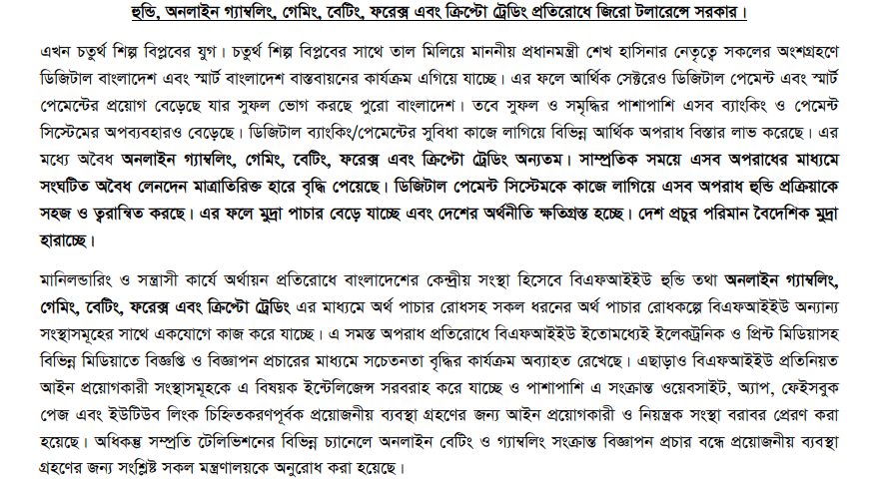
Online Illegal Transactions

Slide 99
Discount claims for shipment of readymade garments
All cases of discounts claimed by the importers on account of discrepancies in documents, short shipment, late shipment, conservative arrest, quality issue etc. in respect of shipment of readymade garments should be submitted (as per prescribed format shown in Appendix 5/71) to the Discount Committee through FEPD, Bangladesh Bank, Head Office for recommendation/ decision. However, before referring such case to the Committee, AD must be satisfied about the genuineness and merit of the case.

Slide 100
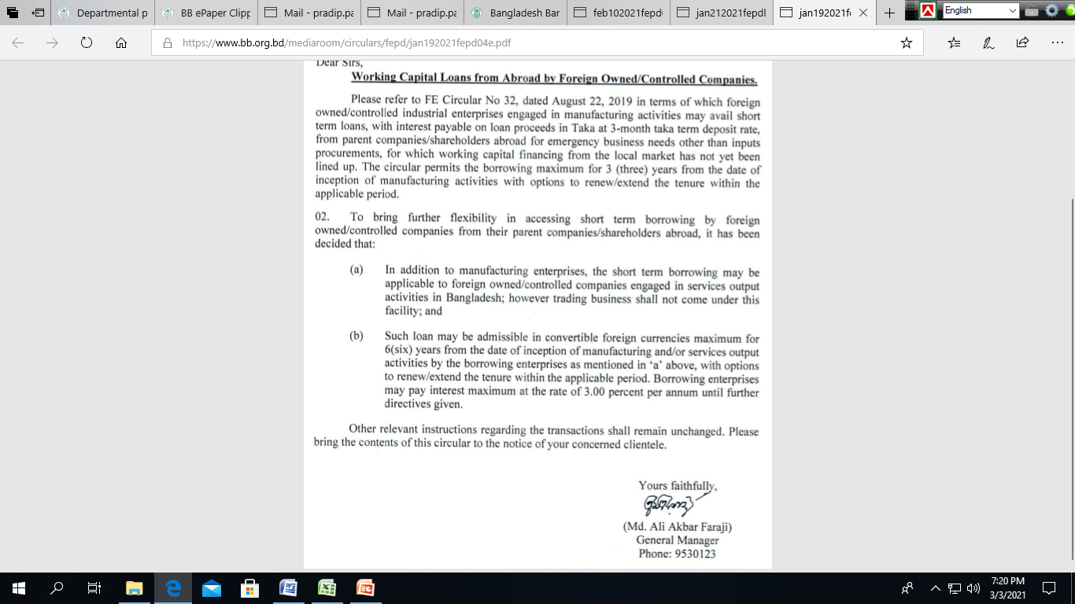
FE Circular Letter No. 5 Date: 19.01.2021

Slide 101
Advance payments against imports under buyer’s credit (FE Circular Letter No. 2 Date: 07.01.2021)
In view of the growing trend of imports under short term buyer’s credit, it has been decided that advance payments against permissible imports may also be executed directly by external financiers and/or offshore banking operations of scheduled banks, subject to repayment guarantees irrespective of amount acceptable to ADs received from banks abroad and compliance of other relevant instructions contained at paragraph 27(i), chapter 7 of GFET-2018 including reporting routine on IMP formalities, inter alia, to Bangladesh Bank.
ADs shall also satisfy themselves regarding the enforceability of repayment guarantees.

Slide 102
Transfer of remunerations to Foreign Currency (FC) accounts maintained by foreign nationals employed in Bangladesh (FE Circular Letter No. 2 Date: 07.01.2021)
To facilitate payment of salary/benefits of expatriate employees, branch offices/liaison offices of foreign companies, enterprises operating in EZs/EPZs/HTPs and exporter-employers having ERQ accounts are allowed to transfer from their admissible FC accounts up to 75 percent of net monthly income of the expatriate employees in equivalent foreign currency to FC accounts maintained and operated by the employees according to paragraph 1, chapter 13 of GFET.

Slide 103
Remittance against current account transactions (FE Circular No. 01 Date: January 04, 2021)
It has been decided that Authorized Dealers (ADs) may remit admissible expenses up to 1(one) percent of annual sales as declared in the previous year's income tax return of the concerned remitter-companies or USD 100,000 whichever is higher.

Slide 104
Business-to-Consumer export through sales orders received on internet
ADs may allow such exports of each sales on e-Commerce website up to USD 500 or equivalent under cash on delivery/payment on shipment terms subject to:
(a) ADs shall have counterparty arrangements with foreign payment service providers to realize the payments by debit their foreign currency accounts or Taka accounts maintained with ADs in terms of paragraph 1(i), chapter 13 and paragraph 8(b), chapter 14 of the Guidelines for Foreign Exchange Transactions-2018, Vol-1.
(b) Overdraft facilities will be allowed for the accounts so maintained in Bangladesh provided that ADs shall have payment guarantees, from banks acceptable to them, for the adequate amounts based on the transaction flows.

Slide 105
Outward remittances on account of software maintenance/support fees (FE Circular No. 51 Date: 19 November, 2020 )
ADs shall no longer need to seek a first time approval from Bangladesh Bank. ADs shall, while effecting remittances, observe the following instructions:
(a) ADs shall have to be ensured of the concerned software having legitimate license;
(b) ADs shall obtain valid agreements for the maintenance/support services executed with foreign service providers.
(c) Remittance requests from the remitters shall be supported by invoices;
(d) An undertaking from remitters to the effect that they have not remitted the payments from other ADs and shall not do the same in future, and they will bring back the remitted amount or its parts in case of non-receipt or partial receipt of services.
(e) Regulations regarding payments of tax at source, value added taxes and other levies applicable on the payments need to be complied with.

Slide 106
Collection of Demurrage, Detention, Handling or equivalent charges by the foreign shipping lines/their agents for calculation of their remittable surplus
It has now been decided that the above mentioned charges collected prior to financial year 2017-18 shall be considered for calculation of surplus earnings provided that:
(a) The charges shall be shown in a supplementary statement showing deduction of appropriate taxes, including necessary assessment thereon, and payment thereof as per Finance Act’ 2017 through amendment of Section 102 of Income Tax Ordinance, 1984 and Income Tax Paripatra No. 19 of 2017-18 of the National Board of Revenue.
(b) The amount so ascertained as per supplementary statement shall be shown in the revised App-5/34 (as per enclosure of FE Circular No. 43/2017).

Slide 107
Temporary accounts for foreign investment in Export Processing Zones (EPZs) and Economic Zones (EZs)
(FE Circular Letter No. 38 Date: 29 October,2020 )
Temporary Non-Resident Taka Accounts and Temporary Foreign Currency Accounts are equally applicable for proposed companies to be established in EPZs and EZs without prior approval of Bangladesh Bank.
Temporary foreign currency accounts may also be opened by ADs and OBUs (in case of Type A enterprises), to park fund remitted from abroad as equity by foreign investors subject to observance of the same instructions as noted in paragraph 2(C), chapter 9 of GFET

Slide 108
Access to finance from domestic sources against overseas guarantees (FE circular 21/2020 )
Taka finance facilities by banks/NBFIs against overseas guarantees (preferable bank guarantee/standby letters of credit) to resident companies irrespective of ownership/controlling status of borrowing entities has been extended to Dec, 2021 (FE Circular Letter No.-17 Date: June 30, 2021)

Slide 109
Issuance of repayment commitments as collaterals against external borrowing by resident entities
In addition to Bangladesh Bank’s approval, ADs shall observe following instructions to apply Bangladesh Bank for approval of issuance of repayment commitments external borrowing by resident entities: (a) all applicable credit norms and prudential parameters, (b) at least 05 (five) percent of the commitment amount shall mandatorily be in cash margin or unencumbered encashable bank deposits. (Ref: FE Circular No. 23 Date: June 21, 2021)

Slide 110
Release of foreign exchange in Card for private travel abroad
FE Circular No. 30 Date: September 23, 2021
ADs may endorse/set travel entitlements on relevant passports to concerned Bangladeshi nationals in international cards for multiple years up to their validity.
In case of exceeding the quota limit endorsed through international cards, while on travel abroad, for unavoidable but bonafide grounds acceptable to ADs, the excess amounts may be adjusted in the following ways: (i) By debit to RFCD accounts of relevant travelers; or (ii) Excess amount not exceeding USD 500 or equivalent may be adjusted against travel quota without prior approval from BB.

Slide 111
Disposal of foreign loan/suppliers credit proposals of private sector enterprises
FE Circular Letter No 22 Date: September 01, 2021
In case of bonafide requirements beyond one year, BIDA will consider to accommodate the requests within the purview of above stated notification as per decision of the 145th meeting of „Scrutiny committee on foreign loan/supplier’s credit in private sector‟ for extension of usance period/refinancing against permissible deferred imports by importers having registered with them or with Department of Textiles. Accordingly, eligible importers may submit applications to BIDA for extension of usance period/refinancing to be allowed by suppliers/lenders against permissible deferred imports beyond one year. Applications shall be submitted to BIDA at least 1(one) month before the maturity of concerned deferred imports.”

Slide 112
Export trade transactions, appropriate safeguards
FE Circular No. 25 Date: July 13, 2021
To ensure safeguards in export trade, ADs need to observe appropriate measures before execution of transactions as noted here under:
(a) ADs shall facilitate export transactions under letters of credit (LCs) routed through authenticated channels from banks with whom appropriate relations are in place.
(b) ADs shall, in addition to be ensured of apparent authenticity of LCs, satisfy themselves of bonafide of applicant banks/issuing banks in case of LCs received through authenticated channels from third banks.
In this case, ADs need to be ensured that applicant banks/issuing banks will receive export documents directly from them or through third banks/other authenticated banks with whom respective ADs maintain appropriate relationship.

Slide 113
Export trade transactions, appropriate safeguards
(c) In case of transferred LCs, ADs shall satisfy themselves of bonafide of first beneficiary and transferring bank besides LC applicant banks/issuing banks.
(d) ADs shall satisfy bonafide of importers abroad as per paragraph 7(iv), chapter 8 of GFET.
(e) ADs shall conduct due diligence on importers’ banks designated for the transactions under sales contracts for being ensured of their step by step responsibilities regarding release of export documents by designated banks to importers and procedural arrangement of payment as per GFET including its subsequent circulars and relevant provisions of the URC in force. In this case, ADs need to be ensured that importer’s banks will receive export documents directly from them or through third banks/other authenticated banks with whom respective ADs maintain appropriate relationship.

Slide 114
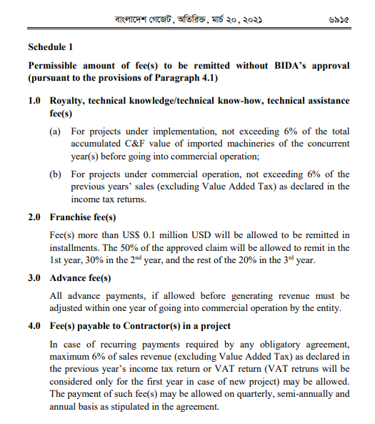
Payment of royalty, fees for technical knowledge or technical assistance and franchise fees to foreign persons or institutes
FE Circular Letter No. 07 Date: April 11, 2021

Slide 115
Thank you.

