Slide 1
FINTECH & BLOCKCHAIN TECHNOLOGIES FOR BANKING
FINTECH & BLOCKCHAIN

Slide 2
Agenda
Fintech
Artificial Intelligence
Augmented Reality (AR)
BIG Data
Blockchain in Banking

Slide 3
Fintech

Slide 4
WHAT IS FINTECH?
Fintech is short for “financial technology.” It’s a catch-all term for technology used to augment, streamline, digitize or disrupt traditional financial services.
Fintech provides people and businesses with access to traditional financial services in innovative ways that previously weren’t available.

Slide 5
Areas of FinTech in Banking
Digital Lending and Credit
Mobile Banking
Mobile Payments
Cryptocurrency & Blockchain
Insurance
Trading
Banking as a Service (BaaS)

Slide 6
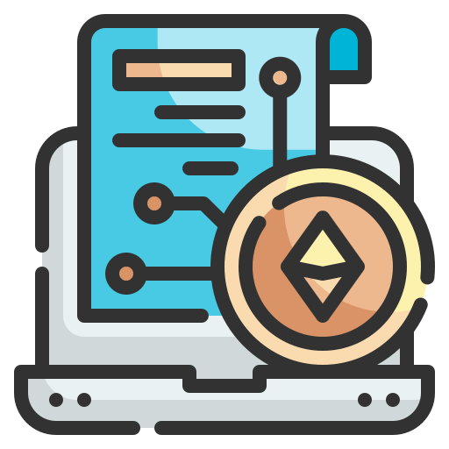
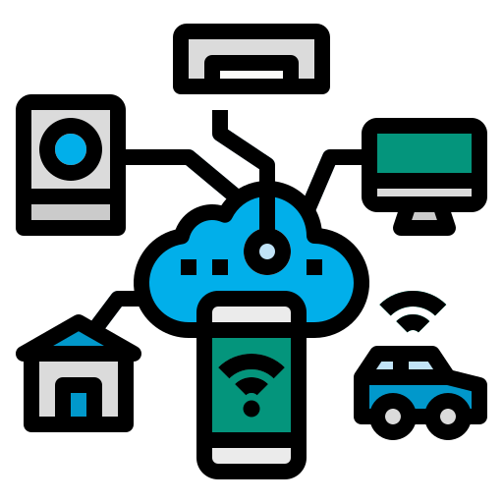
THE DRIVING FORCES OF FINTECH
AR
Smart Contracts
Blockchain
Bots
Internet of Things
Voice-enabled payments

Slide 7
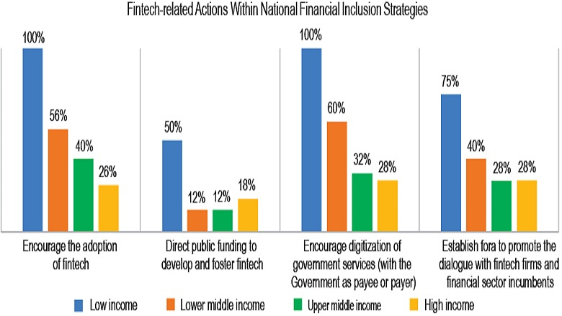
Fintech-related sandboxes with a financial inclusion theme

Slide 8
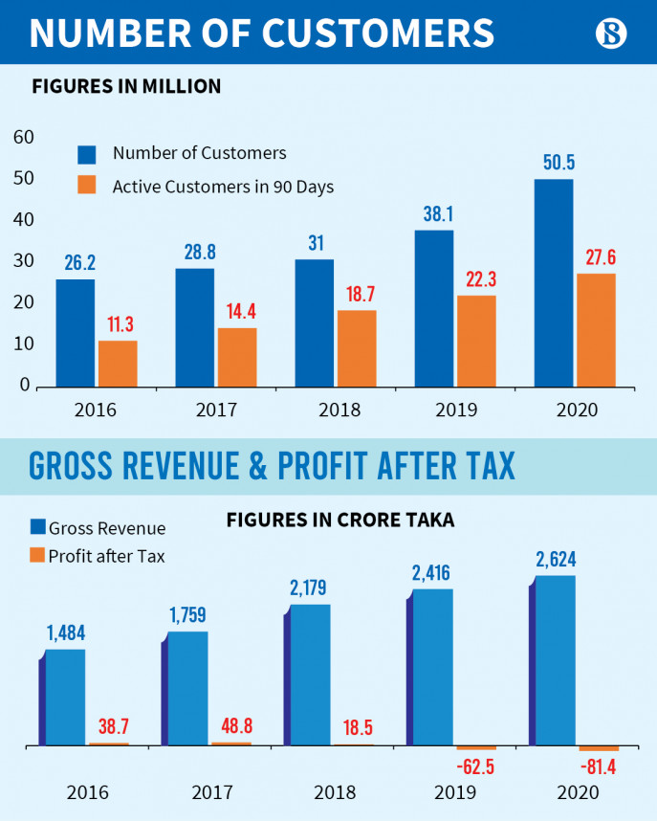
ANALYZING FINANCIAL DIGITALIZATION
Bkash Fintech Growth

Slide 9
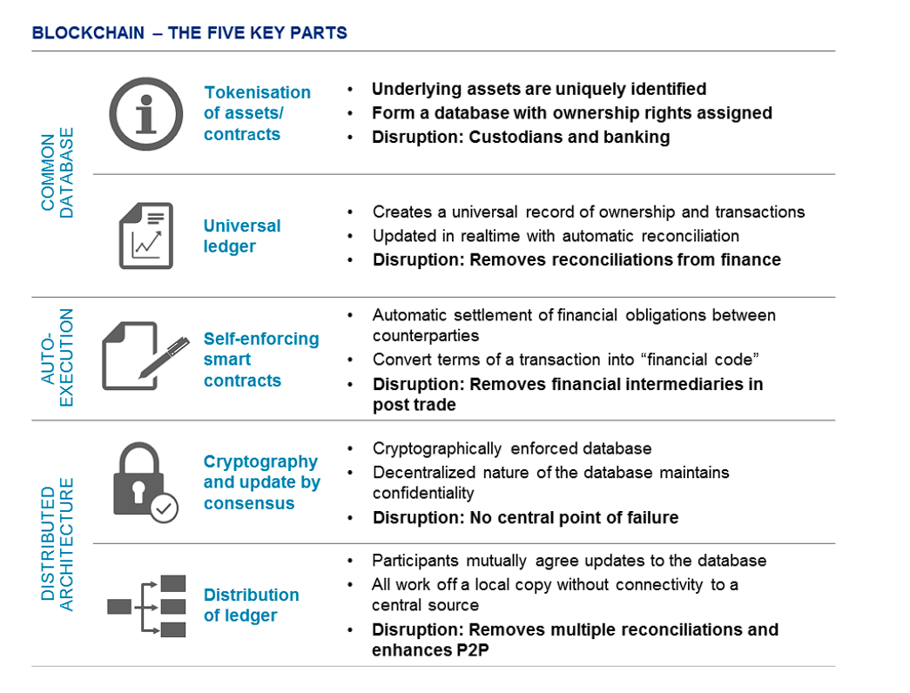
WHY BLOCKCHAIN A FACTOR IN FINANCIAL TRANSACTION

Slide 10
Blockchain Technology Sweeping Transaction Models In Banking
THE WHAT, WHY AND WHEN

Slide 11
What is blockchain?
Blockchain is a system of recording information in a way that makes it difficult or impossible to change, hack, or cheat the system. A blockchain is essentially a digital ledger of transactions that is duplicated and distributed across the entire network of computer systems on the blockchain.

Slide 12
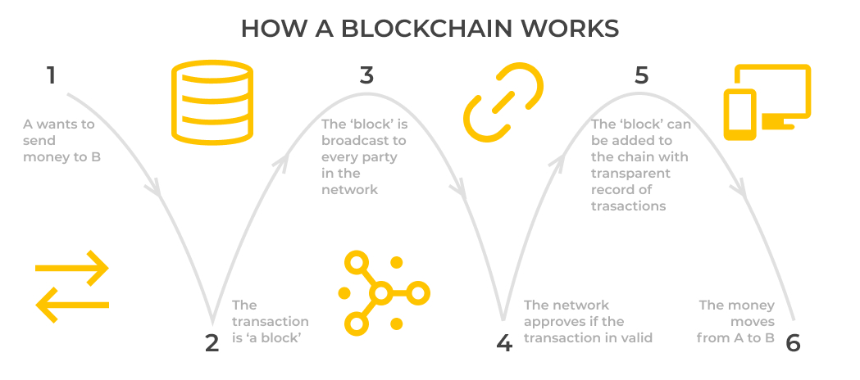
How A Blockchain Works

Slide 13
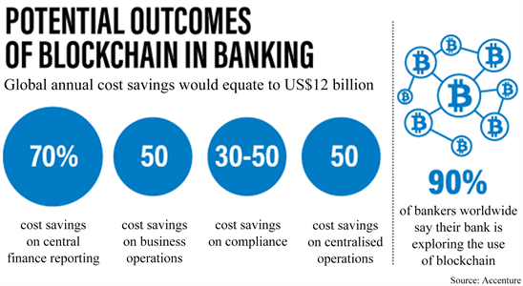

Slide 14
Automation of post-trade events
Applying blockchain and smart contracts to post-trade activities can eliminate the need for intermediaries, reduce counter-parties and operational risk, while providing the infrastructure for faster trade settlement. Financial institutions can settle securities in minutes instead of days, with the major benefits being streamlined real-time settlement, improved liquidity, supply chain optimization and increased transparency.

Slide 15
Payment clearing system: distributed clearing mechanism
Interbank payments often rely on processing by intermediary clearing firms, which involves a series of complicated processes, including bookkeeping, transaction reconciliation, balance , payment initiation, etc. Therefore, the process involved is lengthy and costly. Using cross-border payments as an example, as the clearing procedures for each country is different, a remittance requires nearly 3 days to arrive. This demonstrates the low efficiency and immense volume of occupied funds involved.
Point-to-point payment can also be implemented using blockchain technology, thus eliminatinreconciliationg the intermediary link of third-party financial institutions, which will greatly improve service efficiency and reduce the transaction costs of banks. This will also enable banks to satisfy the requirements for rapid and convenient payment clearing services for cross-border commercial activities. McKinsey has made an estimation which shows that the cost of each transaction in Cross-Border business can be greatly reduced.

Slide 16
Bank credit information systems
The ineffectiveness of bank credit information systems is mainly due to the following: first, the scarcity and poor quality of data makes it difficult to judge the situation of personal credit; second are difficulties in inter-institutional data sharing; third is the unclear ownership of user data, leading to difficulties in circulation due to concerns for privacy and security. Although the solutions to these problems will require the cooperation and participation of different stakeholders, blockchain technology can provide some assistance in addressing these issues-
Establishing data ownership
Promoting data sharing

Slide 17
Distributed innovations in financial transactions
Supply-chain finance involves an extensive amount of manual inspections and paper-based transactions. The process also has numerous intermediaries, a high risk of illegal transactions, high costs, and low efficiency. Blockchain technology can drastically reduce manual interventions and employ smart contracts in order to digitize procedures that rely heavily on paperwork. This would greatly improve the efficiency of supply-chain finance and reduce manual operational risks. With the supplier, buyer, and bank as the main trading parties, and the sharing of contractual information on a decentralized distributed ledger, smart contracts can ensure that payments are made automatically once a predetermined time and result is reached.

Slide 18
Mechanism for fairness and transparency
If implemented, blockchain can act as an online automated surveillance system for each transaction. A blockchain-based exchange can have inbuilt characteristics to track, block and report illegitimate attempt made by anyone on the network, and can provide a robust platform to implement the security policy and standards.
Since the blockchain ledger is designed in such a way that all participants have full record of transactions and, therefore, holdings of investors, it can bring in complete transparency and trust in the market.

Slide 19
Lower transaction costs
Blockchain transactions are faster, as trade confirmations are done through smart contracts by peers instead of any intermediary. As the intermediaries in the system get minimized, costs associated with them, like trades record keeping, audits and trade verifications also get eliminated or reduced.

Slide 20
Mechanism for risk containment
Through blockchain technology, margining system and payment of margin can be done instantly and the frequency of valuation of securities deposited as capital can be done daily compared with the weekly process prevalent now, minimizing the risk.

Slide 21
Higher liquidity
Blockchain can reduce the inefficiencies through automation, which also leads to reduction in cost and thus lowering entry barriers resulting into increased market base. For people, who could not access the markets due to cost barriers will be able to participate, ultimately increasing liquidity and investment.

Slide 22
Comparison of traditional banking businesses, Internet finance businesses, and blockchain + banking businesses

Slide 23
Artificial Intelligence

Slide 24
Greatly Reduces Research Time
People can now use artificial intelligence to execute billions of instructions, perform knowledge graphs, opportunity detection, and analyze big data for financial transactions and banking. This greatly reduces the time required for research.
NO ROOM FOR EMOTIONS
Human reactions allow for creativity, and replacing it with machine learning and artificial intelligence may not always be the best option. People can, nevertheless, make mistakes as a result of emotional strain. Bad emotions and health concerns can lead to poor performance and increase the likelihood of human error. You don't have to worry about such concerns with AI because it is based only on logic and built-in algorithms. This dispassionate approach can aid in making data-driven banking and financial judgments.

Slide 25
BETTER REPRESENTATION OF REPORTS
AI software can create illustrative reports and customized charts. Various filters can be implemented in those reports to easily find the required data. Your reports can also be displayed on other devices and updated in real-time.
EASE OF AUTOMATION
Routine and automated jobs can be done using AI, such as banking and stock trading. You may incorporate the AI, put it in automatic mode, and go about your business. You do need to continually watch or coordinate it for your normal trades.
Despite the fact that it will require frequent maintenance and check-ups, you may program your AI to do regular trades, short sales, stop-limit sales, and other trading activities for passive profit-generating.

Slide 26
CAN BE COMBINED WITH OTHER TECHNOLOGY
Artificial intelligence is highly adaptive. You can combine it with other modern technologies like blockchain and big data for more complex analysis. This can secure the transaction and enhance your overall banking and trading experience.
CONSTANT EVOLUTION
AI is evolving every day. NLP and Neural Processing Units are updated all the time to make them more effective. Algorithms used in stock trading are also being perfected over time to automate the process of forecasting and trading. We now have access to tools such as Trade Ideas for technical and fundamental analysis, Trade Spider for 1-on-1 training, Equbot that can analyze over 15,000 trades every day, and Tech Traders that can run without any human intervention.
These are all powered by AI and with such drastic advancement of technology, who knows what more amazing AI-powered tools await us in the financial sector.

Slide 27
FORECASTING AND PATTERN DETECTION
Forecasting is an important part of trading. Before making a purchase we usually do technical and fundamental analysis. Technical analysis is the study of historical data to find out trading patterns and fundamental analysis requires current information on market variables. AI can perform both analyses. It can go through historical data to find out any recurring patterns in the stock market. It can also obtain information from news headlines, social media, blog posts and understand the movement of stock prices.
REDUCES OVERALL COST
If you use AI, most of the work related to trading will be automated. Sure, computer programs require costs such as maintenance and upgrades but it greatly reduces the cost of brokers and analysts. Even the research cost will be reduced.

Slide 28
Augmented Reality(AR)

Slide 29
WHAT IS AUGMENTED REALITY?
Augmented reality (AR) is an enhanced version of the real physical world that is achieved through the use of digital visual elements, sound, or other sensory stimuli delivered via technology. It is a growing trend among companies involved in mobile computing and business applications in particular.
The Banking is no longer confined to the desk and could project graphs and maps the size of the room in the AR space, enabling the more intuitive input and analysis of information.

Slide 30
BIG Data Analytics

Slide 31
WHAT IS BIG DATA ANALYTICS?
Big data is a field that treats ways to analyze, systematically extract information from, or otherwise deal with data sets that are too large or complex to be dealt with by traditional data-processing application software.
Big data analytics is the often complex process of examining big data to uncover information such as hidden patterns, correlations, market trends and customer preferences, that can help organizations make informed business decisions.

Slide 32
The future is here!

Slide 33
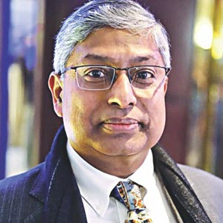
THANK YOU
HABIBULLAH N KARIM
Founder & CEO, Technohaven Company Ltd.
Co-founder & Coordinator, Blockchain Olympiad Bangladesh

