Slide 1
Negotiable Instrument Act 1881
Md. Jahirul Islam
SPO & Faculty
Rupali Bank Training Academy

Slide 2
Negotiable Instrument ACT-1881
Date of Commencement :
9th December, 1881
Date of Promulgation :
1st March, 1882

Slide 3
Negotiable Instrument ACT-1881
Negotiable Instrument Act-1881 is an important part of Mercantile Law.
At the starting this law consist of 17 Chapter and 139 sections ( 9th December 1881)
The Law has been amended several times(1885,1920,1930,1947,1962,1994,2000,2002, 2006).
Section 2 & 139 annulment and section-140,141 Added.

Slide 4
Negotiable Instrument ACT-1881
Range
Ch No. | Name | Range
1 | Preliminary | 1-3
2 | Notes, Bills & Cheques | 4-25
3 | Parties | 26-45A
4 | Negotiation | 46-60
5 | Presentment | 61-77
6 | Payment & Interest | 78-81
7 | Discharge from liability-of ch-2 | 82-90

Slide 5
Negotiable Instrument ACT-1881
Range
Ch No. | Name | Range
8 | Notice of Dishonor | 91-98
9 | Notice & Protest | 99-104A
10 | Reasonable time | 105-107
11 | Acceptance & Payment for honour | 108-116
12 | Compensation | 117
13 | Rule of Evidence | 118-122
14 | Special Provisions relating to cheques | 122A-131C

Slide 6
Negotiable Instrument ACT-1881
Range
Ch No. | Name | Range
15 | Special provisions relating to Bills | 131D-133
16 | International Laws | 134-137
17 | Penalties in case of dishonor of cheque | 138-141

Slide 7
Negotiable Instrument ACT-1881
The term “negotiable instrument” literally means a written document which creates a right in favor of some person and which is freely transferable without any formality.
Negotiable instrument, Transferable document (e.g., a bank note, check, or draft) containing an unconditional promise or order to pay a specified amount to its holder upon demand or at a specified time.

Slide 8
Negotiable Instrument ACT-1881
Negotiable Instrument
Negotiable
Instrument
Transferable
Written document

Slide 9
What is Negotiable Instrument?
A “Negotiable instrument” means a promissory note, bill of exchange or cheque payable either to or to bearer.
Section-13

Slide 10
Essential features of Negotiable Instrument
Transferrable
By Endorsement
By Delivery
Written form
Bearer Instrument

Slide 11
Essential features of Negotiable Instrument
Independent Title: 2 parties
Transerror
Transferee
Can be defective title
Effective title as transferee has no knowledge of fraud

Slide 12
Essential features of Negotiable Instrument
Right to sue
In writing
Payment of a certain sum of Money
Time of payment
The payee must be a certain person
Unconditional order or promise
A negotiable instrument must bear the signature of its maker

Slide 13
Presumptions as to Negotiable instrument
Section-118
Following legal presumption are made in respect of a negotiable instrument until the contrary is proved;
That every N.I was drawn, accepted and endorsed, made or transferred for consideration.
That the date it bears is the date on which it was made;
That it was accepted within a reasonable time after being made and before maturity.
That the endorsement were made in the same order in which they appear.

Slide 14
Presumptions as to Negotiable instrument
Section-118
Following legal presumption are made in respect of a negotiable instrument until the contrary is proved;
That every transaction was made before maturity.
That the lost instrument was duly signed and stamped;
That every holder of N.I is a holder in due course unless it is proved that the holder has taken it from the true owner either without his free consent or without consideration.

Slide 16
Classification of Negotiable Instrument
Negotiable Instrument
On the basis of validity
On the basis of payment
On the basis of location
On the basis of Payee
Demand Instrument
Time Instrument
Inland instrument
Foreign instrument
Inchoate (Incomplete)
Ambiguous
Bearer Instrument
Order Instrument

Slide 17
Inland Instrument
Section-11
Inland Instrument
Instrument which is made or drawn in Bangladesh.
(a) Drawn on a person resident in Bangladesh
or
(b) Payable in Bangladesh.

Slide 18
Foreign Instrument
Section-12
Foreign Instrument
Any such instrument not so drawn, made or made payable shall be deemed to be a foreign instrument.

Slide 19
Ambiguous Instrument
Section-17
Ambiguous Instrument
Where a instrument may be construed either as a promissory note or bill of exchange, the holder may at his election treat it at either, and the instrument shall be thenceforward treated accordingly..

Slide 20
Inchoate stamped Instrument
Section-20
Inchoate Instrument
Where one person signs and delivers to another a paper stamped in accordance with the law relating to stamp duty chargeable on N I, either wholly blank or having written thereon an incomplete N I…

Slide 21
Bearer cheque
This cheque is paid to the bearer of the cheque or whose name the cheque carries in the column meant for the name of the drawee.
This cheque has “or bearer” printed at the end of the dotted lines, which is meant to have the name of the drawee.
This cheque can be presented over the counter of the drawee’s bank and is payable to the one presenting it.
It is a transferable instrument and this can be passed on to another by mere delivery, there is no need to endorse this type cheque

Slide 22
Order Cheque
In this cheque, the printed word “bearer” is cancelled thereby making it payable only to the person whose name is written in the place of drawee.
Once “bearer” has been cancelled on the cheque, it is automatically understood that this is an order cheque and the bank can only complete the transaction once they have identified, to their satisfaction, the bearer of the cheque to be the same person, as named in it.

Slide 23
Demand Instrument
Section-19
Instrument Payable on demand
A promissory note or bill of exchange is payable on demand-
Where it is expressed to be so, or to be payable at sight or on presentment; or
Where no time for payment is specified in it; or
Where the note or bill accepted or indorsed after it is overdue, as regards the person accepting or indorsing it.

Slide 24
Time Instrument
Section-21B
Instrument Payable at future time
A promissory note or bill of exchange is payable at a determinable future time-
At a fixed time after date or sight; or
On or at a fixed time after the occurrence of a specified event which to happen, though the time of its happening may be uncertain.

Slide 25
Quasi Negotiable Instrument
Quasi Negotiable Instruments are those Instruments which can be transferred by endorsement and delivery but the transferee does not get a better title that of the transferor. Therefore they cannot be classified as negotiable instruments and hence the negotiable Instruments act is not applicable to them.
Some of examples of quasi negotiable instruments are:
Bill of Lading
Dividend warrants
Dock Warrant
Share warrants
Carriers Receipt
Letters of Credit
Debentures
Railway receipts

Slide 26
Promissory note
A promissory note is a debt instrument that contains a written promise by one party (the note's issuer or maker) to pay another party (the note's payee) a definite sum of money, either on-demand or at a specified future date.

Slide 27
Promissory note
Section-4
A “promissory note” is an instrument in writing (not being a bank-note) containing an unconditional undertaking, signed by the maker, to pay [ on demand or at a fixed or determinable future time] a certain sum of money only to or to the order of a certain person, or to bearer of the instrument.

Slide 28
Promissory note
Demand Promissory Note

Slide 29
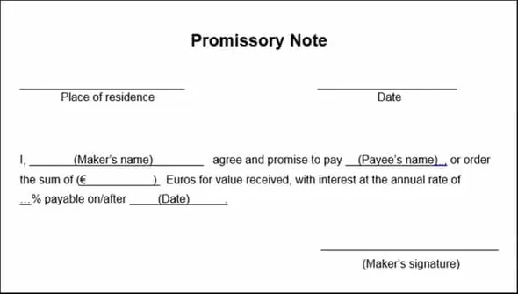
Promissory note

Slide 30
Characteristics of a Promissory Note
It is a written document.
There must be a clear and unconditional promise to pay a certain sum to a specified person or on-demand.
It must be drawn and duly signed by the maker.
It must be properly stamped.
It specifies the name of the maker and payee
The amount to be paid must be certain, given in both figures and words.
Payment is to be made in the country’s legal currency.

Slide 31
Parties to Promissory Note
Drawer: The one who makes the promise to another, to pay the debt is the drawer of the instrument. He/She is the debtor or borrower.
Drawee: The one, in whose favour the note is drawn is the drawee. He/She is the creditor who provides goods on credit or lender, who lends money.
Payee: The one, to whom payment is to be made is the payee of the negotiable instrument.

Slide 32
Bill Of Exchange
A bill of exchange is a written order used primarily in international trade that binds one party to pay a fixed sum of money to another party on demand or at a predetermined date.

Slide 33
Bill Of Exchange
Section-5
A “ Bill of Exchange” is an instrument in writing containing an unconditional order, signed by the maker directing a certain person to pay [ on demand or at a fixed or determinable future time] a certain sum of money only to , or to the order of , a certain person or to the bearer of the instrument.

Slide 34
Characteristics of a Bill of Exchange
It is important to have a bill of exchange in writing
It must contain a confirm order to make a payment and not just the request
The order should not have any condition
The bill of exchange amount should be definite
Fixed date for the amount to be paid
The bill must be signed by both the drawee and the drawer
The amount stated on the bill should be paid on-demand or on the expiry of a fixed time
The amount is paid to the beneficiary of the bill, specific person, or against a definite order

Slide 35
Parties involved in Bills of Exchange
A bill of exchange may involve the following parties
Drawer This is the person who writes and signs the bill.
Drawee This is the person on whom the bill is drawn.
Acceptor This is the person who accepts the bill. In practice, the drawee is the acceptor but a third person may accept a bill on behalf of the drawee.
Payee This is the person to whom the money stated in the bill is payable. He may be the drawer or any other person to whom the bill has been endorsed.
Holder This is the person who is in the possession of the bill, after being drawn. He/She may be the original payee, endorsee and bearer in case of a bearer bill.
Endorser The person, either the drawer or holder, who endorses the bill to any one by signing on the back of it is called an endorser.
Endorsee He/She is the person in whose favor the bill is endorsed.

Slide 36
Parties involved in Bills of Exchange
Drawee in case of need This is a person who is introduced at the option of the drawer. Any endorser may insert the name of such person, and the effect of it is that a resort may be had to him in case the bill is dishonored for non-acceptance or non-payment or in any other need.
Acceptor for honour The person who may voluntarily become a party to a bill as acceptor in the event of the refusal by original drawee to accept the bill if demanded by the notary. The acceptor for honor offers to accept the bill supra protest* with a view to safeguard the honor or prestige of the original drawer or any other endorser, as the case may be. This happens when the bill gets dishonored and a formal certificate of dishonor, known as protest, is issued by the Notary Public to the holder of a bill in question. Hence the term supra protest.
* This happens when the bill gets dishonored and a formal certificate of dishonor, known as protest, is issued by the Notary Public to the holder of a bill in question. Hence the term supra protest.

Slide 37
Parties involved in Bills of Exchange
It is not necessary that all the above mentioned parties are involved in one bill of exchange. Usually there are three parties to a bill of exchange. They are
Drawer,
Drawee, and;
Payee.
It is also not necessary that three separate persons should answer to the description of drawer, drawee, and payee. Depending upon the situation one person may fill any two of three positions. Accordingly, drawer and payee may be the same person. For instance, when the bill is drawn as ‘pay to me or my order‘, drawer and drawee may be the same person. Similarly, when a principal draws a bill on his agent or upon himself, drawee and payee may be the same person.

Slide 38
Bill Of Exchange
.
Bill Of Exchange

Slide 39
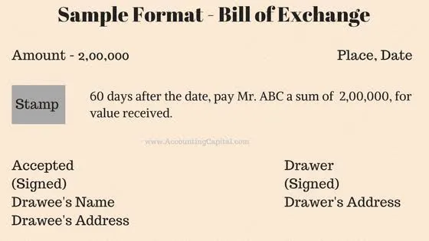
Bill Of Exchange

Slide 40
Cheque
Cheques are the backbone of the banking industry and is still a very important negotiable instrument in the country.
A cheque, or check (American English), is a document that orders a bank to pay a specific amount of money from a person's account to the person in whose name the cheque has been issued.

Slide 41
Cheque
Section-6
A “ cheque” is a bill of exchange drawn on a specified banker and not expressed to be payable otherwise than on demand.

Slide 42
Characteristics of a Cheque
It must be in writing.
It must contain an express order to pay.
The order to pay must be definite and unconditional.
It must be signed by the drawer.
The sum contained in the order must be certain sum.
The order must be to pay money only.
Three parties (drawer, drawee and payee) must be certain.
It is always drawn upon a specified banker.
It is always payable on demand.

Slide 43
Parties to a ‘Cheque’
Drawer: Drawer is person who draws the cheque that is the account holder of the bank.
Drawee: Drawee is the drawer’s banker on whom the cheque is drawn.
Payee: The person who is entitled to receive the payment of money of a cheque.

Slide 44
Parties to a ‘Cheque’
Section-7
“Drawer”, “Drawee”: The maker of a bill of exchange or cheque is called the “Drawer.” The person directed to pay is called the “Drawee.”
“Drawee in case of need,”- When in the bill or in any endorsement thereon the name of any person is given in addition to the drawee to be resorted to in case of need, such person is called a “drawee in case of need”.
“Acceptor”- After the drawee of a bill has signed his assent upon the bill, or, if there are more parts therof than one, upon one os such parts, and delivered the same, or given notice of such signing to the holder or to some person on his behalf, he is called the “acceptor”.
Payee: The person who is entitled to receive the payment of money of a cheque.

Slide 45
Parties to a ‘Cheque’
Section-7
“Acceptor for honour”- When a bill of exchange has been noted or protested for non-acceptance or for better security after the drawee of a bill has signed his assent upon, and any person accepts it supra protest for honour of the drawer or of any one of the endorsers, such person is called an “acceptor for honour”.
Payee: The person named in the instrument, to whom or to whose order the money is by the instrument directed to be paid, is called the “payee.”

Slide 46
Holder
Section-8
The “holder” of a promissory note, bill of exchange or cheque means the payee or endorsee who is in possession of it or the bearer thereof but does not include a beneficial owner claiming through a benamidar. “Holder”

Slide 47
Having requisites but not a holder
A minor;
A thief or a finder of bill;
Who has not acquired possession in a lawful manner;
Where endorsements are given for collection of the ‘Bill of Exchange’, the endorse is not a holder; and
A bank, receiving a cheque payable to order without endorsement on all other bank, is not a holder

Slide 48
Holder in due course
Section-9
“Holder in due course” means any person who for consideration becomes the possessor of a ‘Promissory Note’, ‘Bill of Exchange’ or ‘Cheque’ if payable to bearer, or the payee or endorsee thereof if payable to order before it become overdue, without notice that the title of the person from whom he derived his own title was defective.”

Slide 49
Essential Conditions to Constitute a person a holder in due course
He should be a holder;
He should become the holder for valuable consideration;
He must have become the holder of the negotiable instrument before its maturity
He must take the negotiable instrument complete and regular on the face of it:
He must have become holder in good faith

Slide 50
Privileges of a holder in due course
Instrument purged (get rid of) of all defects;
Rights not effected in case of inchoate instrument;
All prior parties liable
Can enforce payment of a fictitious bill
No effect of conditional delivery

Slide 51
Payment in due course
Section-10
“Payment in due course means payment in accordance with apparent tenor of the instrument in good faith and without negligence to any person in possession thereof under circumstances which do not afford a reasonable ground for believing that he is not entitled to receive payment of the amount therein mentioned.”

Slide 52
Payment in due course
Essential Constituents
Payment is in agreement with the apparent tenor of instrument…
Payment is made in good faith & without negligence.
Payment is made to the person who possesses the instrument who is entitled as holder.
Which do not pay for a rational ground believing that he is not entitled to obtain payment.
Payment is made in money & money only.

Slide 53
Negotiation
When a Promissory Note, Bill of Exchange or Cheque is transferred to any person, so as to constitute that person the holder thereof, the instrument is said to be negotiated.
Section-14

Slide 54
Endorsement
Section-15
When the maker or holder of a negotiable instrument signs the same, otherwise than as such maker, for the purpose of negotiation, on the back or face thereof or on a slip of paper annexed thereto, or so signs for the same purpose a stamped paper intended to be completed as a negotiable instrument, he is said to indorse the same, and is called the “endorser”.

Slide 55
Types of endorsement
Blank endorsement.
Special or Full endorsement.
Conditional endorsement.
Restrictive endorsement.
Partial endorsement.
Facultative endorsement
Sans Frais Endorsement

Slide 56
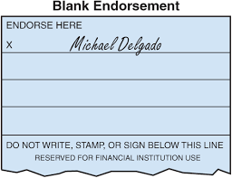
Blank Endorsement
A blank endorsement is a signature on a financial instrument such as a check. No payee is specified, so any holder of the instrument could claim payment.
If the endorser signs his name only, the endorsement is said to be “in blank”.
Section-16

Slide 57
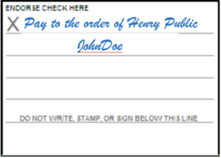
Full Endorsement
An endorsement “in full” or a special endorsement is one where the endorser puts his signature on the instrument as well as writes the name of a person to whom order the payment is to be made.
If the endorser adds a direction to pay the amount mentioned in the instrument to, or to the order of, a specified person, the endorsement is said to be “in full”.
Section-16
The person so specified is called the “endorsee” of the instrument.

Slide 58
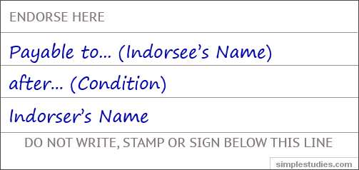
Conditional Endorsement
Section-52
If the endorser of a negotiable instrument, by express words in the endorsement, makes his liability, dependent on the happening of a specified event, although such event may never happen, such endorsement is called a ‘conditional’ endorsement.
Thus, endorsements can validly be made in the following terms:
(i) “Pay B or order on his marriage;”
(ii) “Pay B on the arrival of Pearless ship at Bombay.”

Slide 59
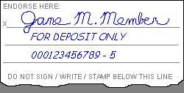
Restrictive Endorsement
Section-52
Restrictive endorsement seeks to put an end the principal characteristics of a Negotiable Instrument and seals its further negotiability. This may sound a little unusual, but the endorsee is very much within his rights if he so signs that its subsequent transfer is restricted.
This prevents the risk of unauthorized person obtaining payment through fraud or forgery and the drawer losing his money.
An example of a restrictive endorsement is the "For Deposit Only" stamp used by most companies on the back of a received check.

Slide 60
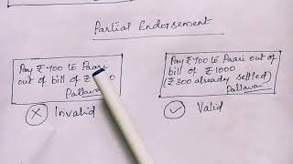
Partial Endorsement
Section-52
Restrictive endorsement seeks to put an end the principal characteristics of a Negotiable Instrument and seals its further negotiability. This may sound a little unusual, but the endorsee is very much within his rights if he so signs that its subsequent transfer is restricted. This prevents the risk of unauthorized person obtaining payment through fraud or forgery and the drawer losing his money.

Slide 61
Facultative Endorsement
An endorsement where the endorser extends his liability or abandons some right under a negotiable instrument, is called a facultative endorsement.
Generally the endorsee must give notice of dishonor of the instrument to the endorser.
In facultative endorsement the endorser waives this duty to the endorsee by writing on the endorsement ‘notice of dishonor waived’.

Slide 62
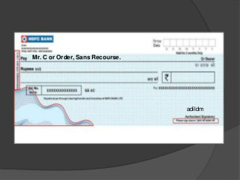
Sans Recourse Endorsement
Where the endorser does not want the endorsee or any subsequent holder, to incur any expense on his account on the instrument, the endorsement is ‘sans frais’.

Slide 63
Difference between figures and words
Section - 18
If the amount undertaken or ordered to be paid is stated differently in figures and in words, the amount stated in words shall be the amount undertaken or ordered to be paid.
Provided that if the words, are ambiguous or uncertain, the amount may be ascertained by referring to the figures.

Slide 64
Anti-Dating & Post Dating
A promissory note or bill of exchange or cheque is not invalid by reason only that it is ante-dated or post-dated.
Provided that the ante-dating or post-dating does not involve any illegal or fraudulent purpose or transaction.
Section – 21C

Slide 65
Liability of drawer
1) a) The drawer of a bill of exchange by drawing it engages that on due presentment it shall be accepted and paid according to its tenor, and that if it be dishonored, he will compensate the holder or any endorser who is compelled to pay it; and
b) The drawer of a cheque by drawing it engages that in the case of dishonor by the drawee he will compensate the holder;
Provided that due notice of dishonour of the bill or cheque has been given to or received by the drawer as hereinafter provided.
2) The drawee of a bill of exchange is not liable thereon until acceptance in the manner provided by this act.
Section – 30

Slide 66
Liability of Drawee of a cheque
The drawee of a cheque having sufficient funds of the drawer in his hands properly applicable to the payment of such cheque must pay the cheque when duly required so to do, and, in default of such payment, must compensate the drawer for any loss or damage caused by such default.
Section – 31

Slide 67
Question? Question?? Question???
What are the consequence of wrongful dishonor of a cheque.

Slide 68
Legal Effects of Wrongful Dishonour
NI Act 1881 (Article 31)
Davidson VS Barclays Bank
Financial Loss
Goodwill Loss
Civil & Criminal Crime
Cheque Amount was £16
Compensation was £250
Who Will Get Compensation?

Slide 69
Cheque payable to order
Section – 85
1.“Where a Cheque payable to order purports to be endorsed by or on behalf of the payee, the drawee is discharged by payment in due course.”
2.“Where a Cheque is originally expressed to be payable to the drawee is discharged by payment in due course to the bearer thereof, notwithstanding and endorsement whether in full or in blank appearing thereon and notwithstanding that any such endorsement purports to restrict or exclude further negotiation.”

Slide 70
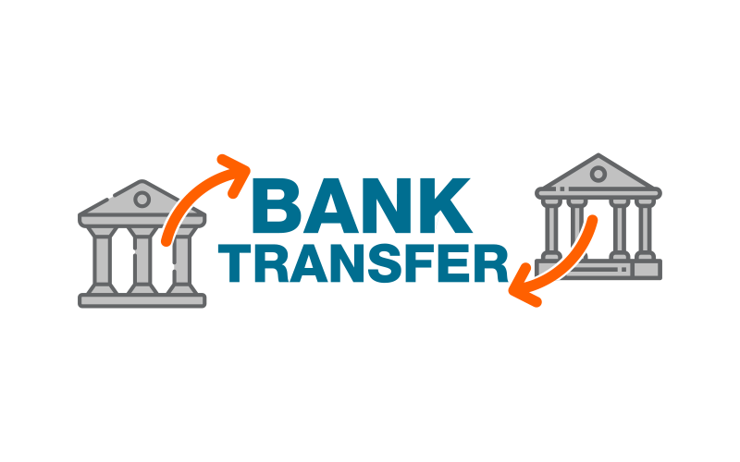
Drawn by one branch of a bank on another
Section – 85A
Where any draft, that is, an order to pay money drawn by one office of the same for a sum of money payable to order on demand purports to be endorsed by or on behalf of the payee, the bank is discharged payment in due course.”

Slide 71
Effect of Material Alteration by endorse
Section – 87
Any material alteration of a Negotiable instrument renders the same void as against anyone who is a party there to at the time of making such alteration and does not consent there to unless it was made in order to carry out the common intention of the original parties.
And any such alteration if made by an endorse discharges his endorse from all liability to him in respect of the consideration thereof.

Slide 72
Materials Or Non material
Materials Parts
Non material alteration
Date
Payee’s name
Courtesy amount (amount in figures)
Legal amount (amount in words)
Signature of the drawer
filling up of incomplete instrument (sec 20)
Conversion of blank endorsement into a special endorsement (section 49).
Qualifying or limiting an acceptance (section 86)
Crossing of a cheque by holder (section 125)

Slide 73
Revocation of Bankers Authority
Section – 122A
“The duty and authority of a banker to pay a Cheque drawn on him by his customer are determined by:-
Countermand of payment
Notice of the customers death, and
Notice of the adjudication of the customer as an insolvent.

Slide 74
Cheque Crossed Generally
Section – 123
Where a cheque bears across its face an addition of the words ‘and company’ or any abbreviation thereof between two parallel transvers lines, or of two parallel transverse lines simply, either with or without the words ‘not negotiable’ , that addition shall be deemed a crossing and the cheque shall be deemed to be crossed generally.

Slide 75
Cheque Crossed A/C Payee
Section – 123A
(1) Where a Cheque crossed generally bears across its face an addition of the words “Account payee” between the two parallel transverse lines constituting the general crossing the Cheque, besides being crossed generally is said to be crossed “Account Payee.
(2) When a Cheque is crossed “Account Payee”
It shall cease to be negotiable; and
It shall be the duty of the banker collecting payment of the Cheque to credit the proceeds thereof only to the account of the payee named in the Cheque.

Slide 76
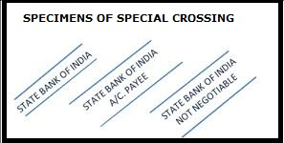
Cheque Crossed Specially
Section – 124
“Where a Cheque bears across its face an addition of the name of a banker, either with of without the words “not negotiable” that addition shall be deemed a crossing and the Cheque shall be deemed to be crossed specially and to be crossed to that banker.”

Slide 77
Crossing after Issue
Section – 125
Where a cheque is uncrossed, the holder may crossed it generally or specially .
Where a cheque is crossed generally the holder may cross it specially.
Where a cheque is crossed generally or specially the holder may add the words “Not Negotiable”.
Where a cheque is crossed specially the banker to whom it is crossed may again cross it specially to another banker his agent for collection.
When an uncrossed cheque, or a cheque crossed generally, is sent to a banker for collection, he may cross it specially to himself.

Slide 78
Crossing a material part of a cheque
Section – 125A
A crossing authorized by this act is a material part of a cheque, it shall not be lawful for any person to obliterate, or expect as authorized by this act, to add to or alter the crossing.

Slide 79
Section – 126
Payment of Cheque Crossed Generally
Payment of Cheque Crossed Specially
“Where a Cheque crossed generally, the banker on whom it is drawn shall not pay it otherwise than to a banker.”
“Where a Cheque is crossed specially, the banker on whom it is drawn shall not pay it otherwise than to the banker to whom it is crossed or his agent for collection.”

Slide 80
“A person taking a cheque crossed generally or specially bearing in either case the words ‘not negotiable’ shall not have and shall not be capable of giving a better title to the cheque than that which the person from whom he/she took it had.”
Section- 130
Cheque bearing “not negotiable”-

Slide 81
“Where a banker in good faith and without negligence receives payment for a customer of a Cheque crossed generally or specially to himself and the customer has no title or a defective title there to, the banker shall not incur any liability to the true owner of the Cheque by reason only of having received such payment.”
Section- 131
Non-liability of banker receiving payment of Cheque

Slide 82
Section- 131A
The provisions of this Chapter (i.e. relations to Cheque) shall apply to any draft, as defined in section 85A as if the draft were a Cheque.
Application of Chapter to drafts

Slide 83
Dishonor of Cheque for insufficiency of funds (Section-138)
Where any Cheque drawn by a person on an account maintained by him with a banker for payment of any amount of money to another person from out of that account for the discharge in whole or in part of any debt or other liability, is returned by the bank unpaid, either because of the amount of money standing to the credit of that account is insufficient to honor the Cheque or it exceeds the amount arranged to be paid from that account by an agreement made with the bank, such person shall be deemed to have committed an offence and shall without prejudice to any other provision of his Act, be punished with imprisonment for a term which may extend to one year, or with fine which may extend to thrice the amount of the Cheque, or with both:

Slide 84
Dishonor of Cheque for insufficiency of funds in the account (Section-138)
Provided that nothing contained in this section shall apply unless
The Cheque has been presented to the bank within a period of six mouths from the date on which it is drawn or within the period of its validity, whenever is earlier.
The payee or the holder in due course of the Cheque as the case may be, makes a demand for the payment of the said amount of money by giving a notice, in writings to the drawer of the Cheque as unpaid and
The drawer of such Cheque fails to make the payment of the said amount of money to the payee of as the case may be to the holder in due course of the Cheque, within thirty days of the receipt of the said notice.

Slide 85
Dishonor of Cheque for insufficiency of funds in the account (Section-138)
The Notice required to be several under clause (b) of subsection (1) shall be served in the following manner-
By delivering it to the person on whom it is to be served, or
BY sending it by registered post with acknowledgement due to that person at his usual or last known place of abode or business in Bangladesh; or
By publication in a daily Bangla Nation newspaper having wide circulation.

Slide 86
Offences of companies
Section – 140
If the person committing an offence under section 138 is a company, every person who, at the time the offence was committed, was in charge of, and was responsible to, the company for the conduct of the business of the company, as well as the company, shll be deemed to be guilty of the offence and shall be liable to be proceeded against and punished accordingly.

Slide 87
Cognizance of Offences- Section-141
Notwithstanding anything contained in the code of criminal procedure, 1898 (Act-V of 1898)
No court shall take cognizance of any offence punishable under section 138 except upon a compliant in writing made by the payee or as the case may be, the holder in due course of the Cheque;
Such compliant is made within one month of the date on which the cause of action arises under clause (c) of the proviso to section 138.
No court inferior to that of a metropolitan Magistrate or a Magistrate of the first class shall try any offence punishable under section 138.

Slide 88
Good for payment cheque
Good-for-payment cheques, which are otherwise called certified cheques, are guaranteed or endorsed cheques that will never bounce because their payment has been guaranteed by the concerned drawee bank.

Slide 89
Good for payment cheque
Cheque is endorsed at the request of the account-holder only after ensuring that the account has sufficient balance and the drawer of the cheque is genuine.
The signature or signatures of the account-holder or account-holders (in the case of joint accounts) is also verified before certifying the cheque.
The amount of the cheque is blocked so that the cheque will not bounce due to insufficient balance.
After completion of all the procedures, the cheque is handed over to the payee or beneficiary.

Slide 90
Good for payment cheque
As such, a good-for-payment cheque is guaranteed for payment. Hence the name. The drawee bank has full liability for the cheque
As such, a good-for-payment cheque is guaranteed for payment. Hence the name. The drawee bank has full liability for the cheque.
The intention behind a good-for-payment cheque is that the payee or beneficiary gets the payment without fail
As per the latest NRB directive, the signatures of two officials and the stamp of the bank or financial institution (BFI) are required to issue good for payment cheques.

Slide 91
Question! Question!! Question!!
When a bank put “Received Payment” endorsement in a cheque?

Slide 92
Question! Question!! Question!!
Can a collecting banker collect a cheque in the personal A/C of the proprietor which is payable to the firm?

Slide 93
Question! Question!! Question!!
i) A bearer cheque and the payee is self,
ii)Payee is a firm or company or proprietor of the firm;
-Can the above cheque deposited in any customer’s A/C for collection? How??

Slide 94
Question! Question!! Question!!
Can a paying banker pay a crossed cheque over the counter? How??

Slide 95
Question! Question!! Question!!
Mr. Kalam is one of the directors of a Ltd. Company issued a cheque duly signed & also company secretary placed for payment in the meantime it is reported that ‘Kalam’ has died,
Can a bank honour the cheque?

