Slide 1
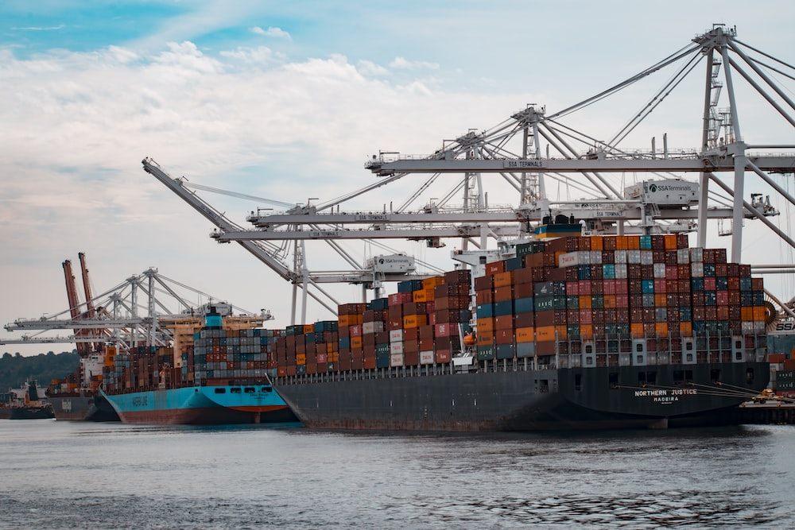
Foreign Trade Financing:
Import Financing
Prepared By
Sharmin Rahman
Principal Officer
Rupali Bank Training Academy

Slide 2
Credit means any arrangement, however named or described, that is irrevocable and thereby constitutes a definite undertaking of the issuing bank to honour a complying presentation. (Article-2, UCP-600)
Types of LC based on Payment Mode
#LC available at Sight
#LC available by deferred payment
#LC available by Acceptance:

Slide 3
Types of LC based on nature
Revolving Credit
Red Clause Credit (Advance to cover the costs of purchasing raw materials, processing, and packaging of goods)
Green Clause Credit (Advance a step further by also taking pre-shipment warehousing at the port of origin and insurance into account)
Stand by Letter of Credit (An instrument typically issued by a bank which undertakes to pay one party to a contract (the beneficiary) when the other party has failed, or is alleged to have failed, to perform the contract.)
Transferable credit
Back to Back LC
Usance but Payable At Sight (UPAS) LC

Slide 4
LC Categorization by Bangladesh Bank
Cash LC (Sight)-01
2. Cash LC (Usance)-02
3.Inland Back to Back LC (Sight)-03
4.Inland Back to Back LC (Usance)-04
5.Foreign Back To Back LC (Sight) -05
6.Foreign Back To Back LC (Usance) -06
7.L/C under Aid/Loan-07
8.L/C under Special Trading Arrangement-08
9.Import from EPZ cash L/C sight- 09
10.Import from EPZ cash L/C Usance- 10
11.Import from EPZ Back to Back (Sight) – 11
12.Import from EPZ Back to Back (Usance) – 12
13.Local Contract (DP)- 13
14.Local Contract (DA)-14
15.Foreign Contract (DP)- 15
16.Foreign Contract (DA)- 16
17.Import by EPZ Country from EPZ company (Sight) -17
18.Import by EPZ Country from EPZ company (Usance)

Slide 5
19.Import by EPZ company from outside EPZ within country (Sight)- 19
20.Import by EPZ company from outside EPZ within country (Usance)- 20
21.Import by EPZ company country (Sight)- 21
22.Import by EPZ company country (Usance)- 22
23.Import deemed exporting manufacturing unit under EDF facility-23
24.Foreign Back to Back LC by EPZ (Sight)-24
25.Foreign Back to Back LC by EPZ (Usance)-25
26.Import from Bangladesh by EPZ companies under BTB LC (Sight)
27.Import from Bangladesh by EPZ companies under BTB LC (Usance)
28.Other (L/C) -99

Slide 6
Import Finance
An import Loan is a short-term cash advance (with recourse) that enables the customer as an importer to meet the customers immediate payment obligations under a sight or usance Letter of Credit presentation or Import Documentary Collection.

Slide 7
1.Payment Against Documents (PAD)
PAD is a kind of Post Shipment Import Trade Finance given by the Bank to the Importer. After receiving the concerned bill from the Bank, the Issuing Bank has to check the documents very carefully within a stipulated time If the bank founds those without any discrepant, the bill has to be lodged and debit PAD A/C, which is the direct liability of the Importer.
#Maximum Tenure: 21 Days
#Interest Rate: SMART+ 3% from the date of creation.
Accounting procedure
Dr. PAD A/C
Cr. HO/Treasury
Reversal of L/C liability
Dr. Bank Liability L/C (cash sight)
Cr. Customer Liability LC (cash sight) [i.e. Contingent Liability, at the time of issuing L/C, now being reversed]
. Shipping documents are to be held with AD until PAD is adjusted by the importer with interest
After debiting PAD A/C bank has to inform the Importer & also to advise him to ‘Retire the bill’ within stipulated time

Slide 8
2. Loan against Imported Merchandise (LIM)
LIM is the short-term demand loan to the Importer, the
importer can retire the bill within their sanction limit
followed by terms and condition from the bank paying certain
amount of bank interest. In LIM, after releasing the goods
from the Customs authority, the possession of the goods
remains with the Bank i.e. under bank‟s lock & key.
.Maximum Tenure: Industrial- 60 days, Commercial-45 Days
.Interest Rate: SMART+3%
Accounting:
Dr. LIM A/C ( In the name of Importer)
Cr. PAD A/C
LIM may be created in two ways:
LIM at the request of Importer retaining margin prescribed on Landed cost
Forced LIM

Slide 9
If the importer is not in a position to retire the bill on cash,
He/ She may apply for LIM. Under the approval of
competent authority, the importer may be allowed to retire the PAD through LIM keeping sufficient margin on Landed Cost of the goods.
The branch must obtain the following charge documents before allowing LIM
i) D.P. Note (CF-1,2)
ii) Letter of arrangement (Appendix 8J)
iii) Letter of disbursement (Appendix 8K)
iv) Letter of Pledge
v) Letter of indemnity (CF-24) [Appendix 8H]
vi) Letter of continuity (CF-11) [Appendix 8B]
Vii )Letter of Disclaimer

Slide 10
Forced LIM
When the importer does not come to the Bank for retiring the Bill, Bank has to clear the imported goods from the Customs authority under bank‟s authority by creating a Lim A/C in the name of the importer, which is known as Forced Lim. Before creating Forced Lim, bank has to calculate the “Landed cost‟ and to determine the value of the imported goods
Interest Rate: SMART+3%

Slide 11
Loan against Trust Receipt (LTR)
LTR is Post Shipment Import Trade finance‟ given by the Bank to the Importer. Difference is, in LIM, the possession of the released goods remains under bank‟s control but in LTR, the Goods remains with the Importer. But he is holding the goods not as their owner but as an agent for the Bank.
Securities:
1. The Letter of Trust Receipt.
2. Other sufficient Securities.
Maximum Tenure: Industrial- 120 days
Interest Rate: SMART+3%
Accounting procedure:
Dr. LTR A/C
Cr. PAD A/C

Slide 12
At times import documents are handed over to the importer by allowing loan facility against Trust Receipt for clearance of goods Trust Receipt (CF-18) is a document of undertaking duly stamped and signed by the importer where importer undertakes clearly to hold the goods or the sale proceeds in trust for the bank till the loan allowed against Trust Receipt is adjusted.
The following documents must be obtained before allowing LTR to importer:
i) Application of importer for LTR in company letter head
ii) D. P. Note (CF-1,2)
iii) Letter of continuity (CF-11)
iv) Trust Receipt (CF-18)
v) Letter of Arrangement (Appendix 8J)
vi) Letter of disbursement (Appendix 8K)
Source: Operation Manual on Foreign Trade Financing (RBL).

Slide 13
Penal Interest
Additional 2.00% p.a shall be charged if the importer
fails to retire the bill within stipulated time.

Slide 14
বিআরপিডি সার্কুলার লেটার নং-১২ তারিখ ২৬ এপ্রিল ২০২২ অনুযায়ী-
সংজ্ঞাঃ নিত্য প্রয়োজনীয় ভোগ্যপণ্য বা ট্রেডিং পণ্য, শিল্পের কাঁচামালসহ ইত্যাদি বিভিন্ন খাতে আমদানি দায় পরিশোধের নিমিত্ত প্রদত্ত সকল প্রকার ফান্ডেড ঋণ সুবিধাসমূহ LTR/LATR/MTR/MPI ইত্যাদি যে নামেই অভিহিত করা হোক না কেন এসকল ঋণসমূহ বাংলায় “আমদানি পরবর্তী অর্থায়ন” এবং ইংরেজিতে “Post Import Financing(PIF)” নামে অভিহিত হবে। তবে ইডিএফ খাতে প্রদত্ত অর্থায়ন PIF- এর আওতাভুক্ত হবে না। এক্ষেত্রে ইডিএফ সংক্রান্ত সংশ্লিষ্ট নীতিমালা অনুসরনীয় হবে।
খাত ও মেয়াদঃ গ্রাহকের চাহিদা, সংশ্লিষ্ট পণ্যের প্রকৃতি এবং উৎপাদন/বিপণন চক্রের সাথে সঙ্গতি রেখে PIF এর মেয়াদ ব্যাংকার- গ্রাহক সম্পর্কের ভিত্তিতে নির্ধারিত হবে, তবে এরূপ মেয়াদ নিম্নবর্ণিত মেয়াদের অধিক হবে নাঃ
ক) নিত্য প্রয়োজনীয় ভোগ্যপণ্যের ক্ষেত্রে (যেমনঃ চাল, ডাল, পেঁয়াজ, রসুন, মসলা, ভোজ্যতেল ইত্যাদি) PIF সৃষ্টির তারিখ হতে অনধিক ৯০(নব্বই) দিন;
খ) নিত্য প্রয়োজনীয় ভোগ্যপণ্য ব্যতীত অন্যান্য ট্রেডিং পণ্যের ক্ষেত্রে PIF সৃষ্টির তারিখ হতে অনধিক ১২০ দিন;
গ) কৃষিখাতের আমদানিকৃত পণ্য (যেমনঃ সার, বীজ, কীটনাশক ইত্যাদি) ও কৃষি যন্ত্রপাতি/ মেশিনারিজ এবং প্রানিজ খাতের আমদানিকৃত পণ্য সমূহের ( যেমনঃ মৎস্যসহ গৃহপালিত পশু-পাখির প্রয়োজনীয় পুষ্টি উপকরণ, ভ্যাকসিন, ঔষধ ইত্যাদি) ক্ষেত্রে PIF সৃষ্টির তারিখ হতে অনধিক ১৮০ দিন;
ঘ) শিল্পের কাঁচামালের ক্ষেত্রে PIF সৃষ্টির তারিখ হতে অনধিক ২১০ দিন।

