Slide 1
Nexia Bangladesh
Training Session
on
How to prepare and present the accounts and reports of a public sector Bank to qualify for BPA Award & Disclosure Requirements

Slide 2
Nexia in Bangladesh
MASUD ALAM CHOWDHURY, ACA, MBA (IBA, DU)
Partner
Nexia in Bangladesh (MABS & J Partners)

Slide 3
Nexia in Bangladesh
Role of ICAB
An Autonomous Body established under the Bangladesh Chartered Accountants Order, 1973 (President's Order No. 2 of 1973) for the purpose of regulating the profession of accountants and for matters connected therewith.
Regulate the Profession of Accountants and matters connected herewith
Administer its members and students
Ensure professional ethics and the code of conduct
Provide specialized and professional training in Accounting, Auditing. Taxation, Corporate Laws, Management Consultancy, Information Technology, and related subjects
Impart Continuing Professional Development (CPD) to members
Foster acceptance and observance of IAS/IFRS ISA/IAPS in Bangladesh.
Keep abreast of the latest developments in accounting techniques, audit methodology, information technology, management consultancy, and related fields and;
Liaise with international and regional organizations to strengthen mutual cooperation
Page # 02

Slide 4
Nexia in Bangladesh
Role of ICMAB
The Institute of Cost and Management Accountants of Bangladesh (ICMAB) is a statutory organization constituted by the Government under The Cost and Management Accountants Ordinance 1977 (Ordinance No Llll of 1977) and regulated under the Cost and Management Accountants Regulations 2019. Thereafter The Cost and Management Accountants Ordinance 1977 has been replaced by the Cost and Management Accountants Act 2018 (Act No. LXX of 2018), published in the official Gazette on 14 November 2018. It is a member of leading regional and global accounting bodies including International Federation of Accountants (IFAC).
ICMAB is the national body of the professional Cost and Management Accountants of Bangladesh. Established with the prime objective of promoting and regulating the Cost and Management Accounting profession in the country.
Page # 03

Slide 5
Nexia in Bangladesh
Role of ICSB
Institute of Chartered Secretaries of Bangladesh (ICSB) was established under an Act of Parliament i.e. Chartered Secretaries Act 2010 is the only recognized professional body to develop, promote and regulate the profession of Chartered Secretary in Bangladesh.
Company Secretary is a statutory officer under the Companies Act 1994. According to Bangladesh Securities and Exchange Commission (BSEC) all the listed companies should have a Company Secretary. Company Secretary is the compliance officer of the company, who has to interact, coordinate, integrate and co-operate with various other functional heads in a company maintains communications with the Board of Directors and coordinates with various authorities and the Board.
Page # 04

Slide 6
Nexia in Bangladesh
Role of Bangladesh Bank
Bangladesh Bank, the central bank and apex regulatory body for the country's monetary and financial system, was established as a body corporate vide the Bangladesh Bank Order, 1972 (P.O. No. 127 of 1972) with effect from 16th December, 1971. BB performs all the core functions of a typical monetary and financial sector regulator, and a number of other non core functions. The major functional areas include :
Formulation and Implementation of Monetary And Credit Policies.
Regulation and Supervision of Banks and Non-Bank Financial Institutions, Promotion and Development of Domestic Financial Markets.
Management of the Country's Foreign Currency Reserves.
Issuance of Currency Notes.
Regulation and Supervision of the Payment System.
Acting As Banker to the Government.
Money Laundering Prevention.
Collection and Furnishing of Credit Information, commonly called as CIB Report.
Implementation of The Foreign Exchange Regulation Act.
Managing a Deposit Insurance Scheme .
Page # 05

Slide 7
Nexia in Bangladesh
Role of BSEC
The regulator of the country’s capital market under the provision of Bangladesh Securities and Exchange Commission Act 1993. Purpose of the BSEC is to protect the interest of investors in securities, develop the securities market and make rules for matters connected therewith. BSEC is an ‘A’ category member of International Organization of Securities Commissions (IOSCO) since 22 December 2013. Main functions are:
Regulating the business of the Stock Exchanges or any other securities market.
Registering and regulating the business of stock-brokers, sub-brokers, share transfer agents, merchant bankers and managers of issues, trustee of trust deeds, registrar of an issue, underwriters, portfolio managers, investment advisers and other intermediaries in the securities market
Registering, monitoring and regulating of collective investment scheme including all forms of mutual funds.
Monitoring and regulating all authorized self regulatory organizations in the securities market.
Prohibiting fraudulent and unfair trade practices relating to securities trading in any securities market.
Promoting investors’ education and providing training for intermediaries of the securities market.
Prohibiting insider trading in securities.
Regulating the substantial acquisition of shares and take-over of companies.
Undertaking investigation and inspection, inquiries and audit of any issuer or dealer of securities, the Stock Exchanges and intermediaries and any self regulatory organization in the securities market.
Conducting research and publishing information.
Page # 06

Slide 8
Nexia in Bangladesh
Role of FRC
Financial Reporting Council (FRC) is a key requirement of the Financial Reporting Act, passed by the parliament in 2015. It is largely viewed as an instrument for restoring public confidence in the capital market. FRC is leading to the significant improvement in the quality of audit and audit report consequently ensure greater financial reporting transparency.
FRC's function involves setting of accounting and auditing standards and monitoring the activities of professional accountants.
Page # 07

Slide 9
Nexia in Bangladesh
Role of SAFA
South Asian Federation of Accountants (SAFA) was formed in the year 1984 to serve the accountancy profession in the South Asian Region and uphold its eminence in the world of accountancy. SAFA as an IFAC network Partner represents over 4,50,000 accountants having membership of the national chartered accountancy and cost and management accountancy institutions in the South Asian countries namely Bangladesh, India, Maldives, Nepal, Pakistan and Sri Lanka, Afghanistan. SAFA came into existence at the initiative of the accounting professional bodies in the South Asian Region, which has a bond of culture and homogeneity of professional environment.
South Asian Federation of Accountants (SAFA) is the apex body of professional accountants within SAARC region comprising professional accounting organizations. Every year SAFA organizes conferences in member countries.
Page # 08

Slide 10
Nexia in Bangladesh
WINNERS OF THE LAST BPA AWARD GIVEN BY ICAB

Slide 11
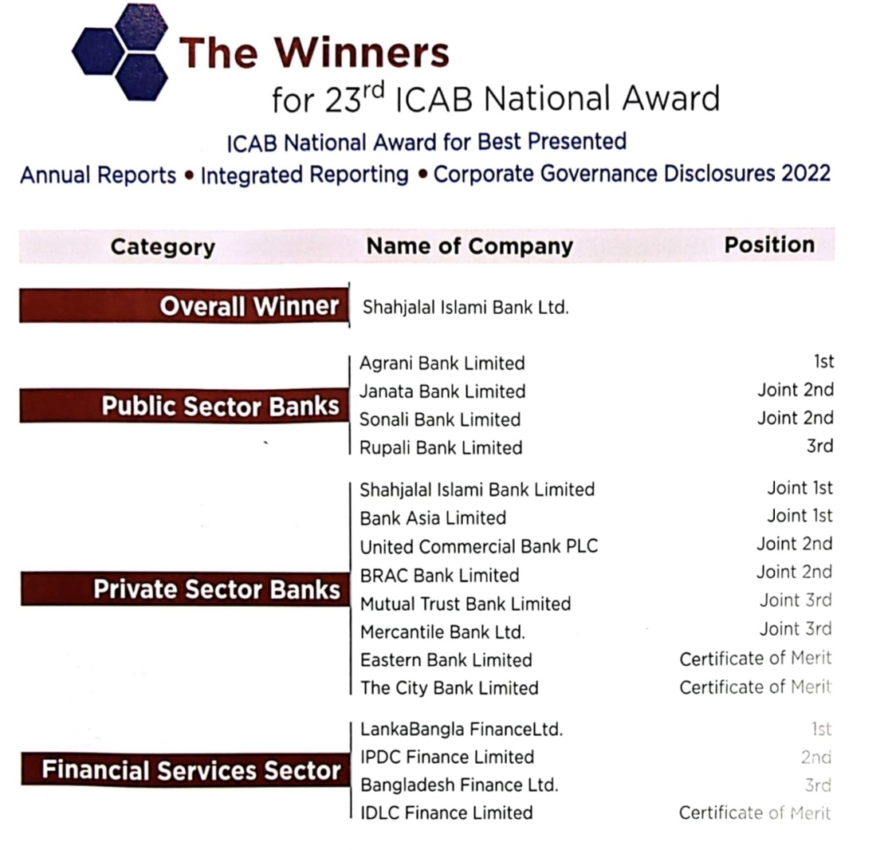
Nexia in Bangladesh
Page # 09

Slide 12
Nexia in Bangladesh
Allocation of Marks for the Best Presented Accounts and Reports
Corporate Objectives, Values & Structure | 5.00
Management Report/ Commentary and Analysis including Director’s Report/ Chairman’s Review/CEO’s Review etc. | 11.00
Sustainability Reporting | 13.00
Appropriateness of Disclosure of Accounting Policies and General Disclosure | 11.00
Financial Statements (Including Formats) | 18.00
Information about Corporate Governance | 11.00
Risk Management & Control Environment | 11.00
Stakeholders Information | 3.00
Graphical / Pictorial Data | 2.50
Horizontal/ Vertical Analysis | 5.00
Profitability/Dividends/ Performance and Liquidity Ratios | 5.00
Statement of Value Added and its Distribution | 5.00
Presentation of Financial Statements | 5.00
Timeliness in issuing Financial Statements and holding AGM | 10.00
Additional Disclosures | 4.50
Specific Areas for Banking Sector | 20.00
Total | 140.0
Page # 10

Slide 13
Nexia in Bangladesh
Weaknesses identified in the Existing Report of Ruplai Bank PLC
Corporate Objectives, Values & Structure |  | 15% improvement is required
Management Report/ Commentary and Analysis including Director’s Report/ Chairman’s Review/CEO’s Review etc. |  | 20-25% improvement is required
Sustainability Reporting |  | 30% improvement is required
Appropriateness of Disclosure of Accounting Policies and General Disclosure |  | 3-5%improvement is required
Financial Statements (Including Formats) |  | 5% improvement is required
Information about Corporate Governance |  | 13-15%improvement is required
Risk Management & Control Environment |  | 15-20%improvement is required
Stakeholders Information |  | 0% improvement is required
Graphical / Pictorial Data:
Horizontal/ Vertical Analysis
Profitability/Dividends/ Performance and Liquidity Ratios
Statement of Value Added and its Distribution |  | 2% improvement is required
Presentation of Financial Statements |  | 30% improvement is required
Timeliness in issuing Financial Statements and holding AGM |  | 100% improvement is required
Additional Disclosures |  | 45% improvement is required
Specific Areas for Banking Sector |  | 15% improvement is required
Page # 34

Slide 14
Nexia in Bangladesh
WHY PRESENTATION OF THE FINANCIAL STATEMENTS IS MOST IMPORTANT FOR A BANK?

Slide 15
Nexia in Bangladesh
WHY PRESENTATION OF THE FINANCIAL STATEMENTS IS MOST IMPORTANT FOR A BANK?
The presentation of accounts and reports is crucial for a banking company because it provides transparency and clarity about its financial health. Stakeholders, including investors and regulatory bodies, rely on these documents to assess the bank's performance, risk management, and compliance with regulations. Accurate and well-presented financial information fosters trust, helps in decision-making, and ensures the stability of the banking sector.
Investor Confidence: Clear and comprehensive financial reports instill confidence in investors. They can assess the bank's profitability, asset quality, and overall financial stability, influencing their decisions to invest or divest.
Regulatory Compliance: Banking companies must adhere to strict regulations. Properly presented reports exhibit compliance with regulatory requirements, helping the institution to avoid penalties and maintain a good standing with regulatory bodies.
Risk Management: Detailed and well presented financial statements enable the identification and assessment of risks. This information is vital for both internal management and external stakeholders to understand the potential challenges the bank may face and how well it is equipped to handle them.
Continue
Page # 11

Slide 16
Nexia in Bangladesh
WHY PRESENTATION OF THE FINANCIAL STATEMENTS IS MOST IMPORTANT FOR A BANK?
Credit Rating Agencies: Credit rating agencies rely heavily on financial reports to assign credit ratings to banking institutions. Higher credit ratings can positively impact the bank's ability to borrow at favorable rates and attract investors. This enhances the confidence of corresponding banks in overseas.
Strategic Decision-Making: Bank executives use financial reports to make informed strategic decisions. Whether expanding services, entering into new markets, or implementing cost-saving measures, a clear understanding of financial performance is crucial for such decision making.
Market Perception: Perception in the financial markets is influenced by the well presented and well disclosed financial information. Positive reports can enhance the bank's image and competitiveness, attracting good customers and partners.
Statutory Auditing: Finally, statutory auditors express their independent audit opinion based on the preparation and presentation of financial statements.
In summary, the presentation of accounts and reports serves as a vital communication tool, influencing the perceptions and decisions of various stakeholders, from investors and regulators to customers and the broader financial community.
Page # 12

Slide 17
Nexia in Bangladesh
QUALITY OF THE BEST PRESENTED ACCOUNTS AND REPORTS OF A BANK

Slide 18
Nexia in Bangladesh
Quality of the reliable accounts and reports of a bank
Usually to evaluate the best published accounts of a bank, consider the following factors:
Financial Performance: Assess key financial indicators like profitability, liquidity, and solvency. Analyze trends over multiple periods for a comprehensive view.
Transparency: Look for clear and transparent disclosure of financial information. A comprehensive breakdown of assets, liabilities, and risk factors is crucial
Compliance: Verify adherence to regulatory standards and accounting principles. Ensure that the bank follows industry-specific guidelines.
Risk Management: Evaluate how well the bank identifies, assesses, and manages risks. This includes insights into credit risk, market risk, and operational risk.
Corporate Governance: Examine the governance structure, including the board's independence, qualifications, and the effectiveness of internal controls.
Continue
Page # 13

Slide 19
Nexia in Bangladesh
Quality of the reliable accounts and reports of a bank
Strategic Initiatives: Understand the bank's strategic direction and initiatives. Evaluate how well these align with industry trends and economic conditions.
Stability and Resilience: Assess the bank's ability to withstand economic downturns or financial shocks. Look at capital adequacy and stress-testing results.
Social Responsibility: Consider the bank's commitment to social and environmental responsibility. Corporate social responsibility initiatives can reflect positively on its reputation.
Comparative Analysis: Compare the bank's performance and practices with industry peers. Benchmarking can provide valuable insights.
Auditor's Opinion: Consider the opinion of the external auditors. A clean audit opinion indicates a higher level of confidence in the published accounts.
By examining these aspects, you can form a comprehensive view of a bank's financial health and the quality of its published accounts.
Page # 14

Slide 20
Nexia in Bangladesh
DISCLOSURE REQUIREMENTS

Slide 21
Nexia in Bangladesh
Presentation and Format
Consistency: Ensure that the presentation and format of disclosures are consistent with prior periods.
Clarity: Disclosures should be clear and understandable for stakeholders.
Comparability: Financial statements should allow for comparison with previous periods and other banks.

Slide 22
Nexia in Bangladesh
General Information
Statement of Financial Position
Assets
Cash and Cash Equivalents: Detail of cash, balances with central banks, and other short-term liquid investments.
Loans and Advances: Breakdown of loans by type, sector, and geographical distribution.
Investments: Classification between held-to-maturity, available-for-sale, and trading.
Fixed Assets: Property, plant, and equipment, including valuation method and depreciation policies.
Intangible Assets: Goodwill, software, and other intangible assets.
Other Assets: Includes receivables, prepayments, and any other significant assets.

Slide 23
Nexia in Bangladesh
Liabilities
Deposits: Breakdown of demand, savings, and term deposits by type and maturity.
Borrowings: Details of borrowings from other banks and financial institutions.
Other Liabilities: Includes accrued expenses, provisions, and any contingent liabilities.
Statement of Comprehensive Income
Interest Income: Breakdown of interest income from loans, investments, and other sources.
Interest Expense: Costs associated with deposits and borrowings.
Net Interest Income: Interest income minus interest expense.
Fee and Commission Income: Breakdown of income from service fees, commissions, and transaction charges.
Other Income: Includes trading income, investment income, and any other relevant income.
Operating Expenses: Detailed breakdown of administrative expenses, salaries, and other operational costs.
Provisions for Loan Losses: Specific provisions and general provisions for impaired loans.
Tax Expense: Current and deferred tax expenses.

Slide 24
Nexia in Bangladesh
Significant Accounting Policies
Basis of Preparation: Statement of compliance with BFRS/IFRS.
Recognition and Measurement: Policies for recognition and measurement of financial assets and liabilities.
Impairment of Assets: Approach to assessing and accounting for impairments.
Revenue Recognition: Policy on recognition of interest income, fee income, and other revenue.
Foreign Currency Transactions: Translation policies and treatment of foreign currency gains and losses.
Employee Benefits: Accounting for pensions, bonuses, and other employee benefits.

Slide 25
Nexia in Bangladesh
Notes to Financial Statements
Segment Reporting: Information on different business segments and geographical areas.
Fair Value Measurements: Methods and assumptions used in fair value measurements.
Contingent Liabilities: Disclosure of potential liabilities that might affect financial statements.
Commitments: Any contractual obligations not recognized in the financial statements.
Related Party Transactions: Disclosures of transactions with related parties, including terms and balances.
Events After the Reporting Period: Significant events occurring after the reporting date.
Risk Management: Policies and disclosures related to credit risk, market risk, and liquidity risk.
Capital Adequacy: Details regarding the bank’s capital structure and adherence to regulatory requirements.

Slide 26
Nexia in Bangladesh
Regulatory Disclosures
Compliance with Bangladesh Bank Regulations: Any specific disclosures required by the central bank.
Basel Requirements: Information on capital adequacy, leverage ratio, and liquidity coverage ratio.
Audit Report: Independent auditor's report and any qualifications or emphasis of matter.
Other Disclosures
Corporate Governance: Information about the governance structure, board of directors, and committees.
Sustainability Reporting: Disclosure of environmental, social, and governance (ESG) factors, if applicable.

Slide 27
Nexia in Bangladesh
DETAILED GUIDELINES FOR BEING AWARDED BY ICAB/SAFA

Slide 28
Nexia in Bangladesh
Detailed Guidelines
Section A: Organizational Overview - Clarity and Presentation
Vision and Mission
Overall strategic objectives
Core values and code of conduct /ethical principles
Profile of the organization
Director’s profiles and their representation on Board of other organizations
Organization/Governing Structure & Group Structure
Continue
Page # 15

Slide 29
Nexia in Bangladesh
Detailed Guidelines
Section B: Management Report / Commentary and Analysis, Strategy and Resource Allocation of the Organization including Director’s Report / Chairman’s Review/CEO’s Review etc.
A general review of the performance of the organisation as a whole and its divisions throughout the year and major improvements from last years.
Description of the performance of the various activities / product(s) / service(s)/ segment(s) of the entity and its group entities during the period under review
Key performance indicators (KPIs) to measure the achievement against strategic objectives
Information on short, medium & long term key strategies of the organization and basis/process of the resource allocation
Organization strategy on market development, product and service development
The company's sustainability strategy with measurable objectives/ targets of the year
A general review of the future prospects/outlook. Information on how the organization contributed to its responsibilities towards the staff (including health & safety)
Continue
Page # 16

Slide 30
Nexia in Bangladesh
Detailed Guidelines
Information on how the organization contributed to its responsibilities towards the staff (including health & safety)
Information on organization's contribution to the national exchequer (duties, taxes & others) & to the economy (measured through GDP contribution, new jobs created, exports, community development etc.)
IT systems and controls including data privacy and cyber security
Information on the impact of primary macroeconomic variable on performance of the company during the year
Chairman's Review Report on the overall performance of the board and effectiveness of the role played by the board in achieving the organization's objectives
Manner in which formal annual evaluation has been made by the Board of its own performance, its committees and board members.
Information about/disclosure on Credit Ratings
Continue
Page # 17

Slide 31
Nexia in Bangladesh
Detailed Guidelines
Section C: Value Creation Model/ Business Model and Capitals
Presentation of a simple diagram highlighting key elements of the business model logically
Business Model which provides a guidance to stakeholders to identify,
What are the key resources and capabilities of the company and which of these provide sustainable competitive advantage?
What are the activities and supporting elements of the business that use these resources and capabilities and how can they be captured to provide a thorough and detailed assessment?
What value is created by the business, and for whom, using these resources and capabilities?
Information on six major capitals & their inter-relationship and interdependence
Disclosures about the different forms of capitals created.
Demonstrating the connectivity of financial performance with performance and outcomes regarding:
the other capitals & how the organization’s strategy and resource allocation plans affect key capitals; and
risk management practices related to them should be included under capital reporting.
Continue
Page # 18

Slide 32
Nexia in Bangladesh
Detailed Guidelines
Section D: Sustainability Reporting- Refer ESG, BRSR, CSR Reports etc.
The objective of this policy is to define the general principles of environmental, social and good governance (ESG) in the main operations of the bank. It is also a fundamental document that defines the principles, management, monitoring and reporting activities of the bank in the field of sustainable development. The bank must have the commitments of mitigating the adverse effects of its operations on the environment and society, actively working towards transforming these impacts into positive outcomes.
Continue
Page # 19

Slide 33
Nexia in Bangladesh
Detailed Guidelines
Section D: Sustainability Reporting- Refer ESG, BRSR, CSR Reports etc.
Information on actions taken by the organization to become more sustainable & contribute to a sustainable global economy -
through social initiatives like employment generation, health, education etc.
through environmental initiatives like climate change etc by focusing on 3R's - Reduce, Reuse and Recycle
through use of advanced technology, innovative ideas etc
through information on consumption and management of materials, energy, water, emission and waste
Information/disclosure on third party assurance report including any impact assessment report and a statement of Independence by such assurer & applicable standards and Accreditations
Information/disclosure on ISO Certification
Corporate Social Responsibility
Information regarding the policy of the Company relating to corporate social responsibility and its implementation
Continue
Page # 20

Slide 34
Nexia in Bangladesh
Detailed Guidelines
Section E: Information about Corporate Governance
Information on Board of Directors (Composition, Roles, meetings, attendance, Quorum)
Annual Report of Board of Directors on the affairs of the company (signed by Chairman or Directors)
Audit Committee Report (Signed by the committee chairman) consisting of various information like its composition, role & responsibilities, meetings, attendance etc.
Remuneration Committee and Nominations Committee reports (signed by the committee chairman) consisting of various information like its composition, role & responsibilities, meetings, attendance etc.
Information on Composition, role, meetings, attendance, etc. of other Board committees
Information as to non - compliances of mandatory requirements of the concerned Statutes and Regulators and whether there are appropriate explanations for such non compliances (-1)
Certificate of compliance with the Ethics and Business Code of Conduct
Information on Important policies and practices
Corporate Governance Compliance statement as required by applicable law
Information on communication and engagement with stakeholders
Continue
Page # 21

Slide 35
Nexia in Bangladesh
Detailed Guidelines
Section F: Enterprise Risk Management
Information on Risk Management Framework
Information on principal risk and uncertainties faced by the organization
Information on risk mitigation strategies (How managing risks)
Section G: Information on company’s internal controls
Information on Internal Controls of the organization
Information on the Internal Control Structure components
Management and Audit Committee/ Auditor's comments/ assurance on the Internal Controls of the organization
Continue
Page # 22

Slide 36
Nexia in Bangladesh
Detailed Guidelines
Section H: Stakeholders Information & Timeliness in issuing Financial Statements and holding AGMs
Distribution of shareholding Pattern
Disclosure of Shares held by Directors/Executives and relatives of Directors/Executives
Reporting of corporate benefits to shareholders like value appreciation, dividend etc. at one place.
Grievance Redressal Mechanism for Investors
Timeliness in issuing Financial Statements and holding AGMs
Continue
Page # 23

Slide 37
Nexia in Bangladesh
Detailed Guidelines
Section I: Accounting Policies, Disclosures, Financial Statements and Analysis
Independent auditor's report including Directors'/ Management's responsibility on financial statements
Compliances with national accounting standards and other requirements of applicable statutes & concerned regulators; local standards and other authoritative literature issued by the concerned authority and any other applicable institutional framework for preparation and presentation of financial statements.(Both Standalone & Consolidated financial statements
Changes in accounting policies/Changes in accounting estimates
Functional and presentation currency
Summary of significant accounting judgements, estimates and assumptions
Basis of preparation of financial statements
Disclosure of impact assessment of standards issued but not yet effective as per the applicable standard. (-0.5)
Adequacy of explanation and quantification in situations where there is no specific standard to deal with a particular item. (-0.5)
Going Concern- Whether statements are prepared on Going concern basis and if there exists any material uncertainties relating to the going concern assumption, whether management made adequate going concern disclosures in the financial statements.
Continue
Page # 24

Slide 38
Nexia in Bangladesh
Detailed Guidelines
Risk disclosures
Information on Significant Accounting policies in line with IFRSs/applicable national accounting standards
Disclosures of all contingencies and commitments
Comprehensive related party disclosures including such transactions which could have potential conflict with interest of company at large
Events occurring after the reporting period
Segment Information and analysis
• Availability of information regarding different segments and units of the entity as well as non-segmental entities/units including type of products & services from which it derives its revenue.
• Segment analysis of:
Segment Revenue and profit/ result
Segment Assets
Segment Liabilities and Equity
Continue
Page # 25

Slide 39
Nexia in Bangladesh
Detailed Guidelines
Horizontal and Vertical Analysis
Share price sensitivity analysis using key variables (i.e. selling price, raw material cost, interest rate and currency) with the consequent impact on the company’s earning
Financial Ratios & Non- financial Ratios (0.5 for each mandatory ratio 0.5*10) & (0.5 marks for each ratio given in guidelines 0.5*6, any) with comparative figures, including reasons for its deviation
Ratios:
• Profitability ratios:
- ROA
- Gross profit ratio
- Net profit ratio
- EBITDA
- Return on capital employed
- Return on Investment
Continue
Page # 26

Slide 40
Nexia in Bangladesh
Detailed Guidelines
• Liquidity ratios:
- Current ratio
- Quick ratio/ Acid Test Ratio
• Non- Financial Ratios:
Customer Retention Ratio
Employee Productivity Rate
Any other six ratios: (may refer guidelines)
Graphical/ Pictorial Data
- Earnings per share
- Net Assets/ Total assets less Total liabilities
- Stock Performances
- Shareholder Funds
- Return on Shareholder Funds/ Return on Net Worth/ Return on equity
Statement of Economic Value Added/ Value Added Statement
- Government as taxes
- Shareholders as dividend
- Employees as remuneration, Retained by the entity, Providers of Debt and Economic Value Added
Continue
Page # 27

Slide 41
Nexia in Bangladesh
Detailed Guidelines
Section J: Overall Presentation of the Annual Report
Whether report have a proper table of contents/index and whether hyperlinking of index to the main sections of report is there for easy navigation & dragging.
Layout of the annual report clearly distinguishing between various segments of the report including distinction is made between standalone and consolidated statements
Does any colour contrast between text and background enhance or detract from the report readability
Usefulness and relevance of information & photographs provided in the report keeping in view whether there is any overcrowding of unnecessary and irrelevant information is provided.
Nature of details provided in terms of unit of measurement, rounding off criteria adopted, etc. and whether they are easily noticeable and whether there is consistency of adoption of the same throughout the annual report.
Continue
Page # 28

Slide 42
Nexia in Bangladesh
Detailed Guidelines
Section K: Whether any Penalties/ Fines are charged by the regulatory authority/ies or any negative remark/ observation is given by the 3rd party assurer like statutory, secretarial auditor etc. in their report and Whether management’s reply is adequate on that matter.(Negative marks (-2))
Page # 29

Slide 43
Nexia in Bangladesh
List of Applicable IAS
# IAS 1 | Presentation of Financial Statements
IAS 7 | Statement of Cash Flows
IAS 8 | Accounting Policies, Changes in Accounting Estimates and Errors
IAS 10 | Events After the Reporting Period
IAS 12 | Income Taxes
IAS 16 | Property, Plant and Equipment
IAS 19 | Employee Benefits (2011)
IAS 21 | The Effects of Changes in Foreign Exchange Rates
IAS 24 | Related Party Disclosures
IAS 27 | Consolidated and Separate Financial Statements
IAS 33 | Earnings Per Share
IAS 34 | Interim Financial Reporting
IAS 36 | Impairment of Assets
IAS 37 | Provisions, Contingent Liabilities and Contingent Assets
IAS 38 | Intangible Assets
Page # 30

Slide 44
Nexia in Bangladesh
List of Applicable IFRSs
IFRS 1 | First-time Adoption of International Financial Reporting Standards
IFRS 2 | Share-based Payment
IFRS 3 | Business Combinations
IFRS 5 | Non-current Assets Held for Sale and Discontinued Operations
IFRS 7 | Financial Instruments: Disclosures
IFRS 8 | Operating Segments
IFRS 9 | Financial Instruments
IFRS 10 | Consolidated Financial Statements
IFRS 13 | Fair Value Measurement
IFRS 15 | Revenue from Contracts with Customers
IFRS 16 | Leases
Page # 31

Slide 45
Nexia in Bangladesh
Corporate Governance Requirements
Page # 32

Slide 46
Nexia in Bangladesh
Corporate Governance Requirements
Page # 33

